Slide 1
Scalable Diffusion Models with Transformers

Slide 2
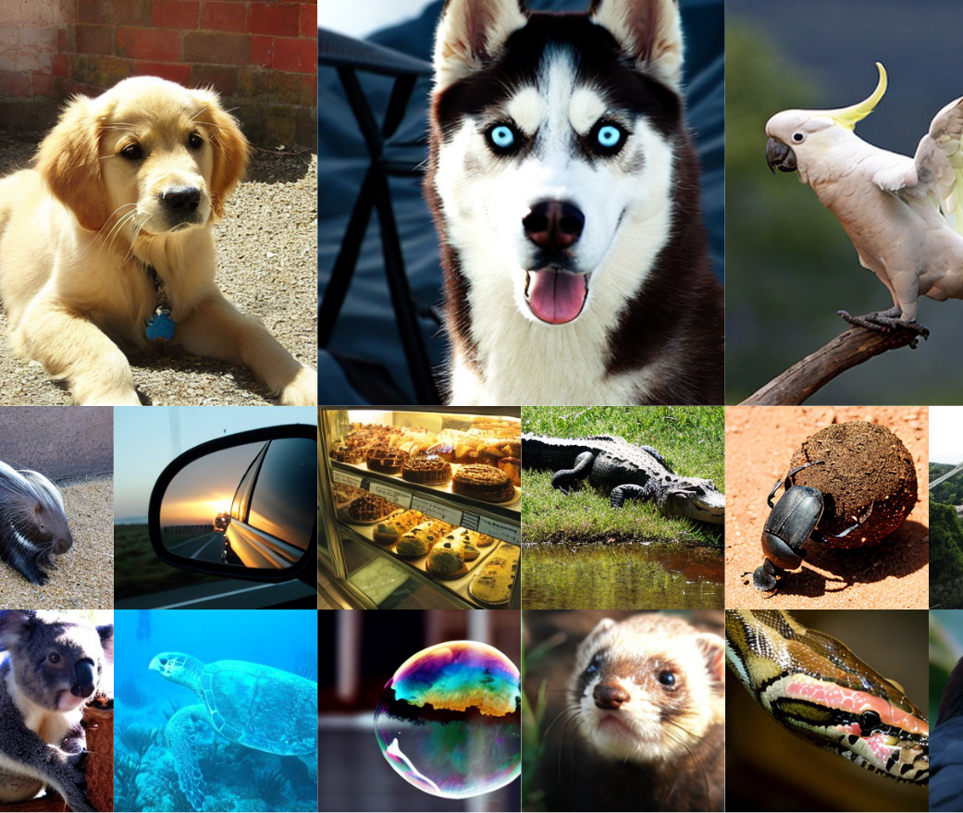
Introduction
Transformers Dominate ML
NLP, vision, and beyond have largely shifted to transformer architectures.
Shift from U-Net to Transformers
The U-Net backbone is not critical for high performance in diffusion.
Replacing it with a standard transformer design retains scalability, robustness, and efficiency.
Why DiTs?
DiTs follow Vision Transformer (ViT) best practices.
They unify architecture choices across domains and open up new research possibilities.

Slide 3
Related Work
Denoising Diffusion Probabilistic Model (DDPM)
DDPM is a generative approach that learns to reverse a gradual noising process, turning random noise into high-quality images.
During training, noise is incrementally added to real images, and the model is taught to remove noise step-by-step, thereby capturing detailed data distributions.
This iterative denoising strategy achieves impressive fidelity and diversity in generated images, often surpassing more traditional generative models.
Reverse Process
Forward Process

Slide 4
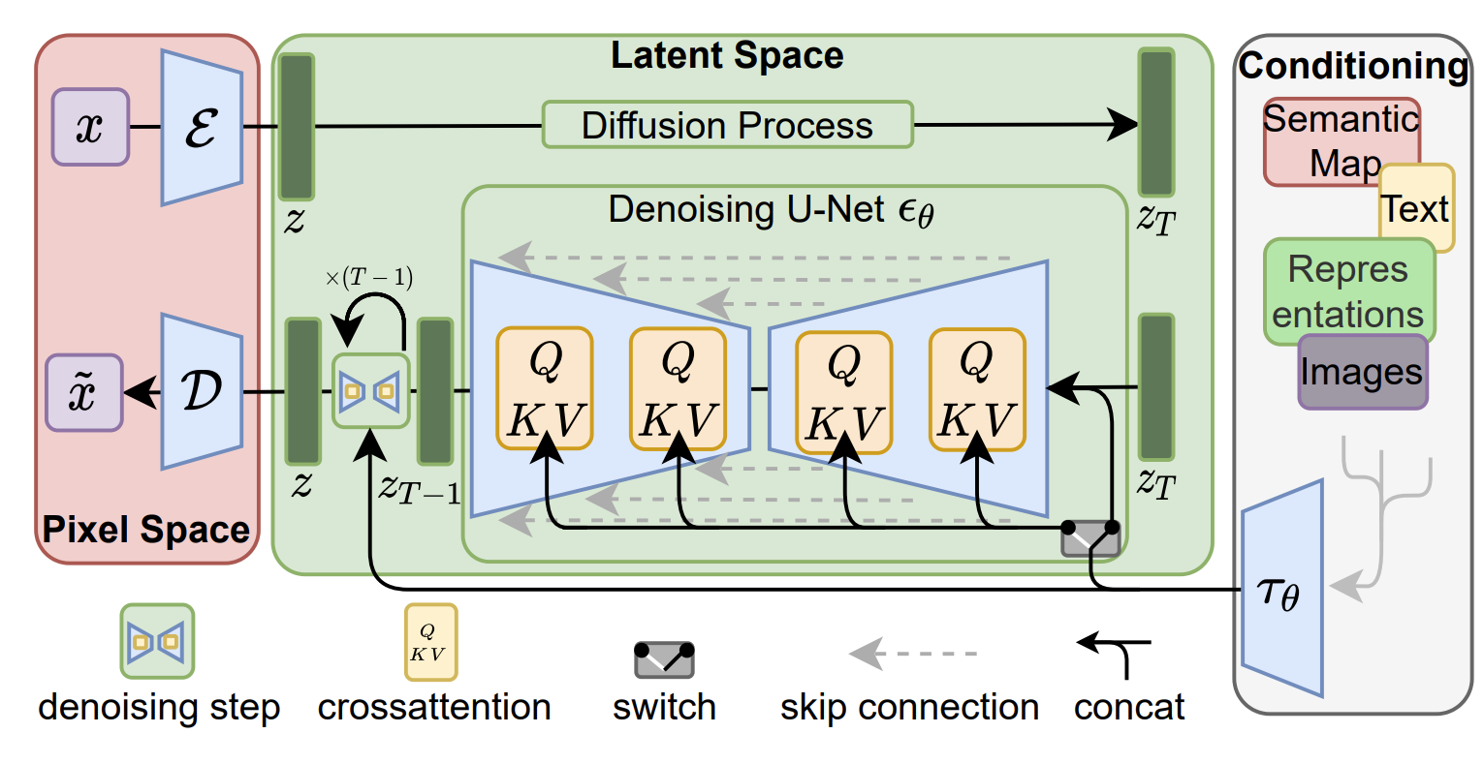
Related Work
Latent Diffusion Model (LDM)
LDM performs diffusion process in lower-dimensional latent space by a pre-trained autoencoder and U-Net architecture.

Slide 5
Related work
Autoencoder
Using an encoder to compress an image into latent code and a decoder to reconstruct it
Using LDM (e.g., Stable Diffusion) as base model, T2V and personalized T2I usually freeze the autoencoder during finetuning, so they share clean latent distribution.
U-Net
The U-Net is trained to learn the clean latent distribution within the DDPM framework.
Cross-Attention
Cross-attention dynamically fuses the latent image representation with the textual prompt, enabling more precise and context-aware image generation.

Slide 6
Related Work
Learn an autoencoder that compresses images into smaller spatial representations with a learned encoder $E$.
Train a diffusion model of representations $z = E(x)$ instead of a diffusion model of images $x$ ($E$ is frozen).

Slide 7
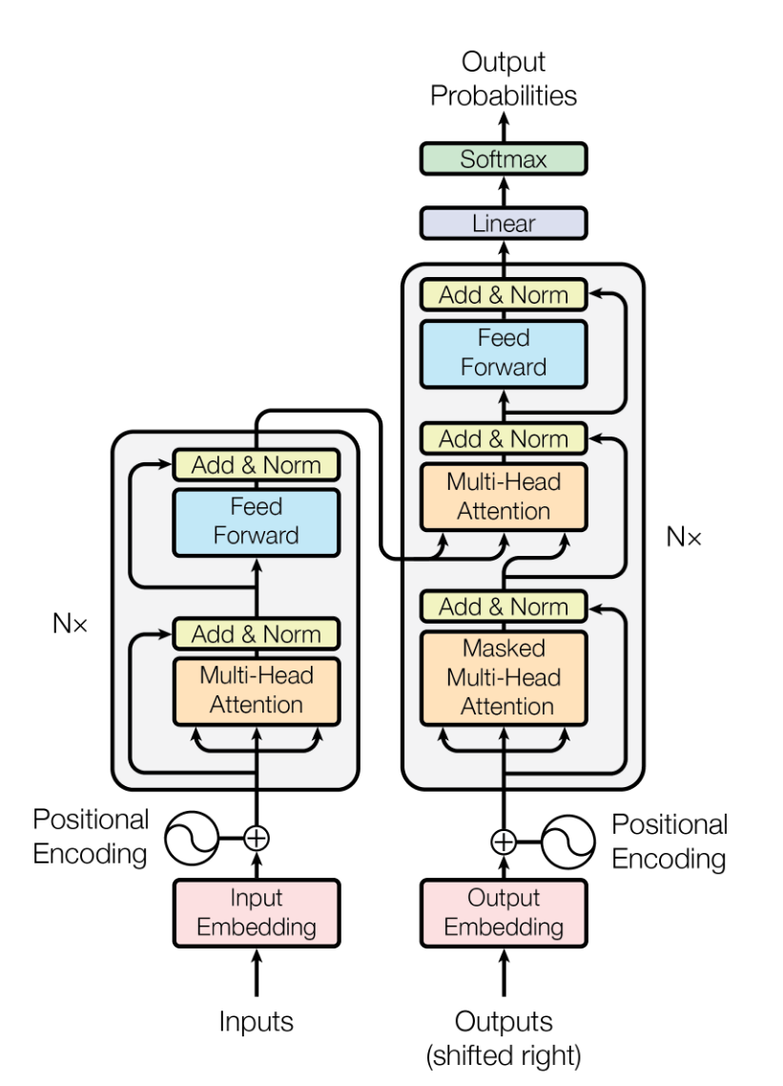
Preliminary
Transformer
Position Embedding
Injects sequence-order information into the otherwise order-agnostic architecture.
Self-Attention (Query, Key, Value)
Q (Query) compares against K (Key) to find relevant information.
V (Value) carries the actual data to be aggregated.
Multi-Head Mechanism
Parallel attention “heads” capture different contextual relationships.
Advantages
Parallel computation, better handling of long-range dependencies, flexible for various tasks.

Slide 8
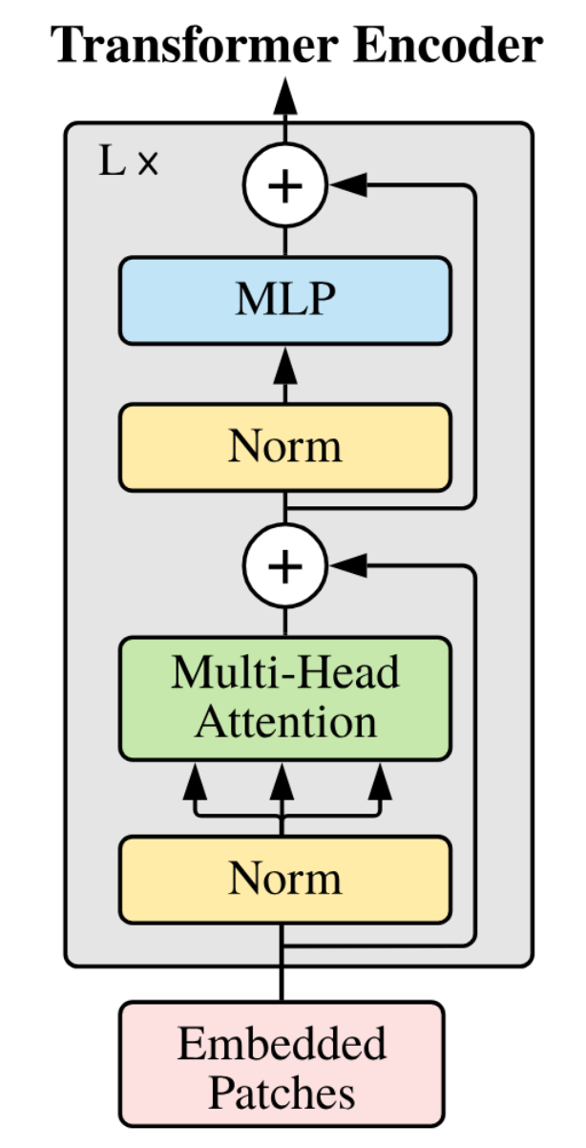
Preliminary
Vision in Transformer (ViT)
ViT breaks an image into small patches treated like tokens, enabling self-attention to capture global relationships without relying on standard convolutional operations.

Slide 9
Preliminary
Classifier-free guidance (CFG)
1. CFG removes the need for an external classifier by training both conditional and unconditional variants of the model simultaneously.
2. At inference time, the difference between the unconditional and conditional predictions is scaled by a guidance factor, controlling how strongly the condition influences the output.
3. This approach provides a flexible way to adjust adherence to prompts or conditions, often improving generation quality while retaining diversity.

Slide 10
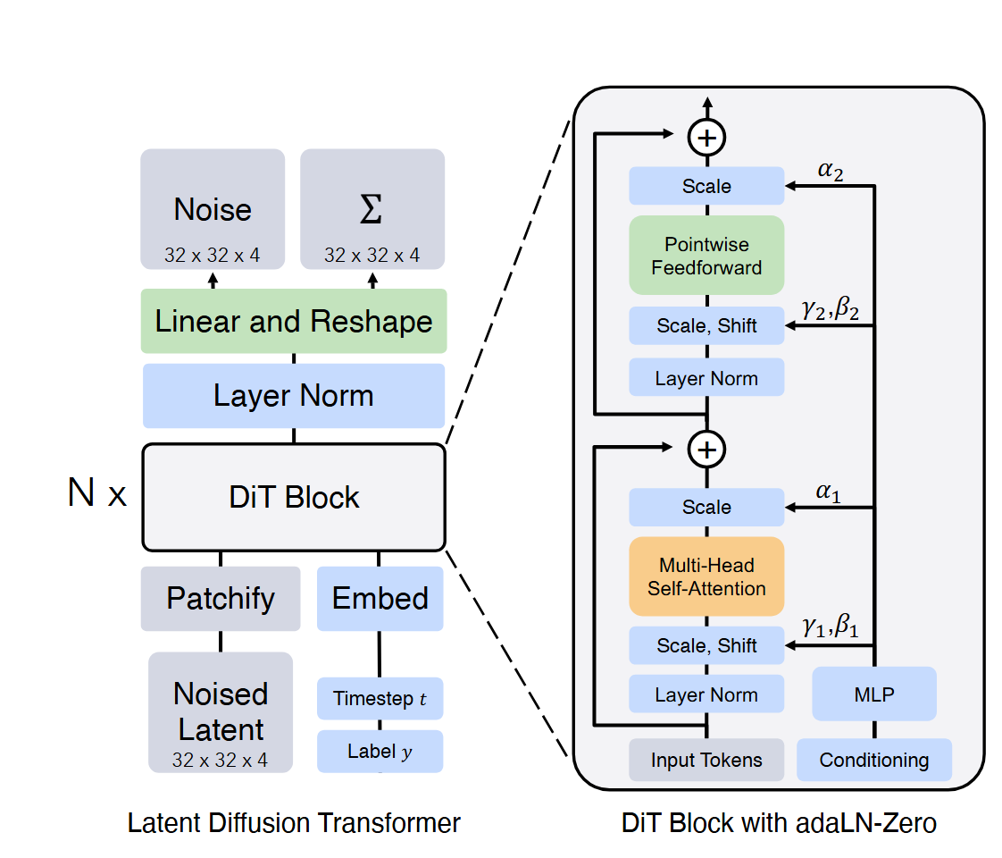
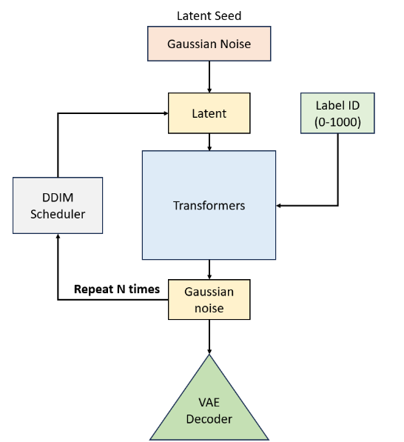
Method

Slide 11
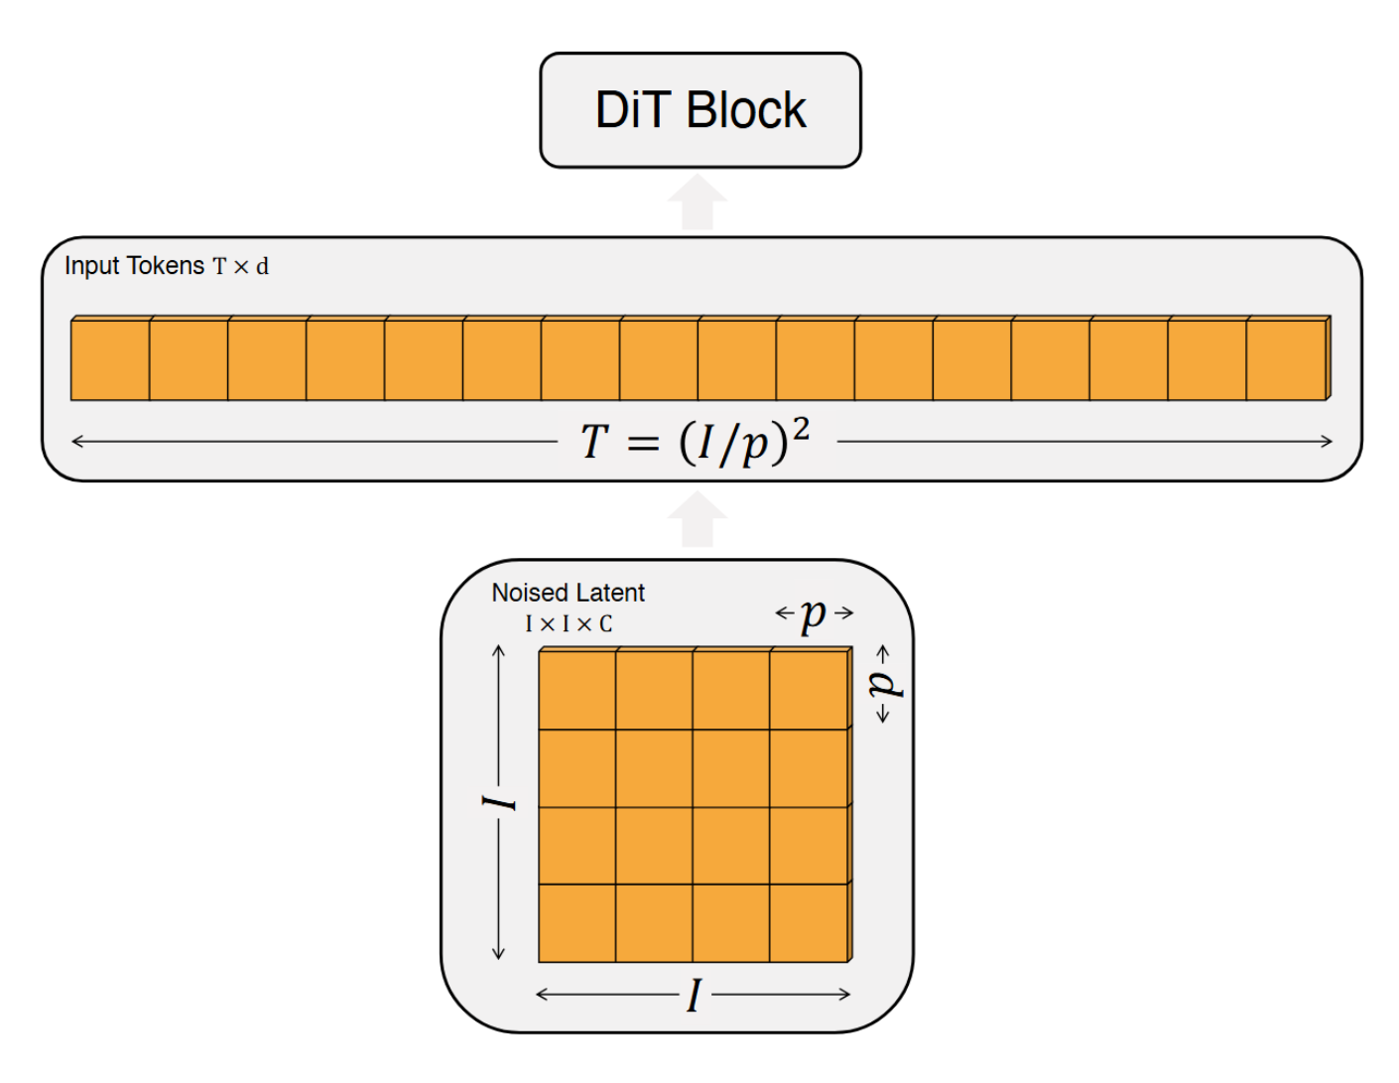
Method

Slide 12
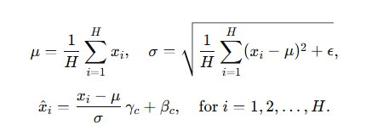
Method
Adaptive Layer Normalization (AdaLN)
AdaLN dynamically adjusts its scale and shift based on a given condition, enabling more flexible and context-aware normalization.
Layer Normalization
Adaptive LN

Slide 13
Method
AdaLN - Zero
Preserve a model’s original performance by initializing adaptive offsets to zero, allowing for a safe and gradual integration of conditional adjustments.

Slide 14
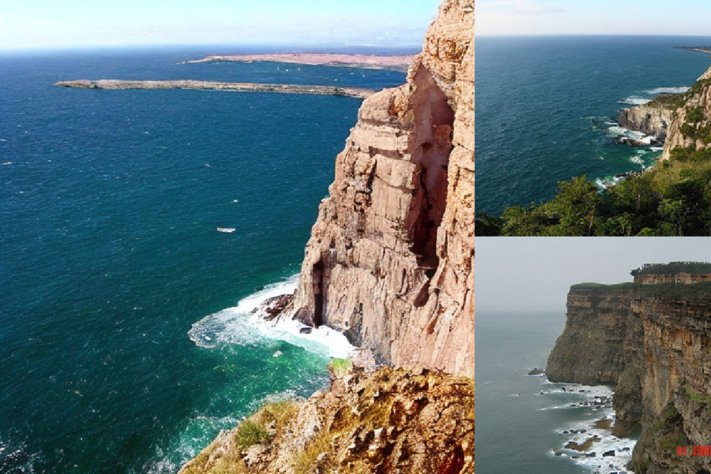
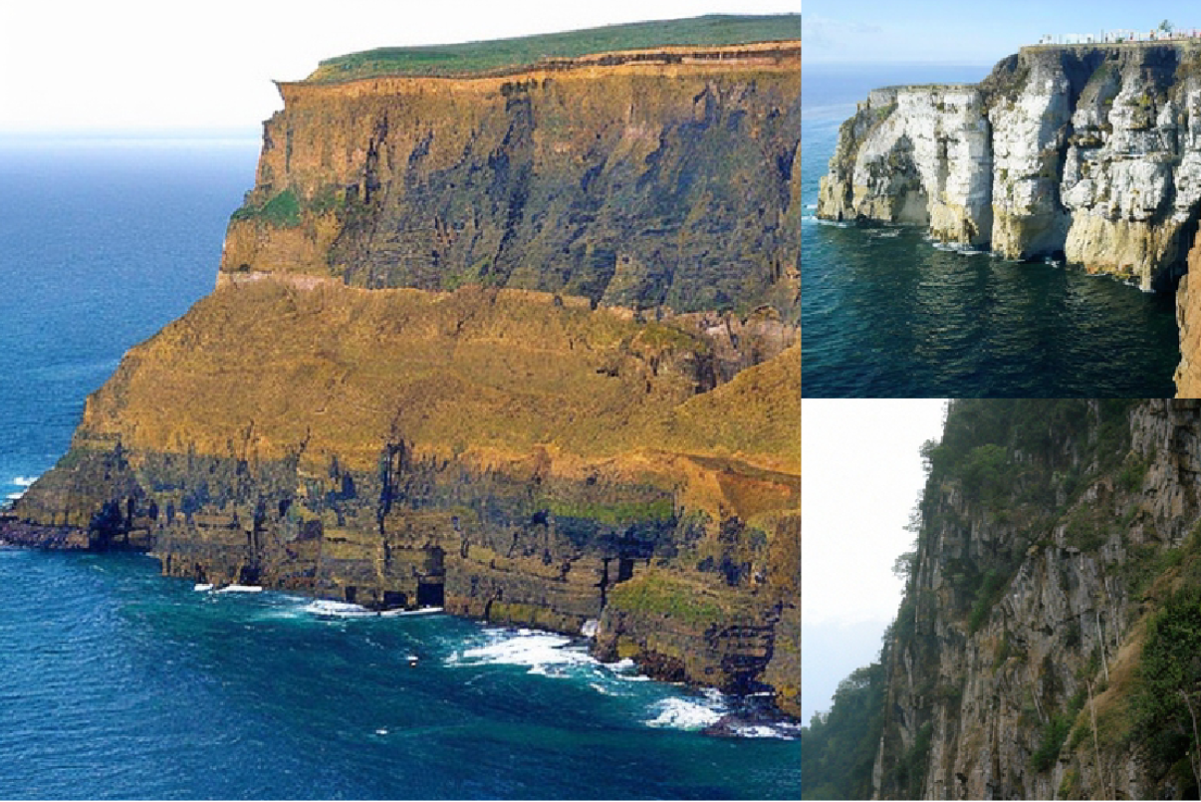
Result
CFG scale = 4.0 Class label = “cliff drop-off”

Slide 15
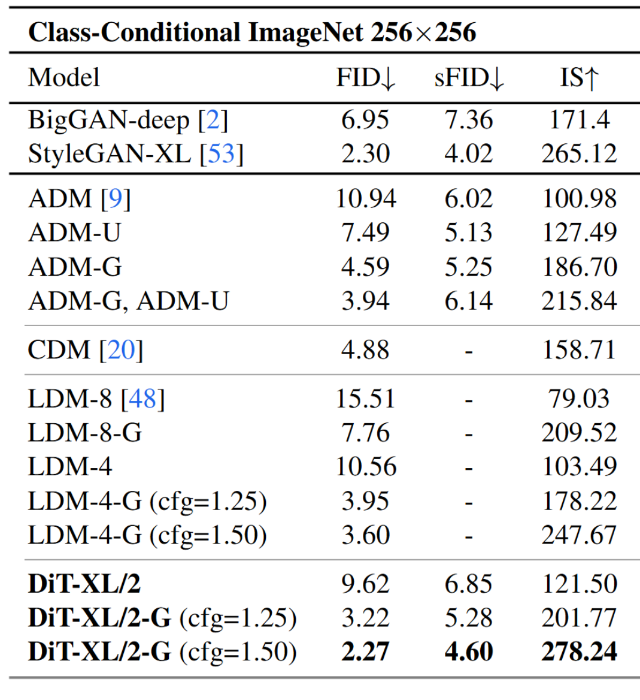
Comparison
1.FID（Fréchet Inception Distance）
2.IS（Inception Score）

