Slide 1
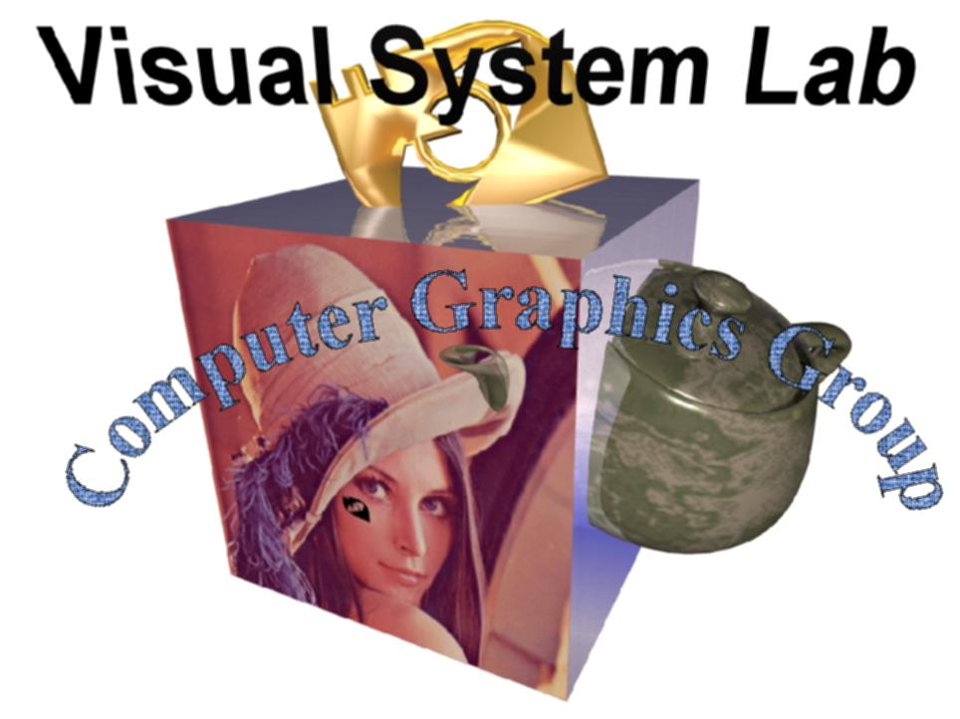
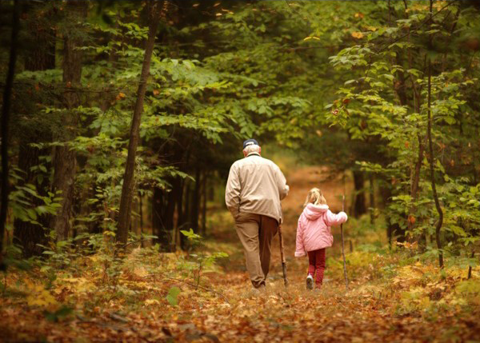
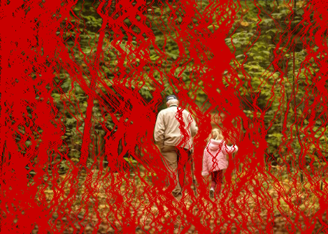
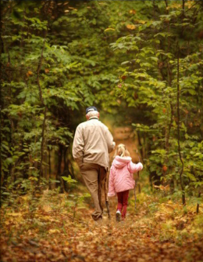
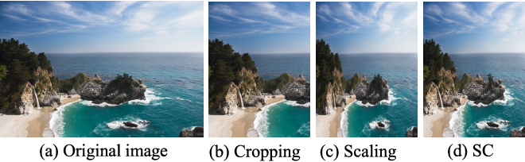
Computer Graphics Meets CVGIP
Image Resizing Using Seam Carving (SC)
(x,y)
Seam
(x,y+1)
李同益

Slide 2

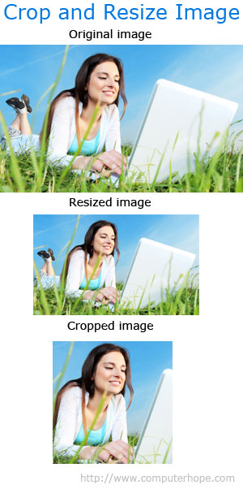

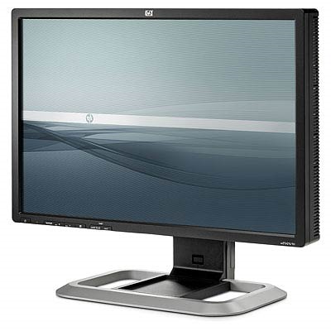


Image/Video Retargeting
Direct scale
along x axis
Adapt image/video content to different display devices
  Resolution
  Aspect ratio
Distorted
along x axis
? : ?
16 : 9
2.39 : 1
4 : 3
Notes:
In our research we are interested in visual media retargeting, which deals with adapting media for display on devices which are different from those it was originally intended for. For example, imagine playing an old TV show on a modern HDR display, or watching a wide-screen movie on a mobile phone. By now we have a large spectrum of various display devices that have different contrast, resolution and aspect ratio, and ideally it would be nice to be able to play any media on any device, while fully taking advantage of its capabilities.
In this talk, we will concentrate on one aspect of the retargeting problem, namely the aspect ratio. [click] As you can see, all these different video output devices have different aspect ratios, and the question is, how to resize a given video to fit a screen with a particular aspect ratio?
2

Slide 3
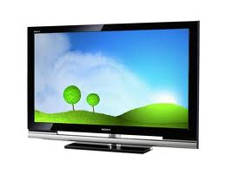
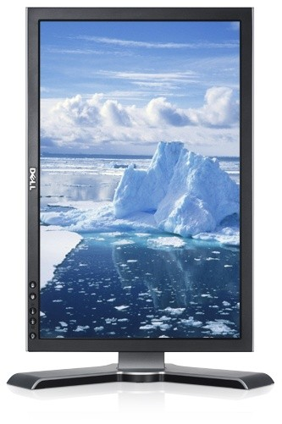

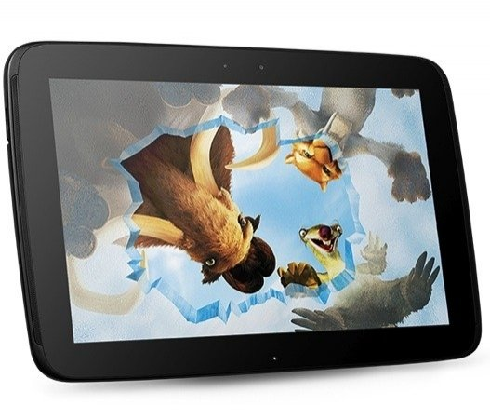
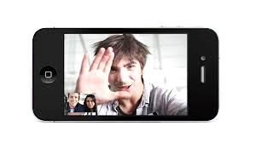
Image Resizing
Need to fit images to various display media (wide-screen TV, PDA, thumbnail...) but with less distortion !!
4:3
16:9
1:1
Notes:
When is image resizing needed?
As we all know, there are many display devices with different resolutions and aspect ratios in recent years.
Examples are cell phone, traditional TV, wide screen TV and so on.
To fully utilize the target screen resolution, the image needs to be resized to fit the resolution of display media.
The basic idea is to preserve aspect ratio of salient content and distort the non-important regions.

Slide 4
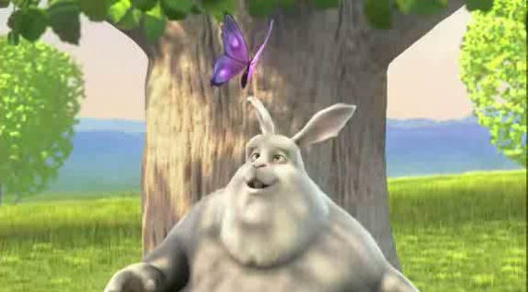
Resizing – Standard Solutions
Linear scaling
  everything is distorted
Letterboxing
  screen not fully utilized
Cropping
  objects close to boundary are removed
© Blender Foundation
Notes:
This sounds like a simple enough question, and video resizing has been done for years of course, mostly using these three simple techniques. Imagine we wish to display this video on a narrow screen. For the rest of the talk I will explain everything for squeezing videos horizontally, but the opposite, widening operation is essentially the same, just think of it as squeezing vertically.
4

Slide 5
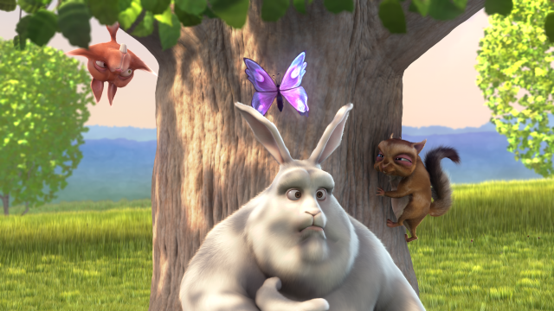
Resizing – Standard Solutions
Linear scaling
  everything is distorted
Letterboxing
  screen not fully utilized
Cropping
  objects close to boundary are removed
© Blender Foundation
Notes:
So, to squeeze this video, we can apply simple linear scaling [click] – but then the entire content is distorted.
5

Slide 6
Resizing – Standard Solutions
Linear scaling
  everything is distorted
Letterboxing
  screen not fully utilized
  Uniformly scaled, i.e. no distortion but with non-appealing empty space!!!
Cropping
  Lobjects close to boundary are removed
© Blender Foundation
Notes:
Another option is letterboxing, where we do not distort anything [click], but then we must add these black stripes on the sides of the image, and everything gets smaller. And we don’t take advantage of the whole screen.
6

Slide 7
Resizing – Standard Solutions
Linear scaling
  everything is distorted
Letterboxing
  screen not fully utilized
Cropping
  objects close to boundary are removed
  May lose important objects
© Blender Foundation
Notes:
Finally, cropping is a very common solution. [click] Cropping does not distort any shapes, but it can potentially remove important parts of the image or video if they are close to the boundaries.
7

Slide 8
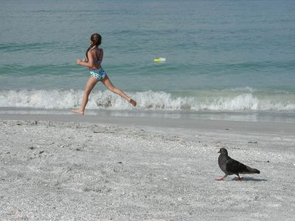
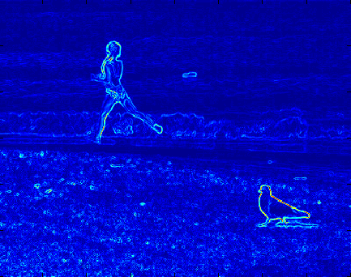
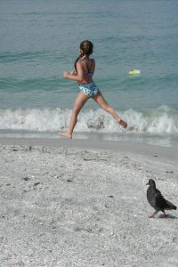
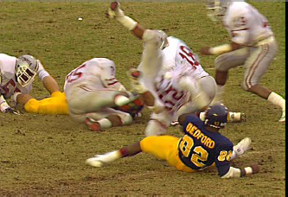
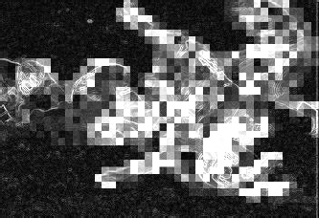
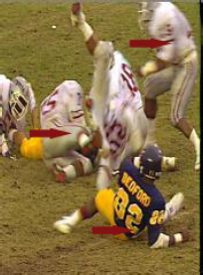
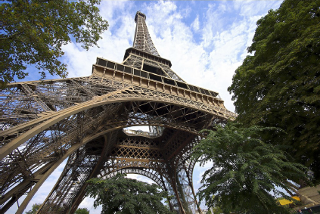
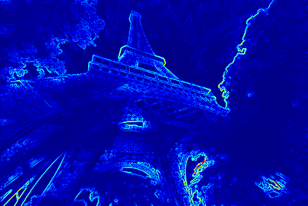
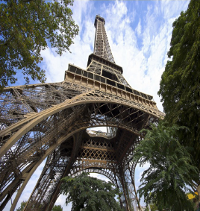
Resizing – Content-Aware Solutions
[Visual Media Retargeting, SIGGRAPH Asia 09 Course]
Determine ‘important’ regions
Apply operator
Seam-carving
[Avidan+Shamir 2007]
i.e., cut unimportant
seams
Non-homo. warping
[Wolf et al. 2007], i.e.,
deform non-important
objects only
Optimized scale&stretch
[Wang et al. 2008], i.e.
allowing uniform scale
for important objects
and non-uniform scale
for non-important
objects
Notes:
These methods use different techniques for defining saliency, and different operators to take it into account
In this talk, we will introduce seam carving and optimized scale&stretch method.
Also, mention its extension to video and other applications.
8

Slide 9

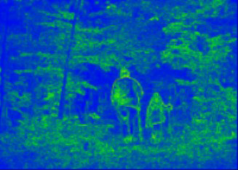
Seam carving: nonlinear cropping
[Avidan and Shamir 2007; Rubinstein et al. 2008]
An image gradient is a directional change in the intensity or color in an image.
Define an importance map (for example: gradients)
Remove lowest-energy 1D seams (one by one)
i.e., Gray = R*0.299 + G*0.587 + B*0.114
Image gradients are very strong cue for detecting edges within image
(x,y)
  A seam is a connected path of low energy pixels crossing the image from top to bottom, or from left to right
(x,y)
a connected path of
low energy pixels
Notes:
Seam carving. (1) compute an importance map such as gradient at each pixel and its value is ranged between (0,1). Continuous pixels along continuous lines with low energy
(2) Remove a 1D seam (continuous pixels along a seam line by line)

Slide 10


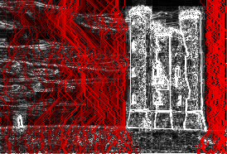


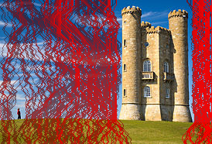
Scaling is undesirable because the castle is distorted.
Original image to be made narrower
Cropping is undesirable
because part of the castle is removed.
Seam carving

Slide 11
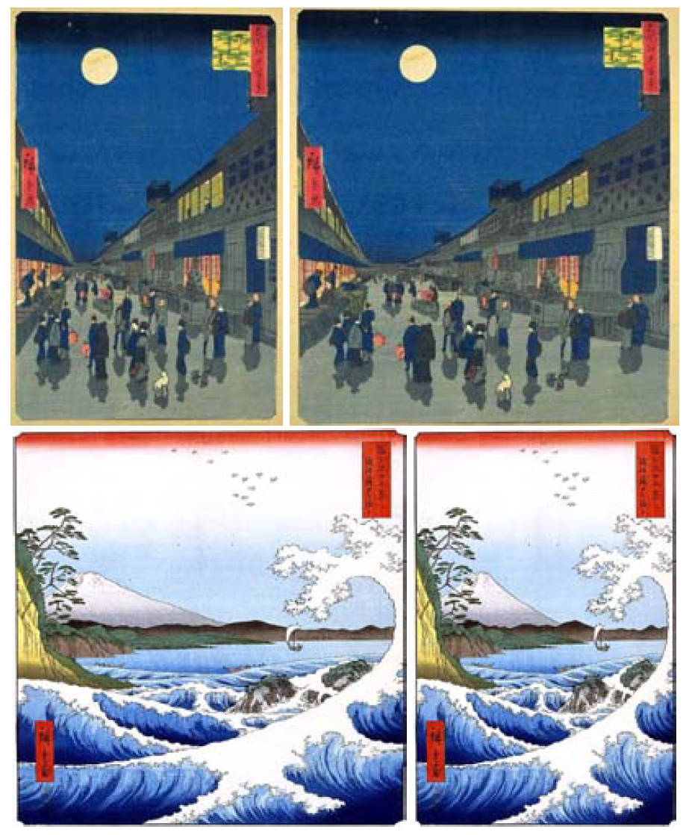
Image reduction & Image enlarging
For image reduction, seam selection ensures that while preserving the image structure, we remove more of the low energy pixels and fewer of the high energy ones.
For image enlarging, the order of seam insertion ensures a balance between the original image content and the artificially inserted pixels.
Image enlarging n seams
i.e., select n highest seams and duplicate n seams
Image reducing n seams, i.e., select n lowest seams and delete n seams

Slide 12
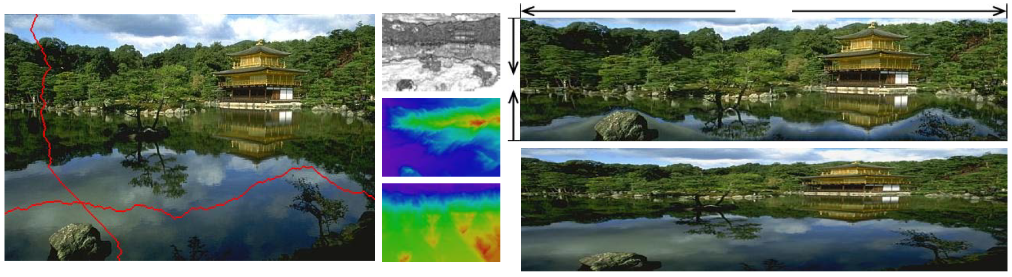
Seam Carving
A seam is a connected path of low energy pixels crossing the image from top to bottom, or from left to right.
Seam-carving is a simple image operator that can change the size of an image.
Image enlarging n seams i.e., select n highest seams and duplicate n seams

Slide 13
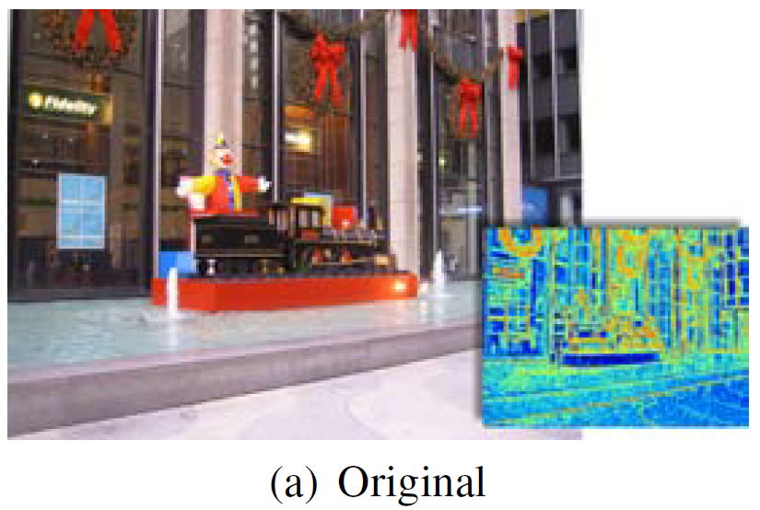
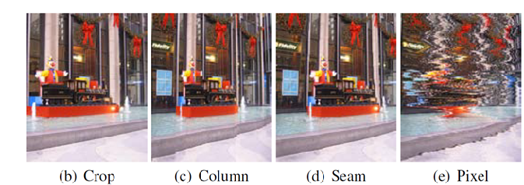
Image reduction
Results of 4 different strategies for reducing the width of an image.
(b)有最高能量的子視窗 (crop)
(c)移除每行有最低能量
(d)Seam removal
(e)每行移除相同數的低能量

Slide 14
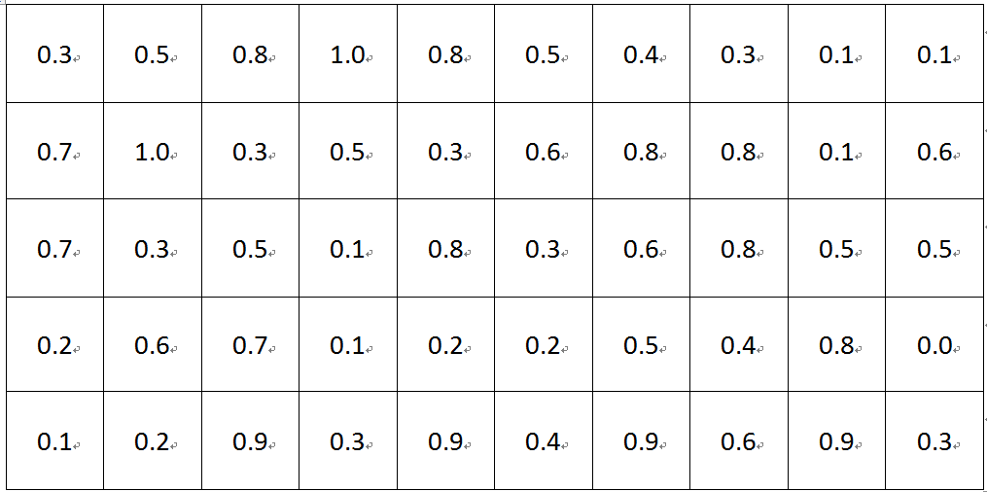
Image reduction (conti.)
12.8

Slide 15
Image reduction (conti.)
12.8
12.8

Slide 16
Image reduction (conti.)
12.8
12.8
13.4

Slide 17
Image reduction (conti.)
12.8
12.8
13.4
13.1

Slide 18
Image reduction (conti.)
12.8
12.8
13.4
13.1
13.5

Slide 19
Image reduction (conti.)
12.8
12.8
13.4
13.1
13.5
12

Slide 20
Image reduction (conti.)
12.8
12.8
13.4
13.1
13.5
12

Slide 21
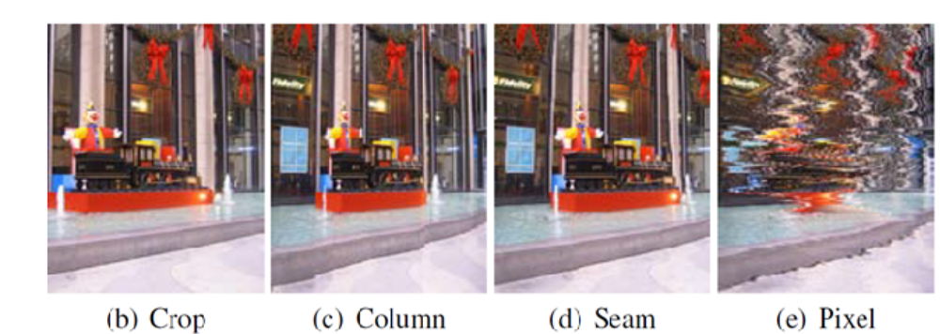
Image reduction
Results of 5 different strategies for reducing the width of an image.
(b)有最高能量的子視窗
(c)移除每行有最低能量
(d)Seam removal
(e)每行移除相同數的低能量

Slide 22
Image reduction (conti.)
2

Slide 23
Image reduction (conti.)
2
2.6

Slide 24
Image reduction (conti.)
2
2.6
3.2

Slide 25
Image reduction (conti.)
2
2.6
3.2

Slide 26
Image reduction (conti.)
2 | 2.6 | 3.2 | 2 | 3 | 2 | 3.2 | 2.9 | 2.4 | 1.5

Slide 27
Image reduction (conti.)
2 | 2.6 | 3.2 | 2 | 3 | 2 | 3.2 | 2.9 | 2.4 | 1.5
The disadvantage is to lose some important pixels on some deleted lines
such as 2nd line (with 2.4)

Slide 28
Image reduction
Results of 5 different strategies for reducing the width of an image.
(b)有最高能量的子視窗
(c)移除每行有最低能量
(d)Seam removal
(e)每行移除相同數的低能量

Slide 29
Image reduction (conti.)
1.6

Slide 30
Image reduction (conti.)
1.6
1.5

Slide 31
Image reduction (conti.)
1.6
1.5
1.9

Slide 32
Image reduction (conti.)
1.6
1.5
1.9

Slide 33
Image reduction (conti.)
1.6
1.5
1.9
1.3
1.9
1.7
2.2
1.7
1.6
1.0

Slide 34
Image reduction (conti.)
1.6
1.5
1.9
1.3
1.9
1.7
2.2
1.7
1.6
1.0

Slide 35
Image reduction
Results of 5 different strategies for reducing the width of an image.
(b)有最高能量的子視窗
(c)移除每行有最低能量
(d)Seam removal
(e)每行移除相同數的低能量

Slide 36
Image reduction (conti.)

Slide 37
Image reduction (conti.)
V
V
V
V
V

Slide 38
Image reduction (conti.)
This pixel is not selected for
this line,
So, breaking continuity
V
V
V
V
V

Slide 39
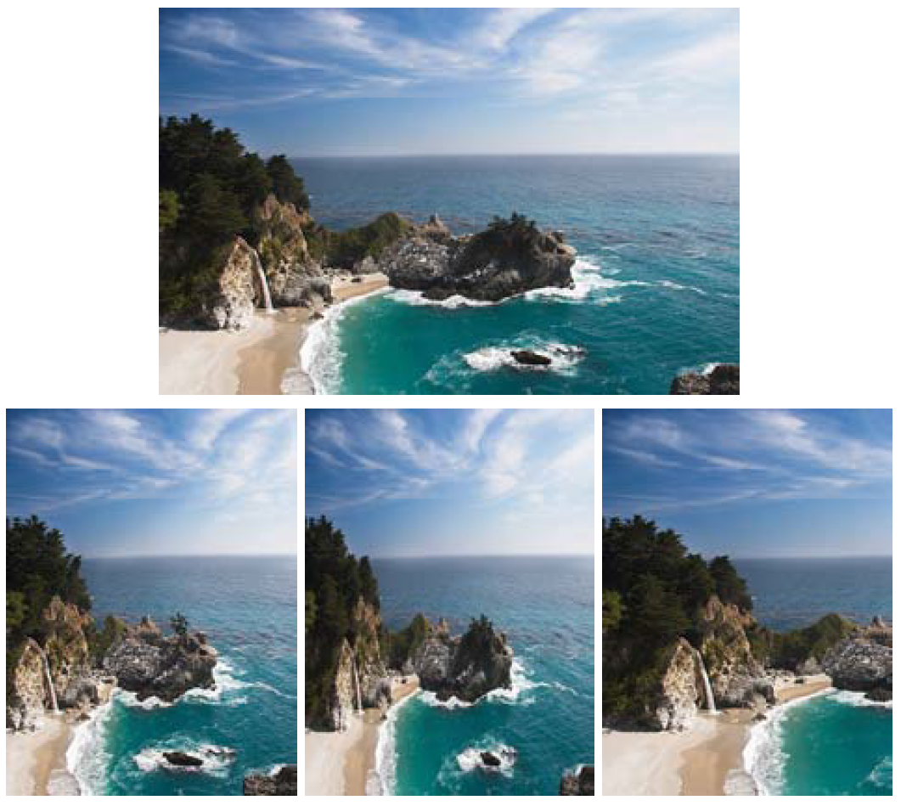
Aspect Ratio Change(1/2)
影像縮減：
Left:
Seam removals
Center:
Scaling
Right:
Cropping
Notes:
In this case, seam carving is better!

Slide 40
Aspect Ratio Change(2/2)
影像拉寬：
In both examples the original
image is widened by seam
insertion.
(a) To add a line, 1) choose a seam with
largest value, and then 2) repeat a same seam
(b) To add n line, 1) choose n seams first
and then 2) repeat n seams

Slide 41
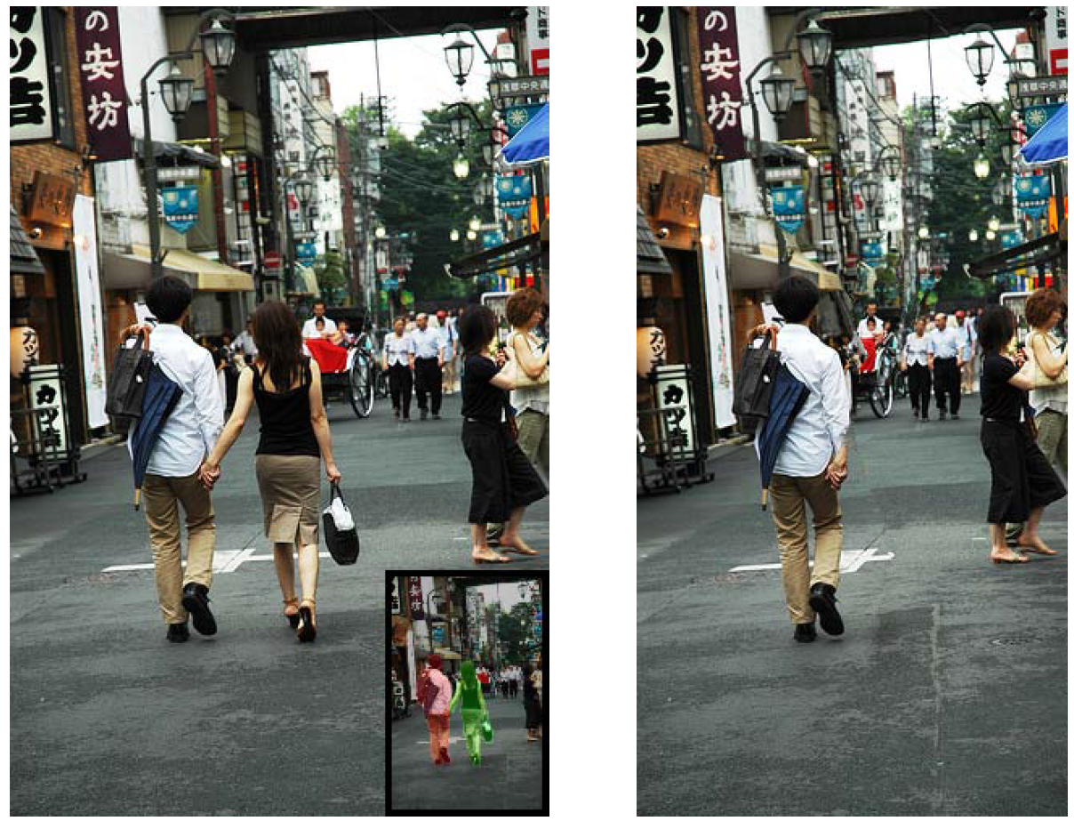
Object Removal
The system can automatically calculate the smaller of the vertical or horizontal diameters (in pixels) of the target removal region and perform vertical or horizontal removals accordingly .
用簡單的UI讓使用者
描繪出要移除的物件

Slide 42
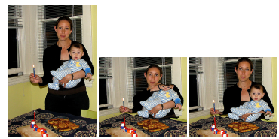
Limitations
Combined with a face detector we get much better results.
Detected pixels will be important, so their seams are avoided to be deleted as possibly as they could be
Without detection
With detection

Slide 43
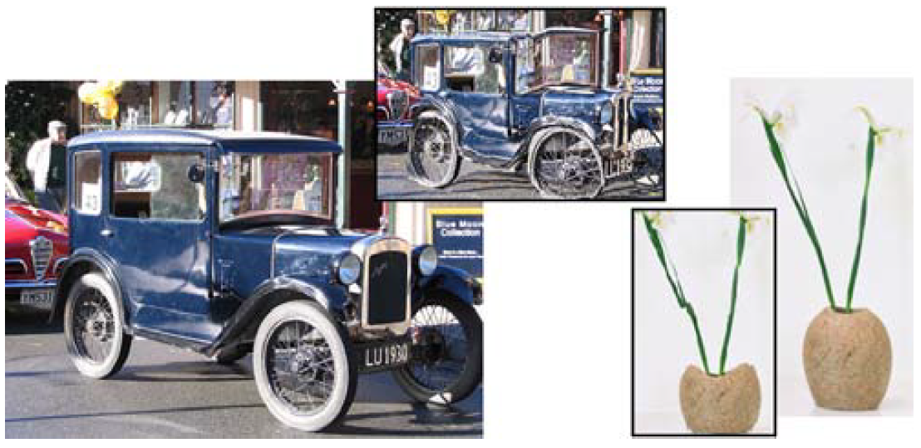
Limitations
若影像太過單調，且不包含不太重要的部分，則不太適用此方法，用傳統的scaling 反而會比較好。

Slide 44
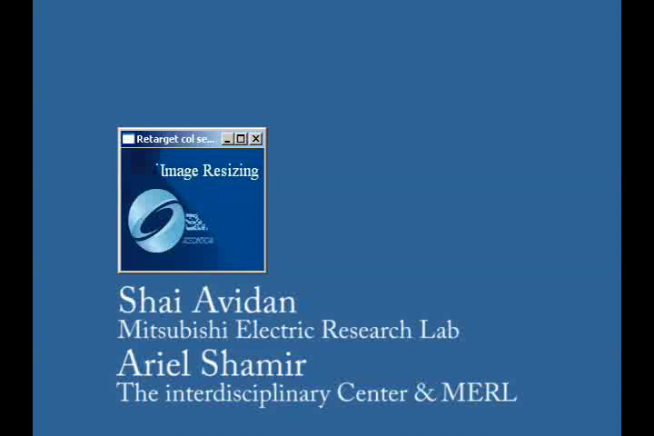
影片Demo

Slide 45
Reference
Seam carving for content aware image resizing: MATLAB
http://danluong.com/2007/12/21/seam-carving-matlab-implementation-tutorial/
liquid-resize
http://www.thegedanken.com/retarget/
CAIR code
http://code.google.com/p/seam-carving-gui/
Rsizr線上
http://cn.rsizr.com/
簡單小程式
http://swieskowski.net/carve/

Slide 46
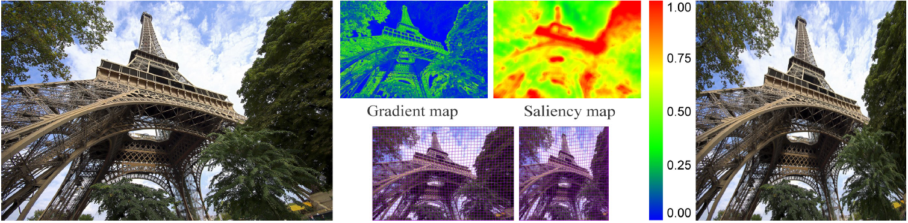
OPTIMIZED SCALE-AND-STRETCH FOR IMAGE RESIZING
published in ACM Siggraph Asia 2008

Slide 47

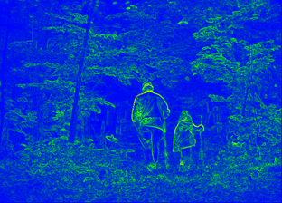
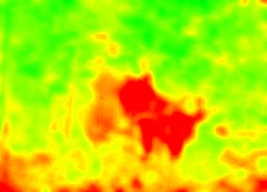
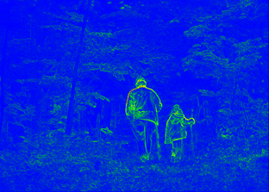
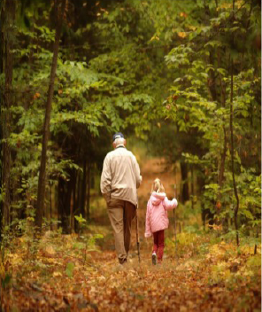
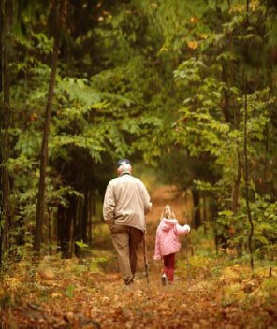
Importance map
In computer vision, a saliency map is an image that highlights either the region on which people's eyes focus first or the most relevant regions for machine learning models.^{[1]} The goal of a saliency map is to reflect the degree of importance of a pixel to the human visual system or an otherwise opaque ML model.
x
=
saliency map
[Itti et al. 98]
importance map
gradients only
importance map

Slide 48
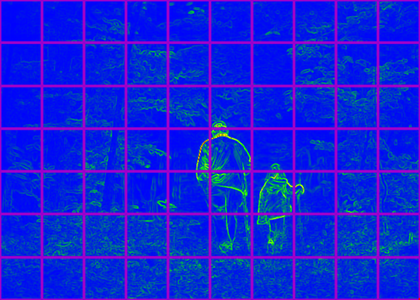
The warping mechanism
quads with high importance:
uniform scaling
quads with low importance:
allowed non-uniform scaling
Optimize the location of mesh vertices, interpolate image

Slide 49
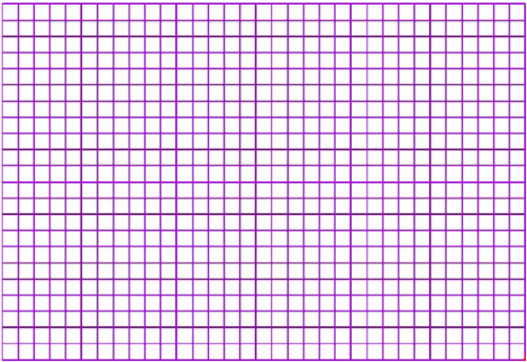
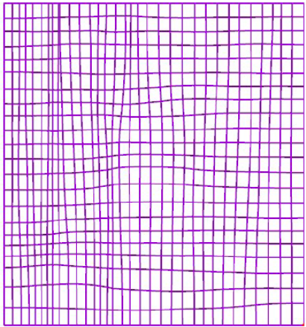
The warping mechanism
Grid mesh, preserve the shape of the important quads
Optimize the location of mesh vertices, interpolate image
Notes:
For each warped quad image, we interpolate image.

Slide 50


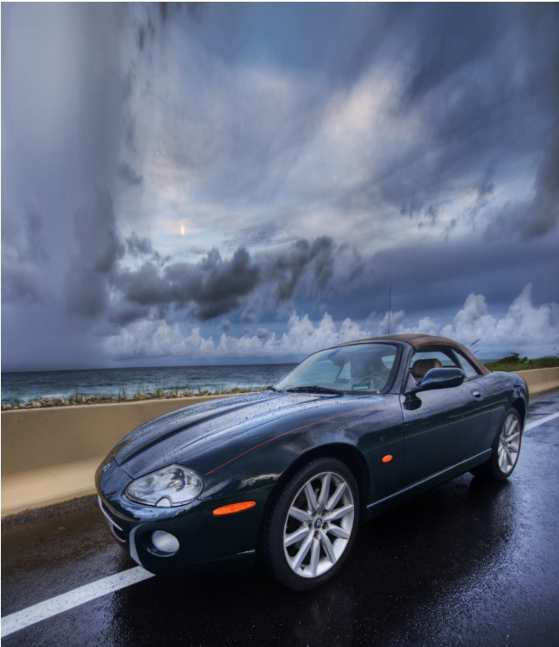
Results
original
SC (Seam carving)
ours
http://graphics.csie.ncku.edu.tw/Image_Resizing/data/ImageResizing08.mp4

Slide 51
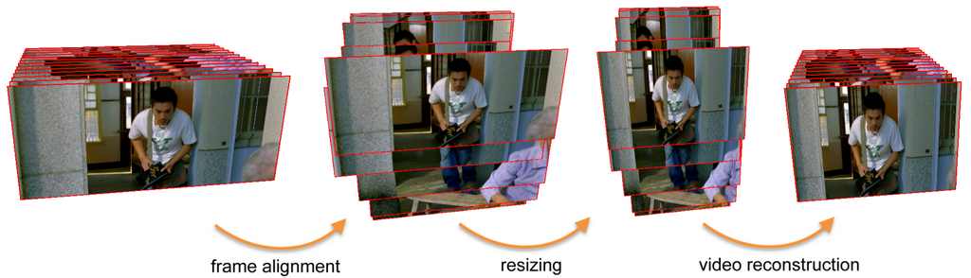
Motion-Aware Temporal Coherence for Video Resizing
Yu-Shuen Wang¹, Hongbo Fu², Olga Sorkine³, Tong-Yee Lee¹, Hans-Peter Seidel⁴
ACM Transaction on Graphics (Proceedings of SIGGRAPH 2009 Asia)
¹National Cheng Kung University, Taiwan, ²City University of Hong Kong, ³New York University, ⁴MPI Informatik
http://graphics.csie.ncku.edu.tw/VideoResizing/data/videoResizing.mp4

Slide 52
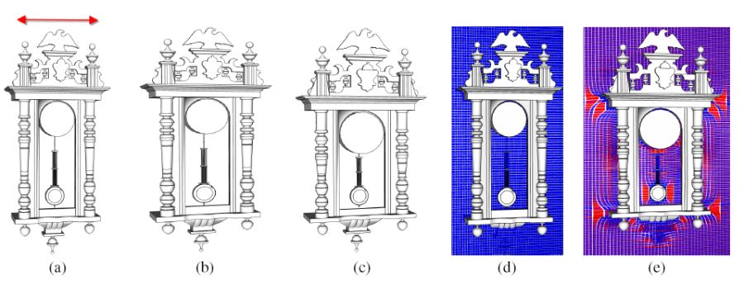
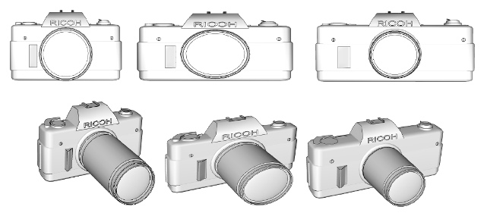
Non-homogeneous Resizing of Complex Models

Slide 53
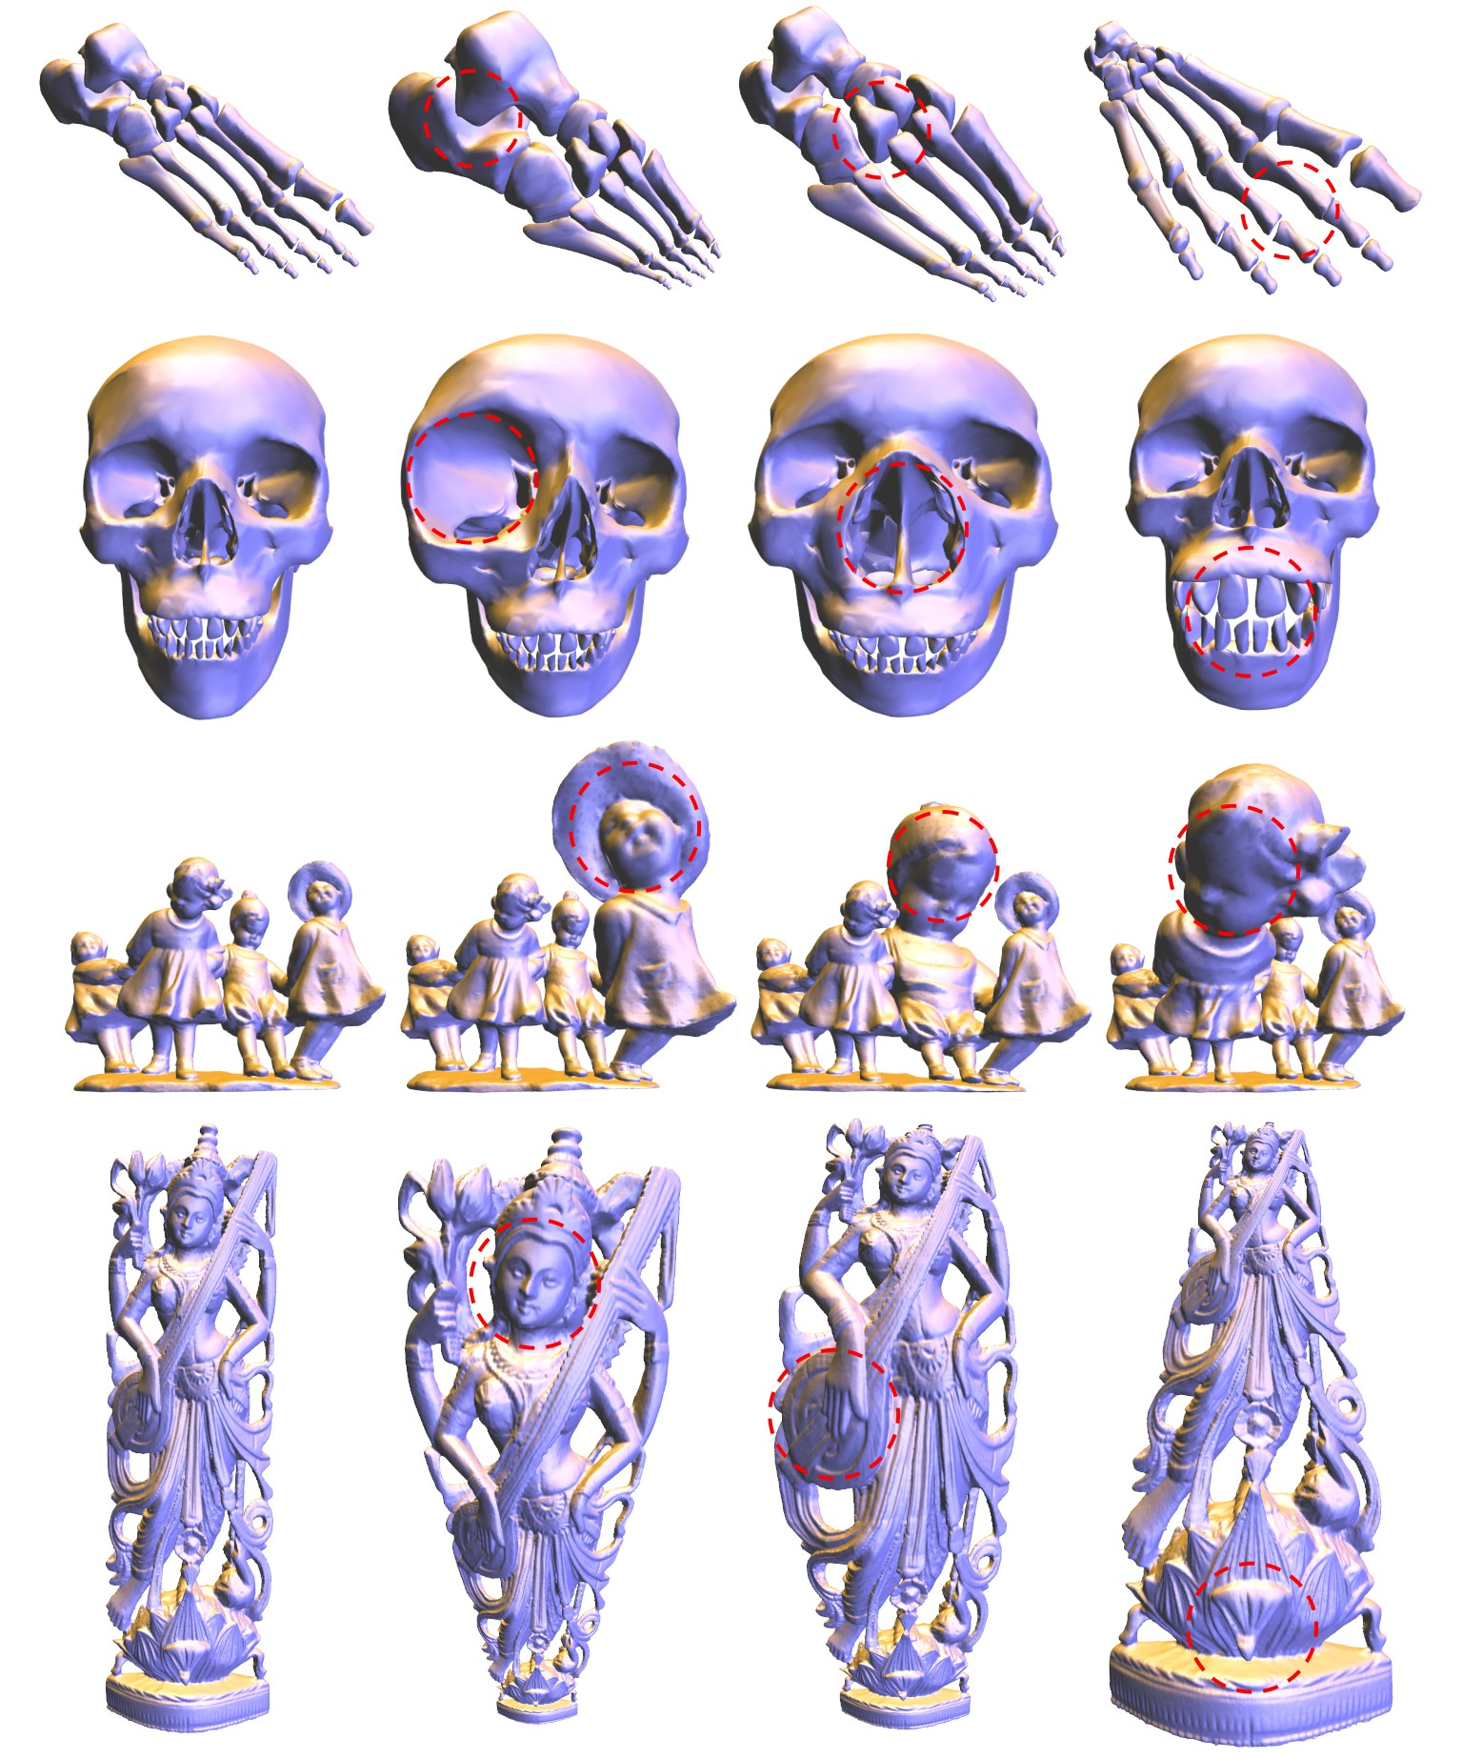

“Focus+Context Visualization with Distortion Minimization”
http://graphics.csie.ncku.edu.tw/Vis2008/vis-1013_final_video.mp4

