Slide 1
ArbInterp: Arbitrary Generative Video Interpolation
Guozhen Zhang, Haiguang Wang, Chunyu Wang,
Yuan Zhou, Qinglin Lu, Limin Wang
ICLR 2026

Slide 2
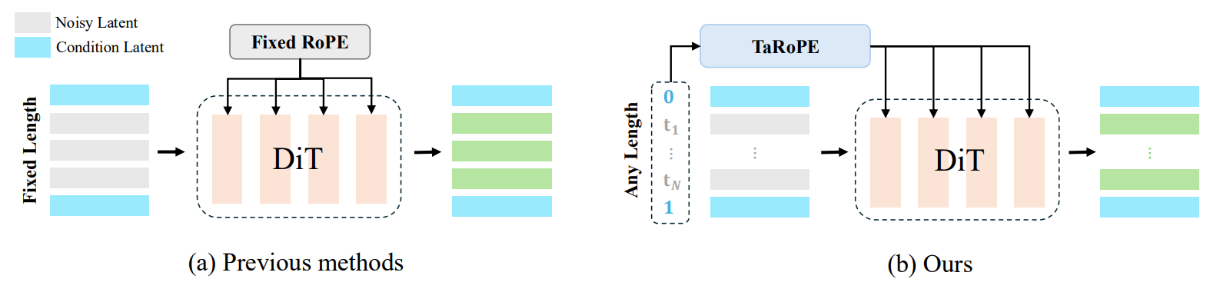
Introduction
Video Frame Interpolation (VFI)
  Generate coherent intermediate frames between given start and end frames.
ArbInterp
  A generative VFI framework for:
    Arbitrary Timestamps
    Arbitrary Lengths

Slide 3
Background
Current Trend
  Leveraging pretrained video generative models for VFI.
The Bottleneck (Existing Methods)
  Fixed Paradigm: Predefined number of intermediate frames.
  Discrete Positions: Limited control over continuous timestamps.
  Long-Sequence Challenge: Cross-segment spatiotemporal inconsistency.

Slide 4
Related Work
Deterministic Methods (Flow-based)
  Flow estimation → Warping
  Examples
    FILM · RIFE
  Challenge
    Struggles with highly complex motion and scenes
Generative Methods (Diffusion-based)
  Generative video prior
  Examples
    LDMVFI · DynamiCrafter · TRF
  Challenge
    Fixed interpolation: Predefined frames with uniform temporal spacing

Slide 5
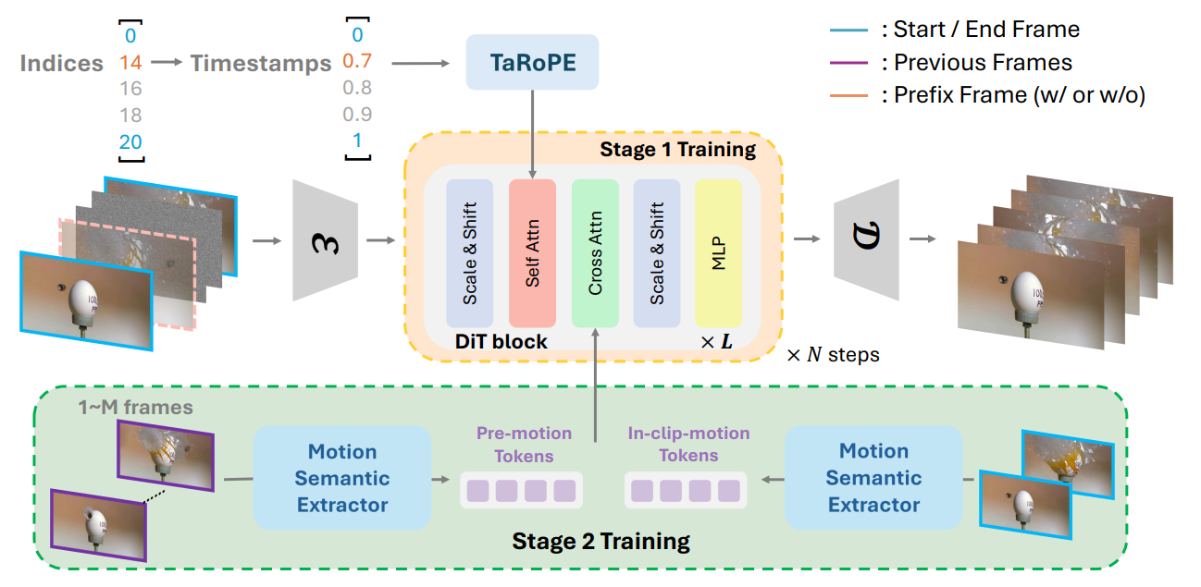
ArbInterp
Built upon the open-source Wan video generation model
Timestamp-aware Rotary Position Embedding (TaRoPE) and Appearance-Motion Decoupling Strategy
Timestamp-aware RoPE
Transferring Video Generation Models
Appearance-Motion Decoupling

Slide 6
Transferring Video Generation Models
Flow Matching Framework
  The denoising network is trained to predict velocity vectors.
Token Replacement
  The noisy latents of the first and last frames are replaced with ground-truth latents to guide intermediate-frame prediction.

Slide 7
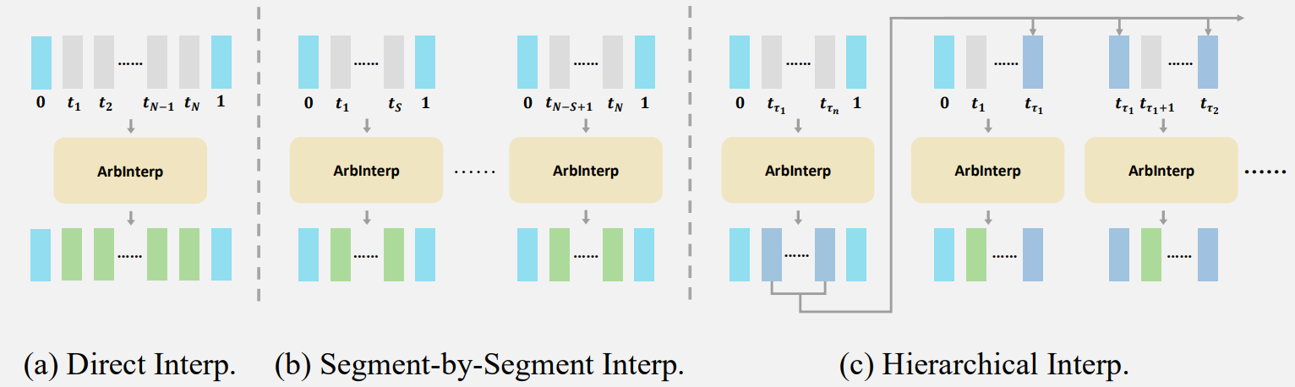
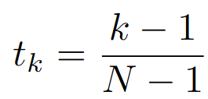
Timestamp-aware RoPE
Vanilla RoPE
  Temporal position = discrete frame index k.
TaRoPE
  Replace k with continuous timestamp t ∈ [0,1].
  Enable arbitrary temporal positions.
Inference Strategies
  Direct, Segment-by-Segment, and Hierarchical.

Slide 8
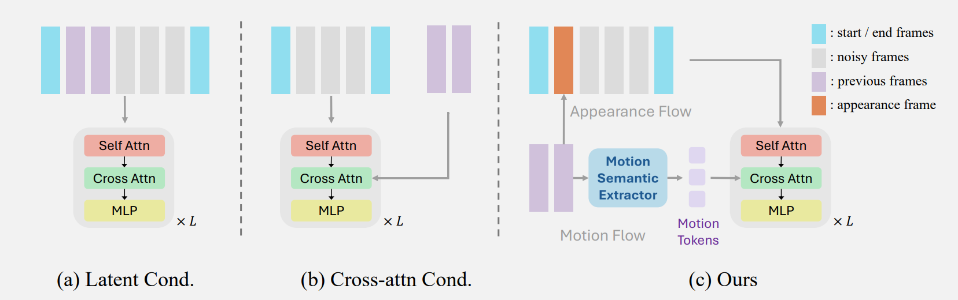
Appearance-Motion Decoupling
Appearance Consistency
  Last frame → Prefix Frame
  Maintain visual consistency
Motion Coherence
  Previous frames → Motion Tokens
  Maintain motion coherence

Slide 9
Experiment Setup
Benchmarks Created
  MultiInterpBench — multi-scale interpolation evaluation.
  2× / 8× / 16× / 32×.
Baselines
  LDMVFI, DynamiCrafter, TRF, and GI.
Evaluation
  FID / FVD / LPIPS / VBench
Efficiency
  Segment-wise synthesis reduces the computational cost for arbitrary-length interpolation.

Slide 10
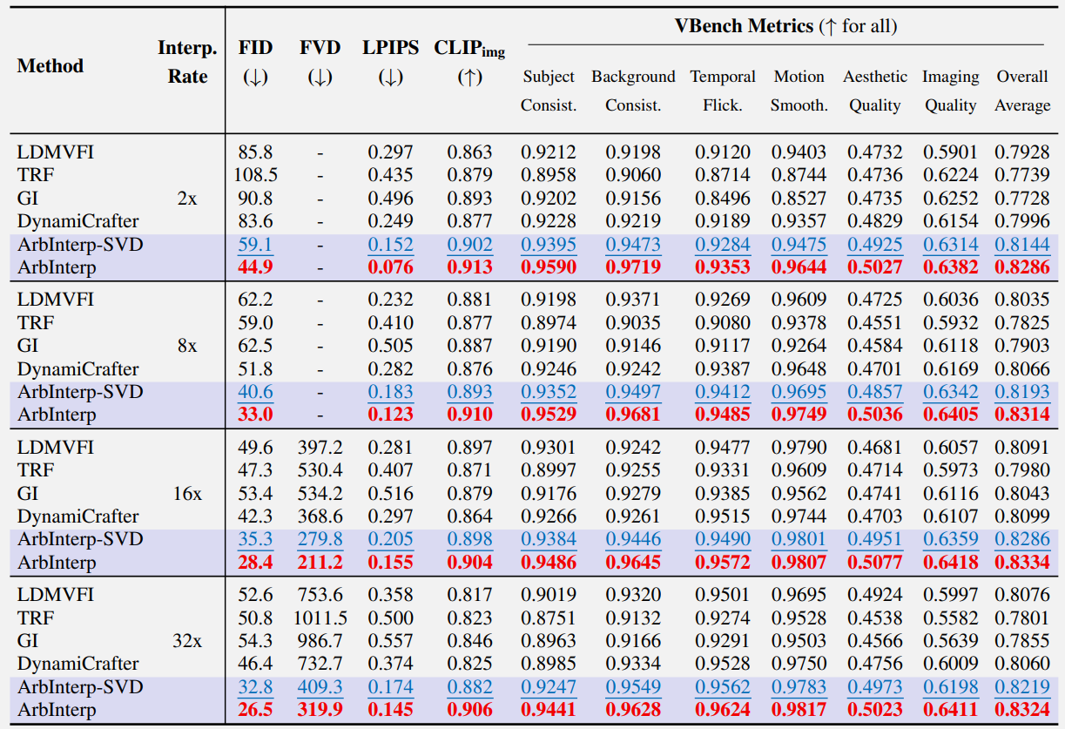
Experimental Results
Multi-scale Frame Interpolation

Slide 11
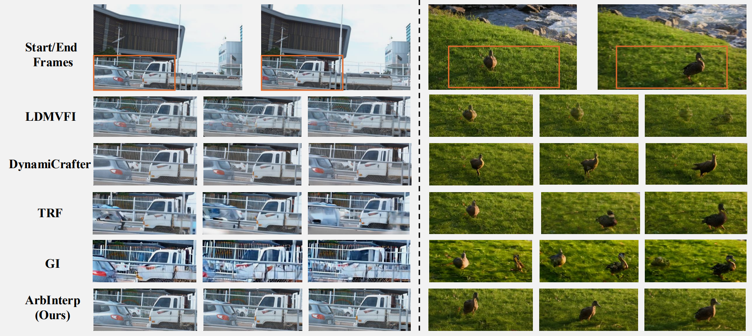
Experimental Results
Visual Results

Slide 12
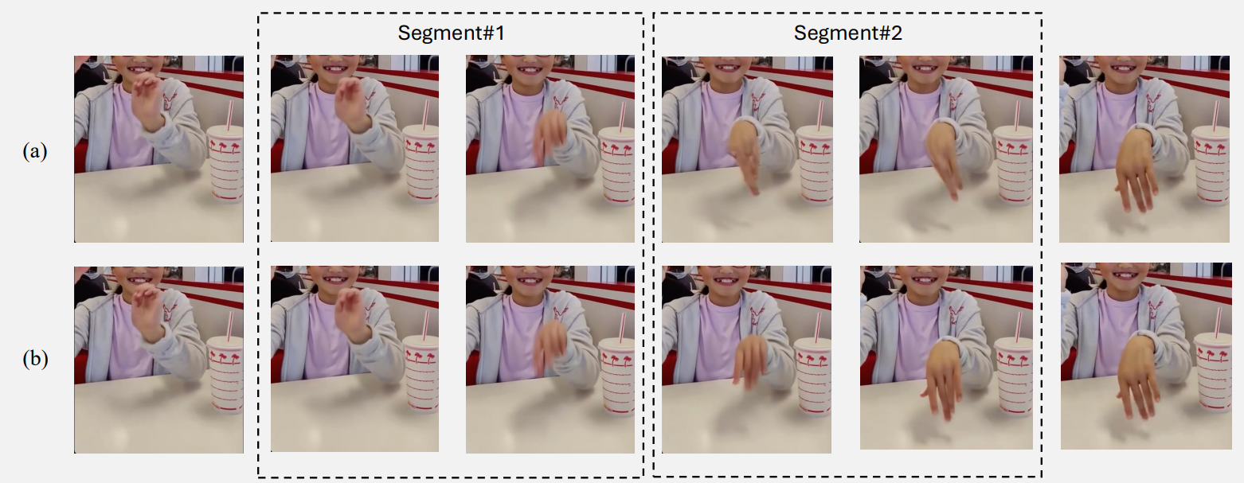
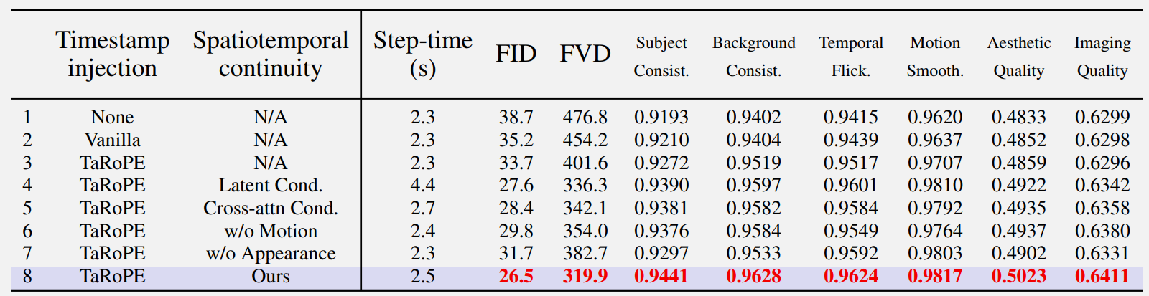
Experimental Results
Ablation Study

Slide 13
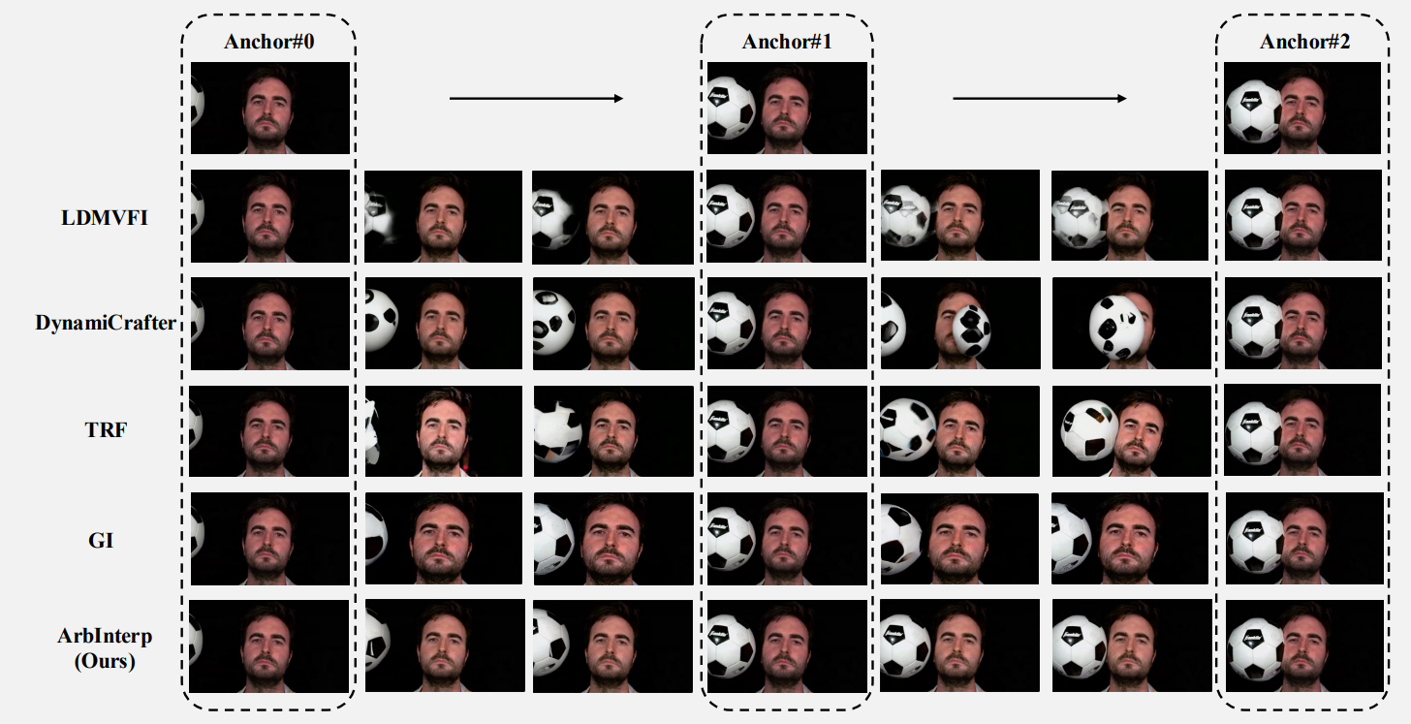
Experimental Results
Streaming Frame Interpolation

Slide 14
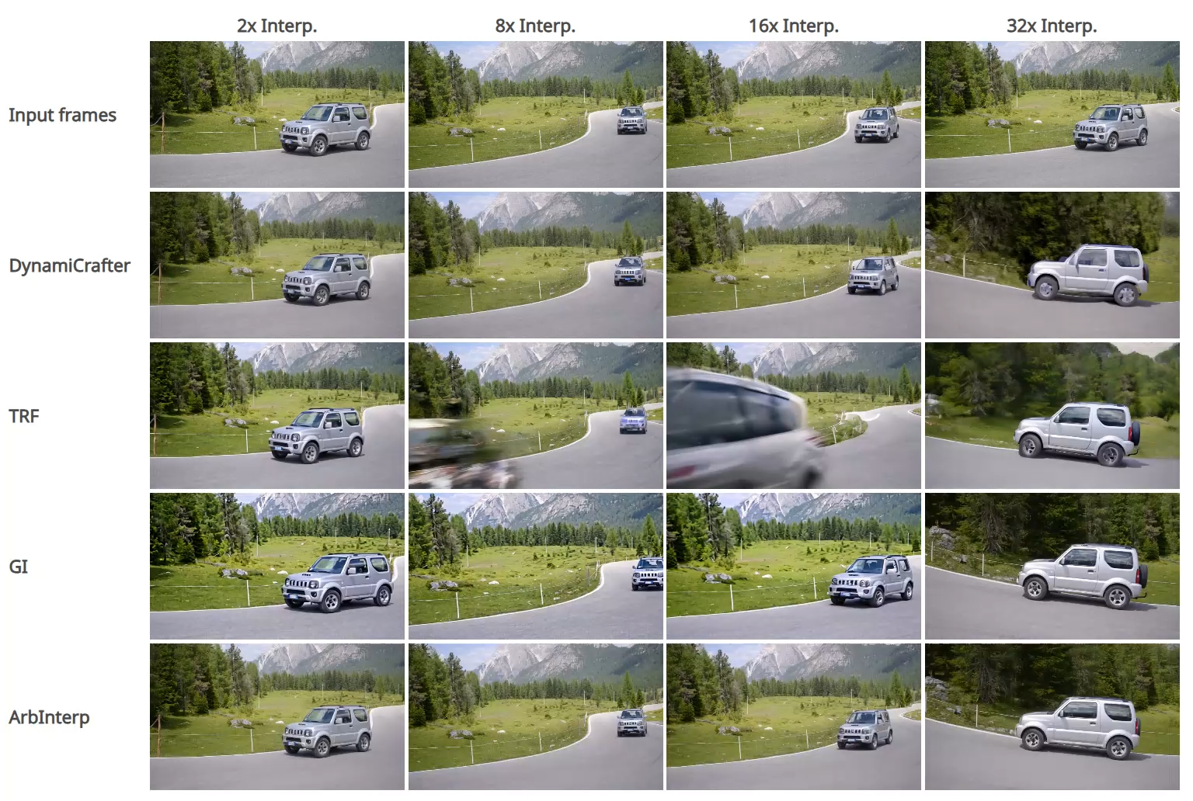

Slide 15
Conclusion
Arbitrary Time
  TaRoPE → continuous timestamps
Long-range Consistency
  Appearance-Motion Decoupling → stable appearance & motion

Slide 16
Thank you for listening

