Slide 1
HW 3 – Scene Graph Animation

Slide 2
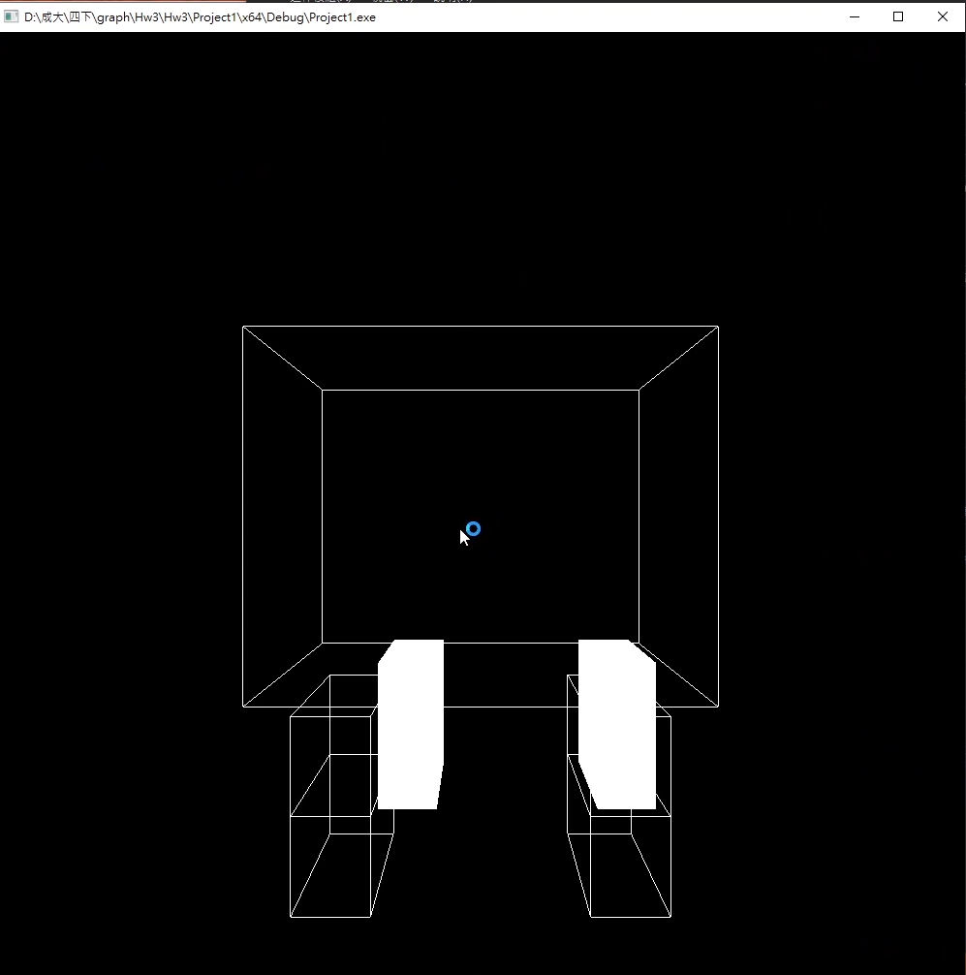
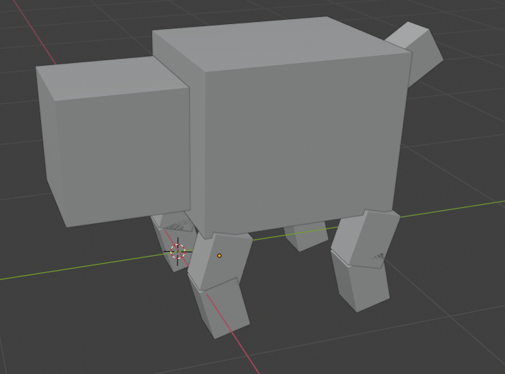
Objectives(Basics)
Implement 3D animation using scene graph architecture and multiple basic components.

Slide 3
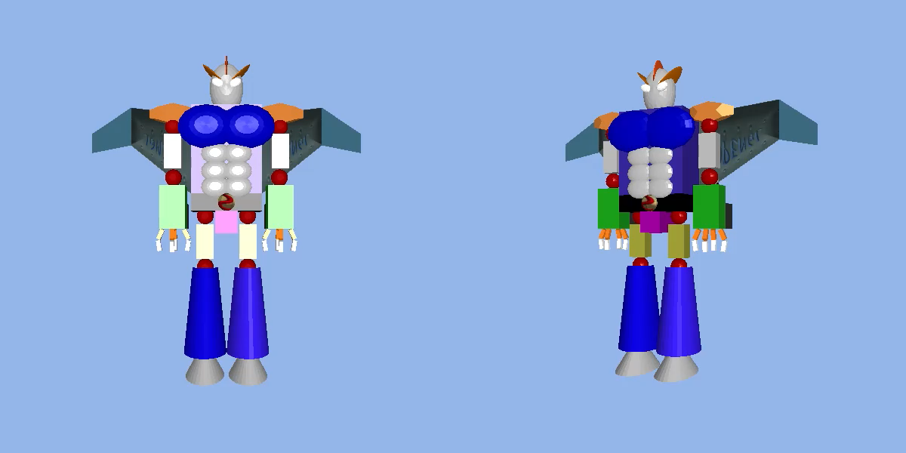
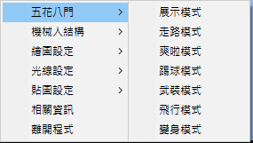
Objectives(Advanced)
In the freeze-frame perspective, the large changes visible to the naked eye are considered advanced .(If you are not sure, you can email the TAs to ask which type of model you made).

Slide 4
Basic Requirements
The depth of the architecture MUST have at least 3 levels.
The transformations must be realistic.
You MUST implement the animation by yourself. Do not use the library function, e.g., Panda3D: Actor Animations to directly load the animation from file.
Record your result from the start and remember to also include any additional features to get extra points. Scoring heavily depends on the demo video, so please double-check it before uploading.

Slide 5
Additional
You will receive additional scores if you successfully implement and demo the following features.
  Using texture. (e.g., hw1 teapot’s texture)
  Camera rotation and translation.
  Moving around. (e.g., running in circles)

Slide 6
Scoring Standard
The scoring levels are divided into Basic and Advanced, each with possible bonus points.
Basic level starts at 70 points, with 2 points added for each bonus item completed, up to a maximum of 80 points.
Advanced level starts at 85 points, with the same bonus structure, up to a maximum of 95 points.
Report scores are not graded by level and contribute between 1 to 3 points.

Slide 7
Submission
Compress your file into <student ID>_<student name>.zip,
e.g., NE6134087_方榮彬.zip
The zip file needs to include:
  Source Code and Model Files (if any)
  Report (.pdf), including:
  (1) Environment, (2) Method description and (3) How to run the program
  Demo Video
Upload to Moodle:
  Deadline: 2026/05/18 (Mon.) 23:55

