Slide 1

SPGen: Spherical Projection as Consistent and Flexible Representation for Single Image 3D Shape Generation
SIGGRAPH Asia 2025

Slide 2
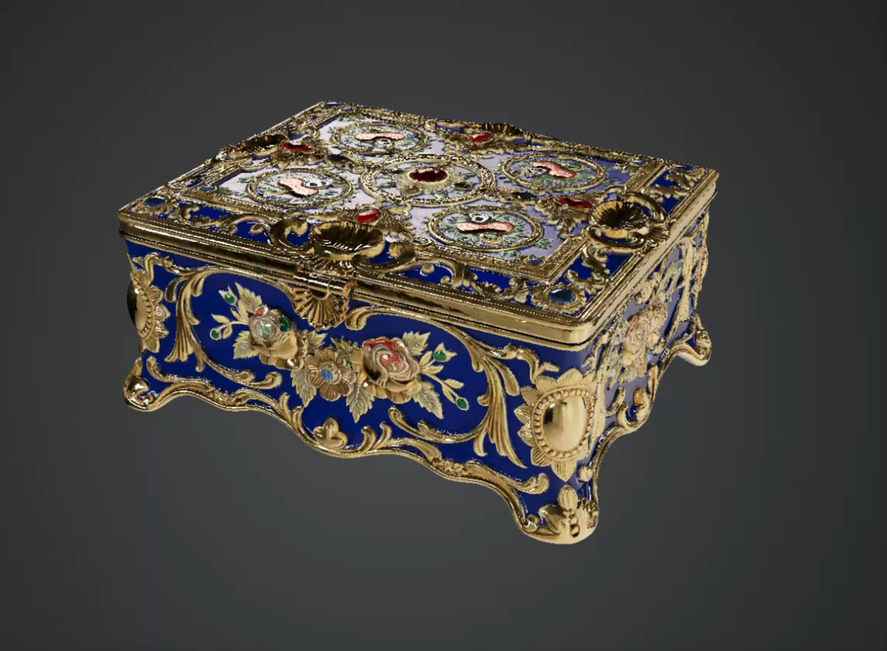
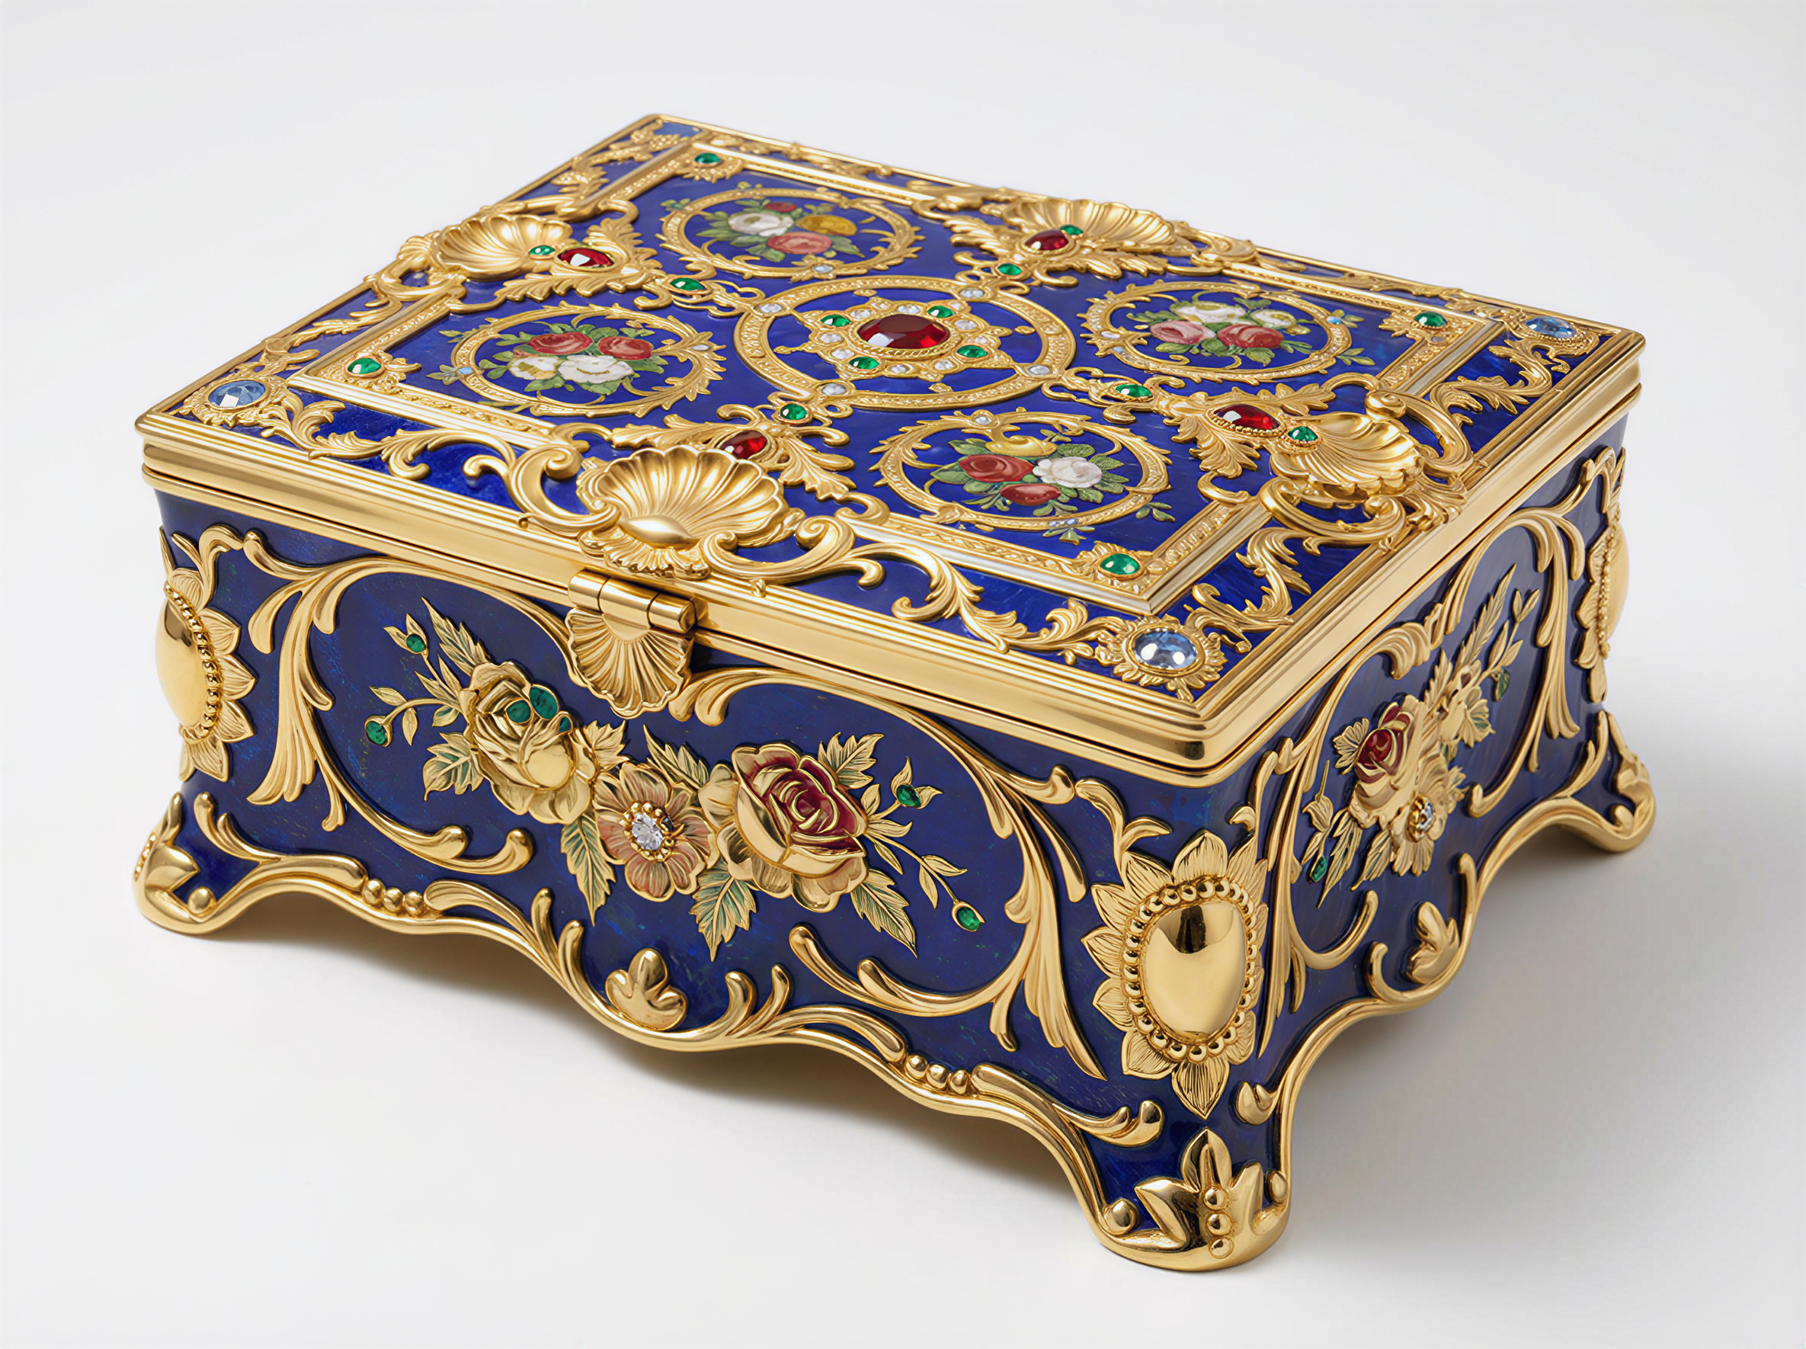
Image to 3D

Slide 3
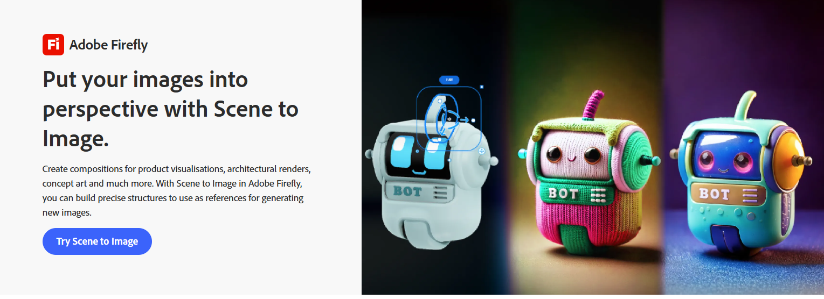


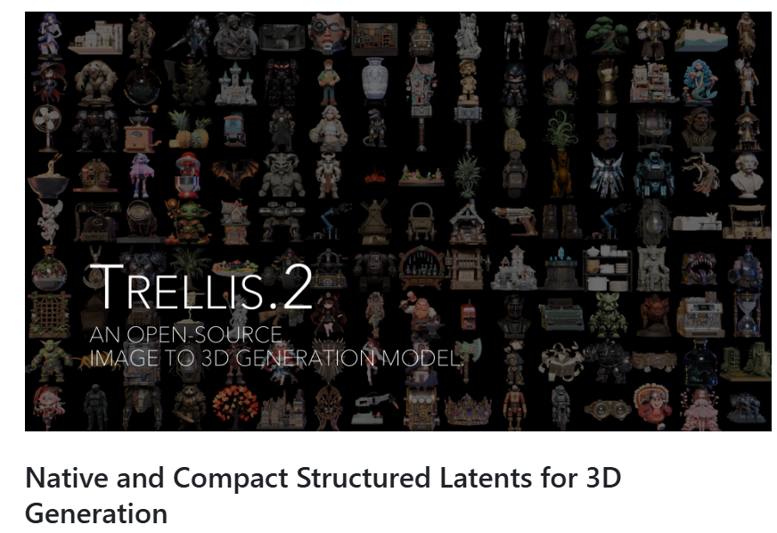
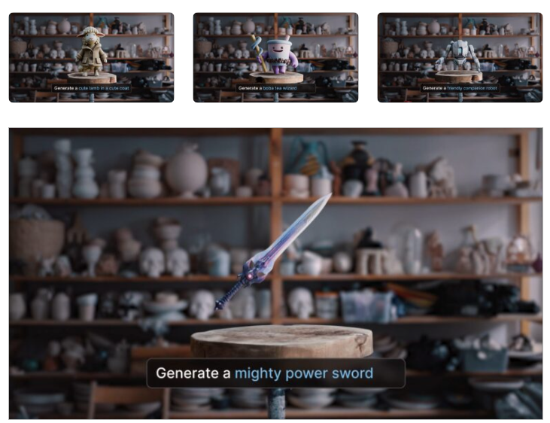

Slide 4


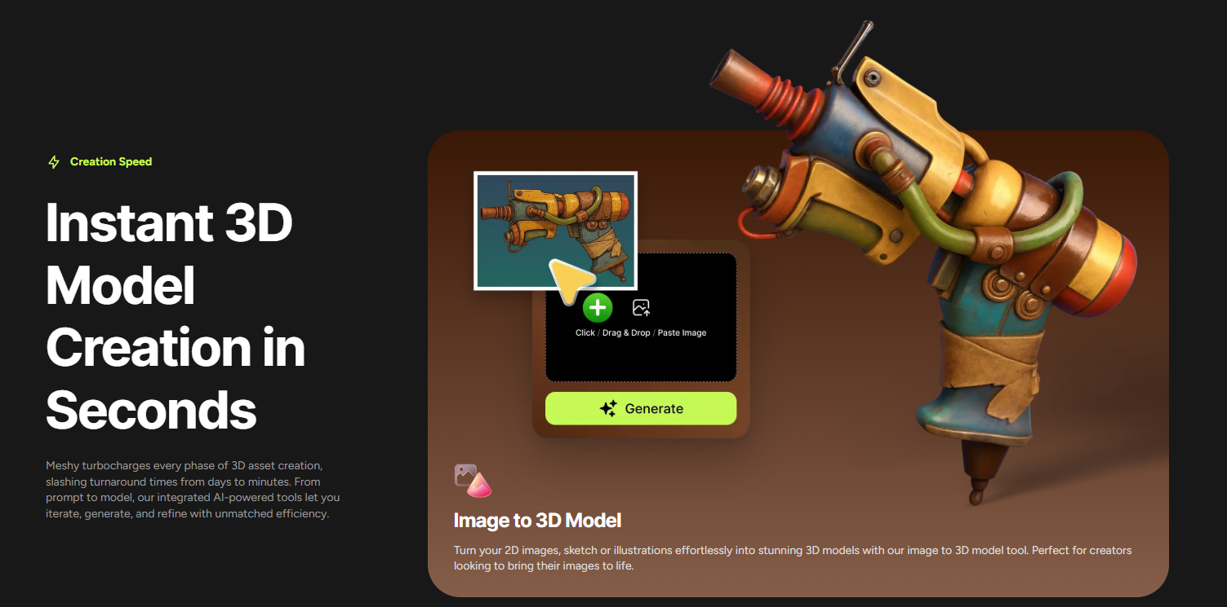
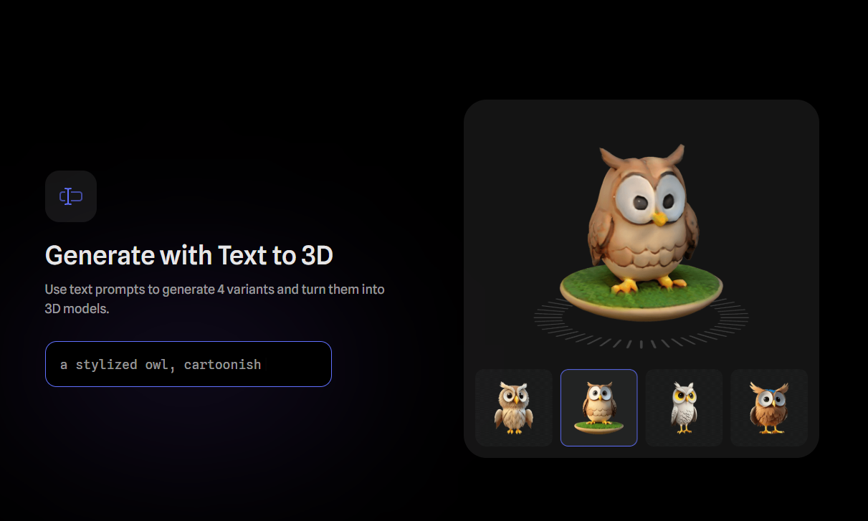


Slide 5
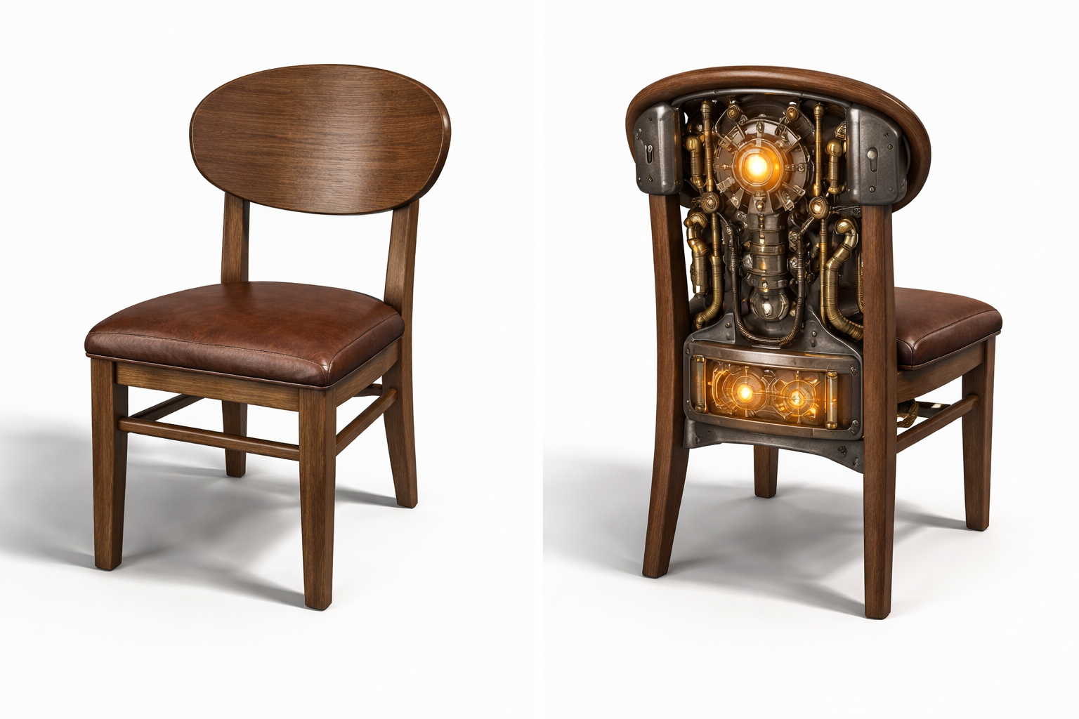
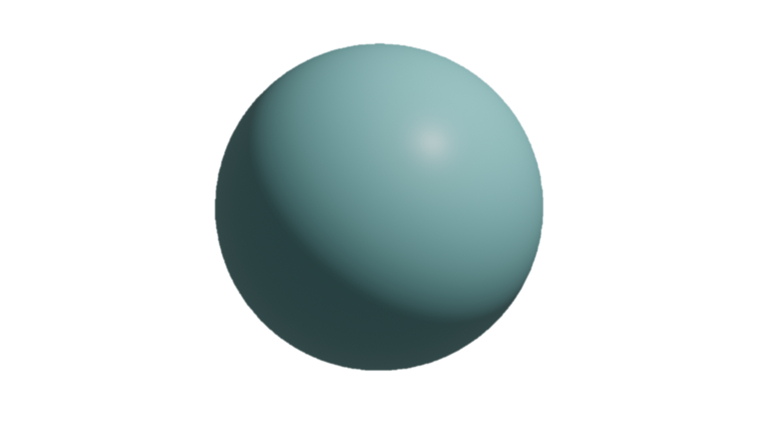
Why is Image → 3D Hard?
Mathematically: Ill-posed / underdetermined problem
Sphere or Circle?
Color or Lighting?
back side/ internal geometry?

Slide 6
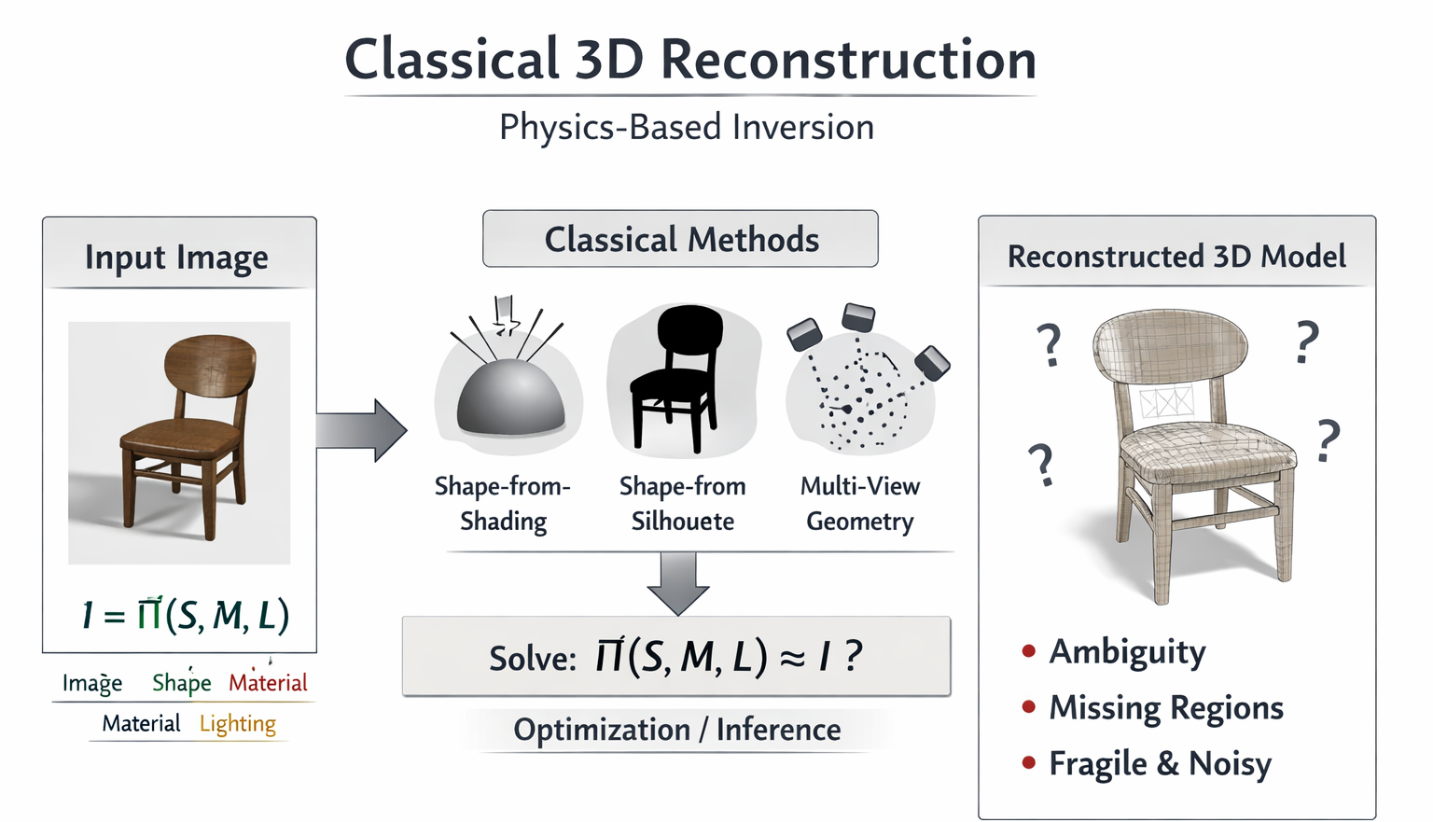
Why Classical Methods Fail
=> Not enough information

Slide 7
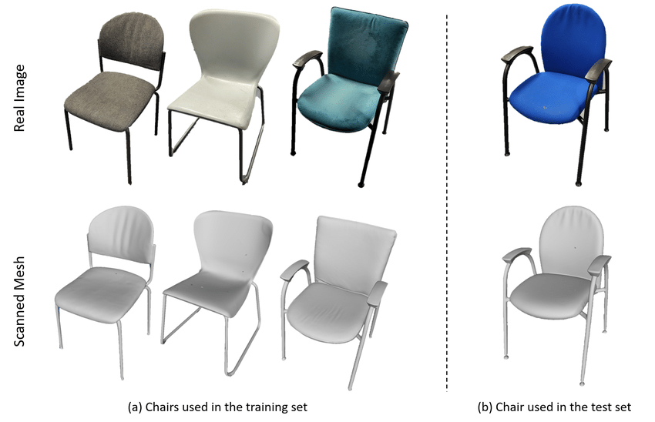
Why Generative Models Work
From physics-based inversion → to data-driven prior learning

Slide 8
3d Generation Main Paradigms
1. Optimization-based : Dreamfusion (SDS/NeRF)
2. Multi-View Generation : Wonder3D (CVPR 2024)
3. Feed-forward 3D Generation: InstantMesh

Slide 9
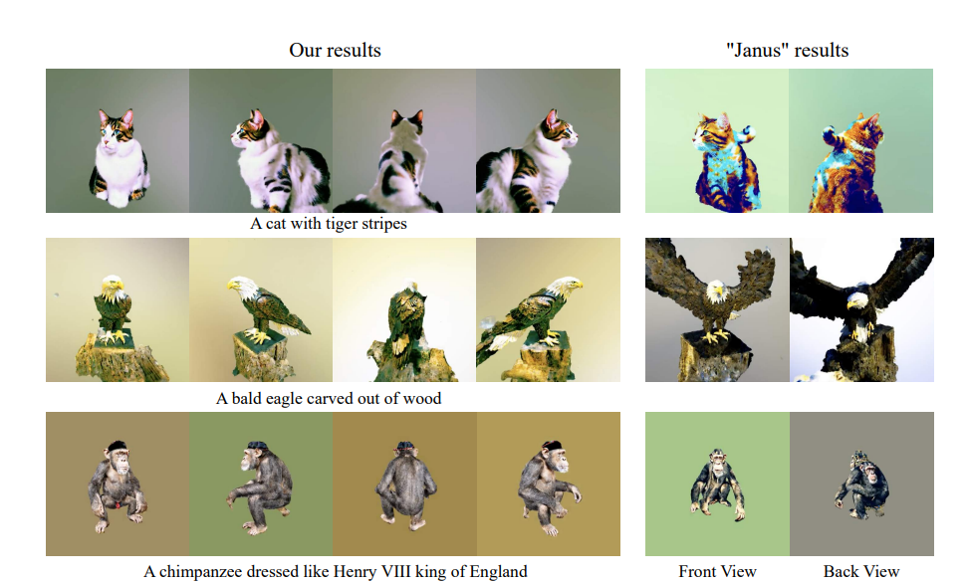
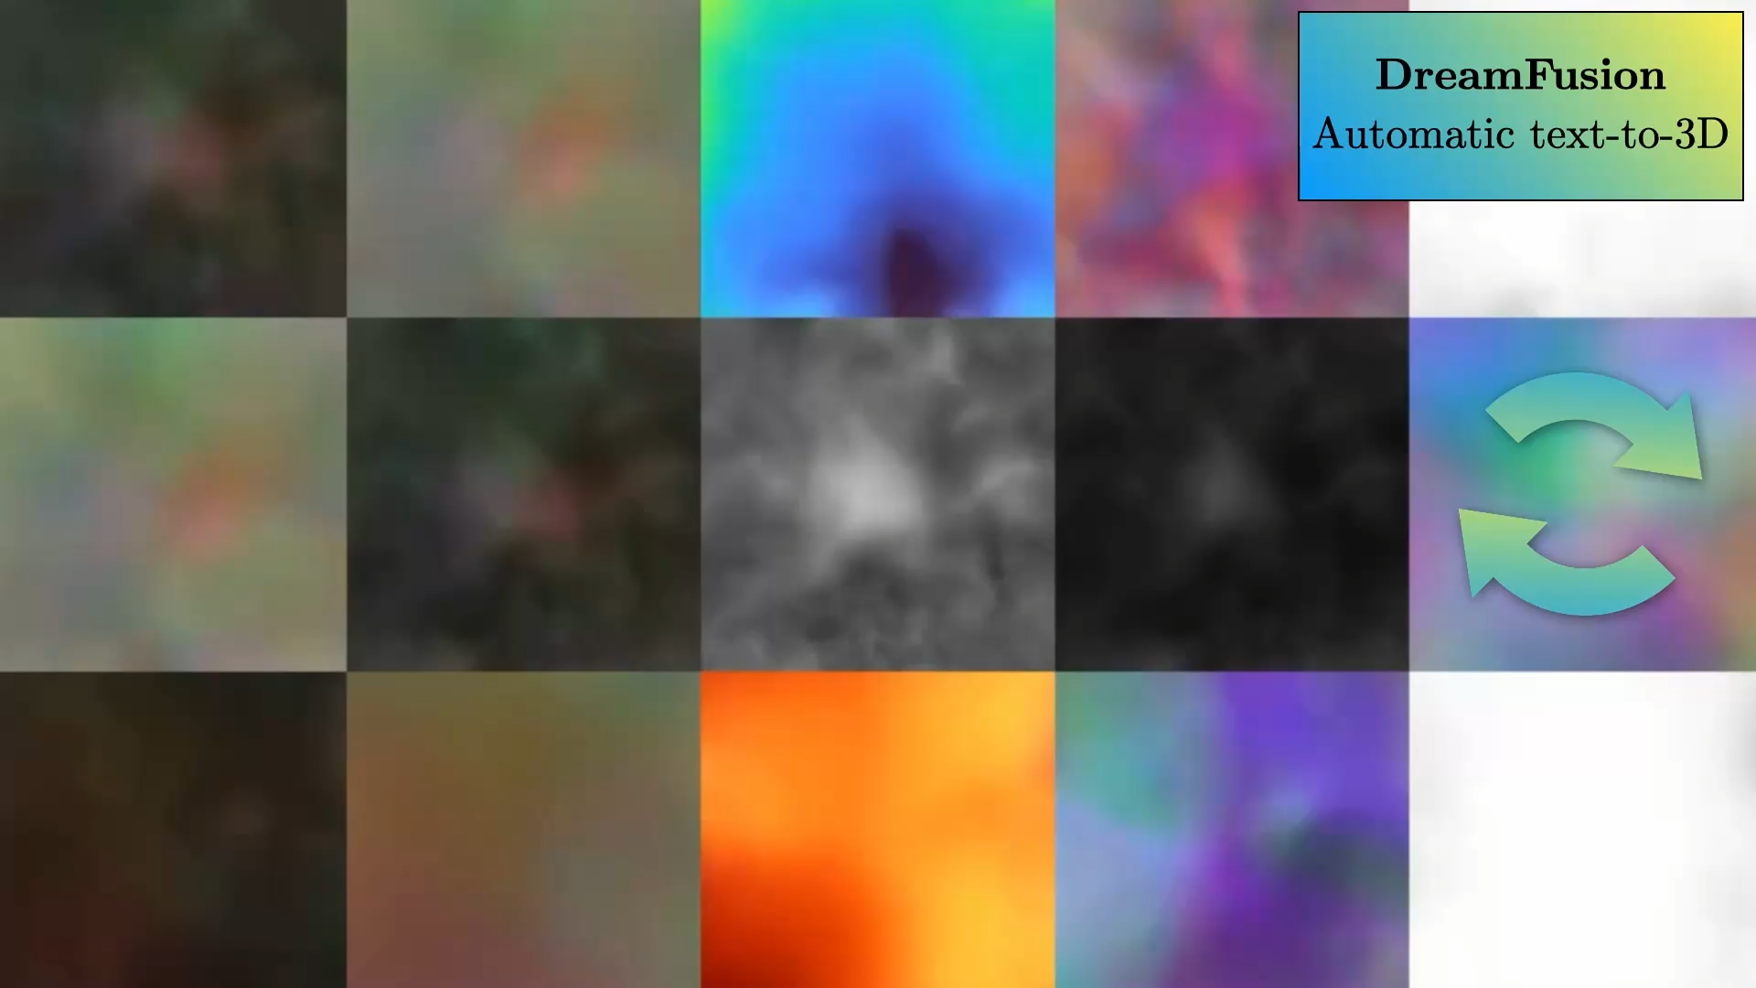
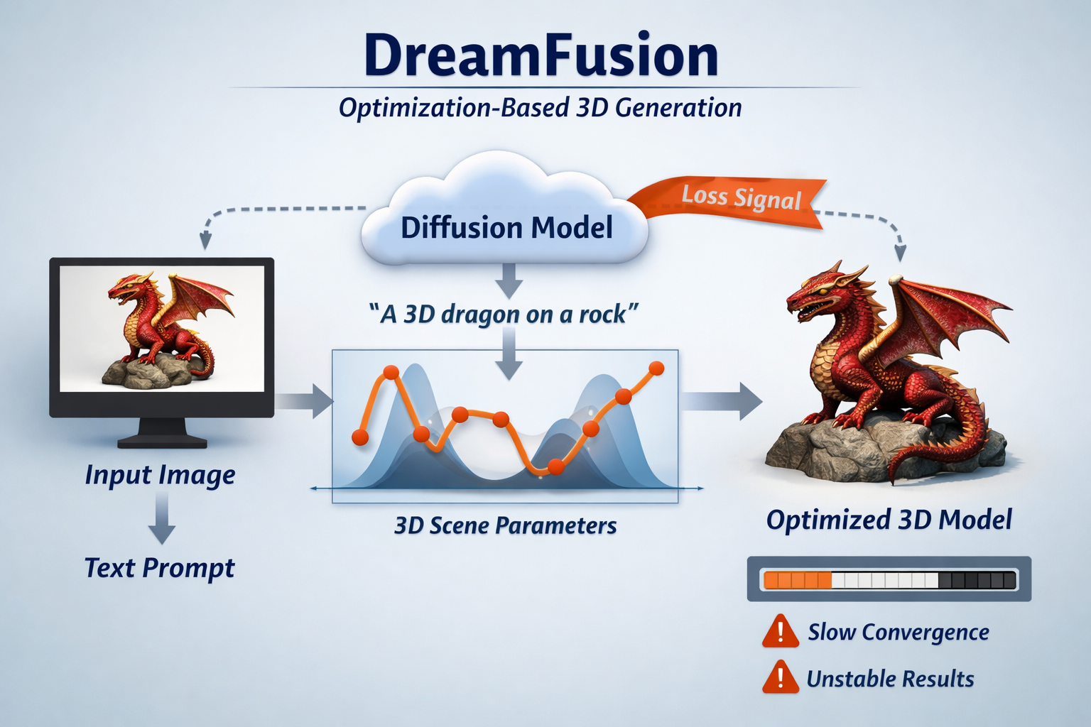
Dreamfusion

Slide 10
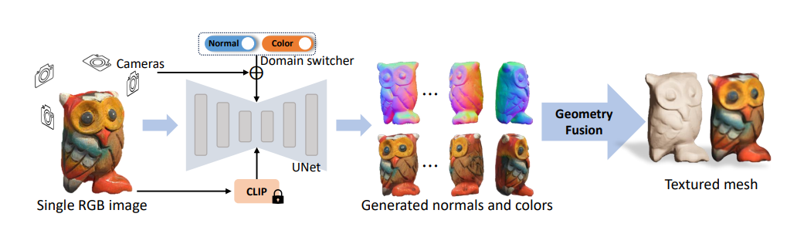
Wonder3D

Slide 11
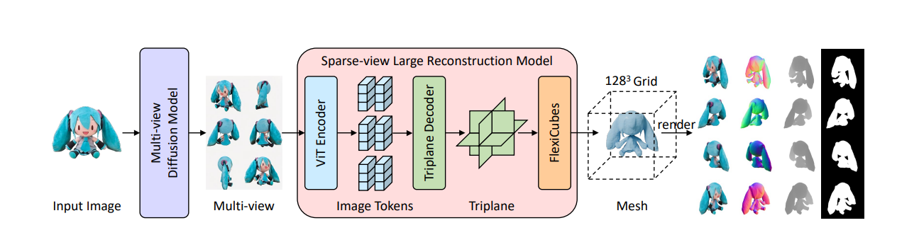
InstantMesh
Notes:
The Multi-View Bottleneck
Loss of Micro-Details
Blind Spots and Complex Topologies

Slide 12
Run time
Dreamfusion -> Wonder3D -> InstantMesh
hours -> minutes -> seconds

Slide 13
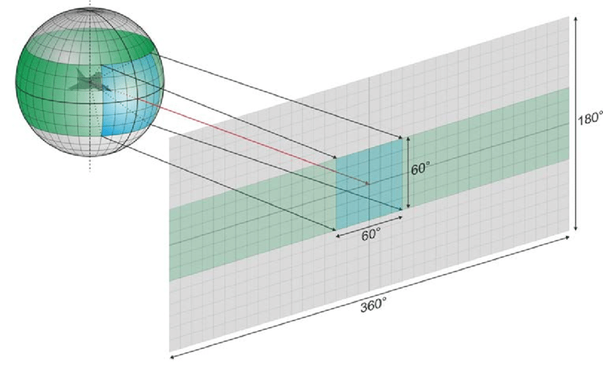
SPGen
Spherical Projection

Slide 14
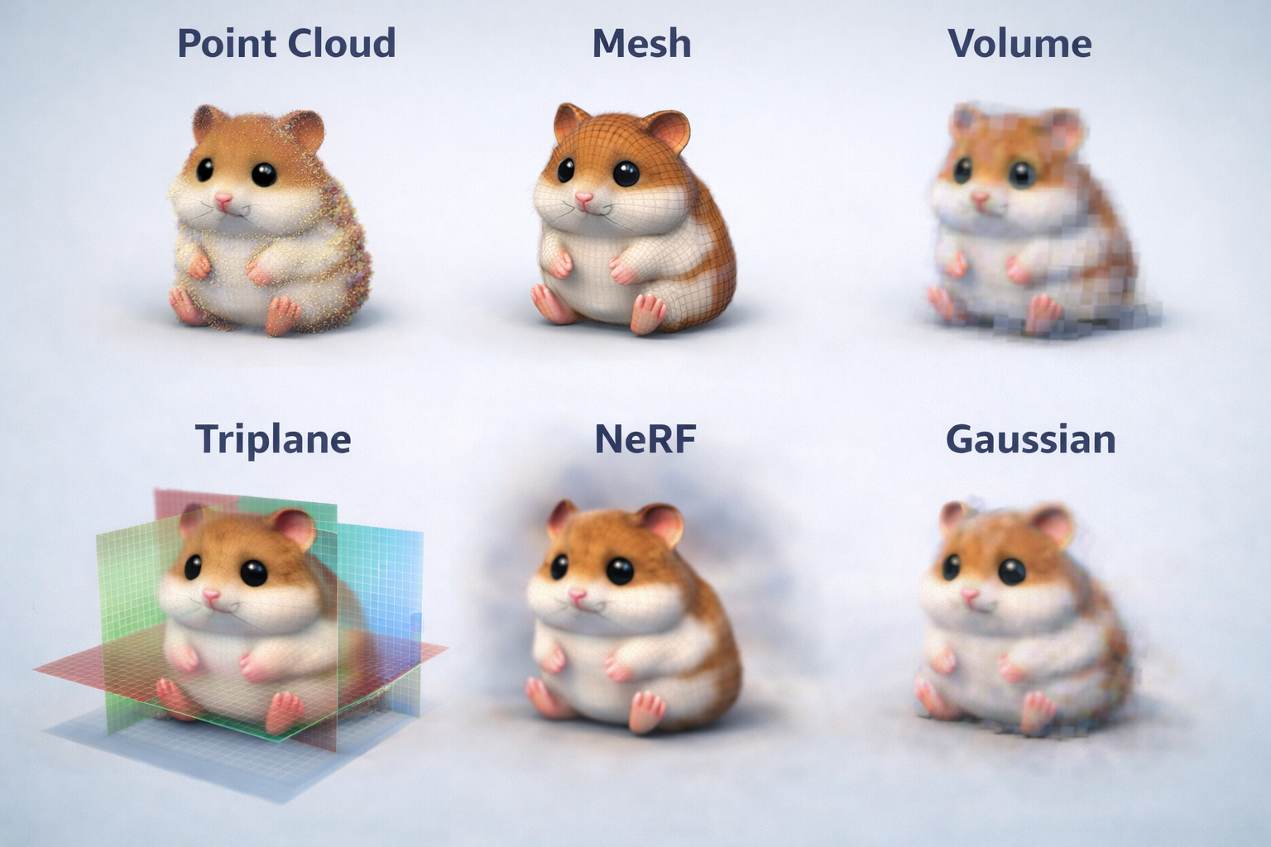
3D representations

Slide 15
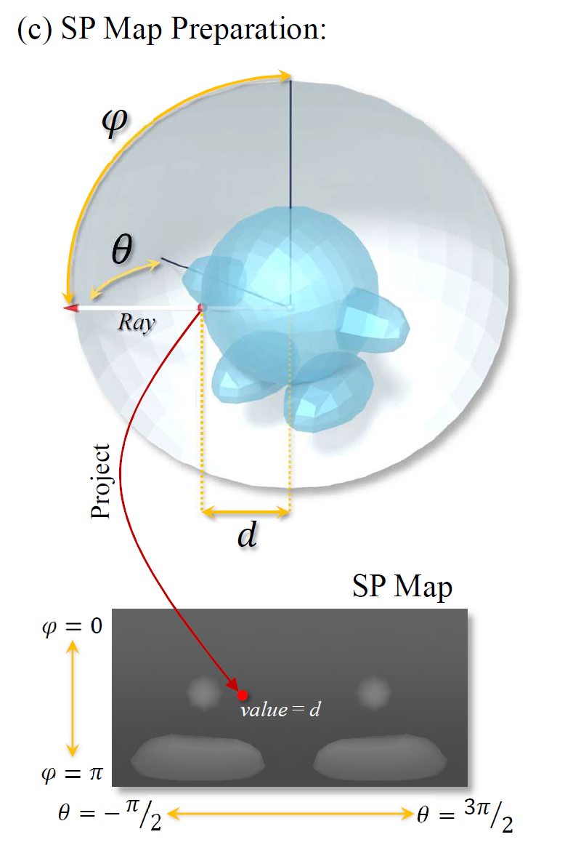
Represent 3D as spherical images
Like a depth map.

Slide 16
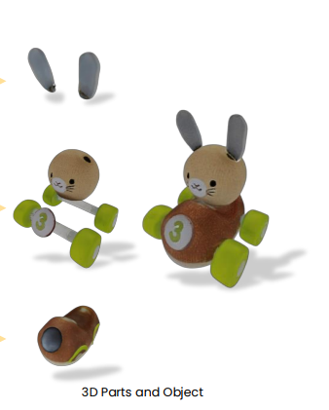
Why
Consistency: 1-to-1
Flexibility: internal structures
Efficiency: 2D

Slide 17
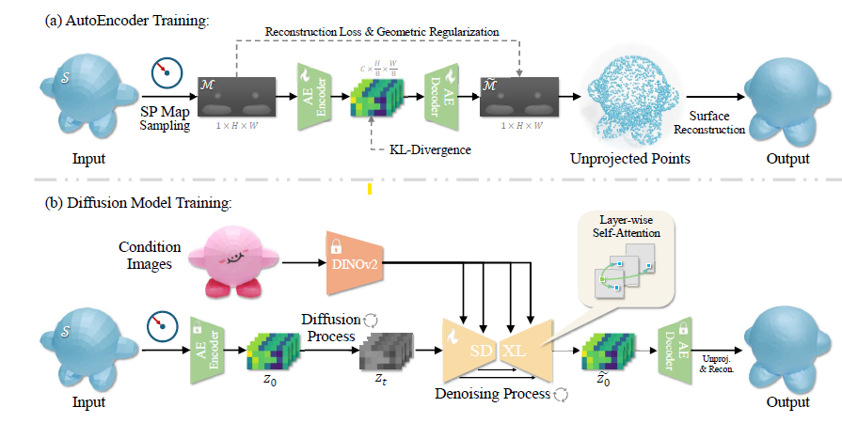
Pipeline

Slide 18
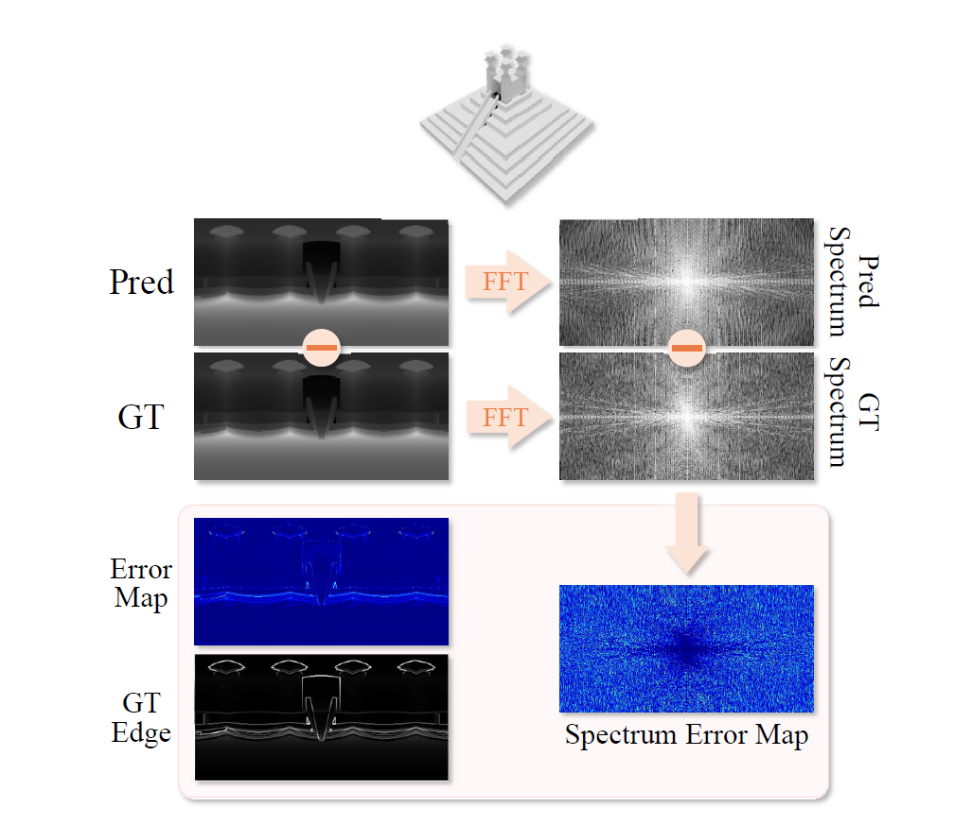
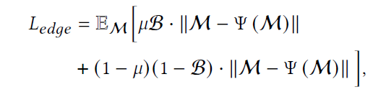



Slide 19
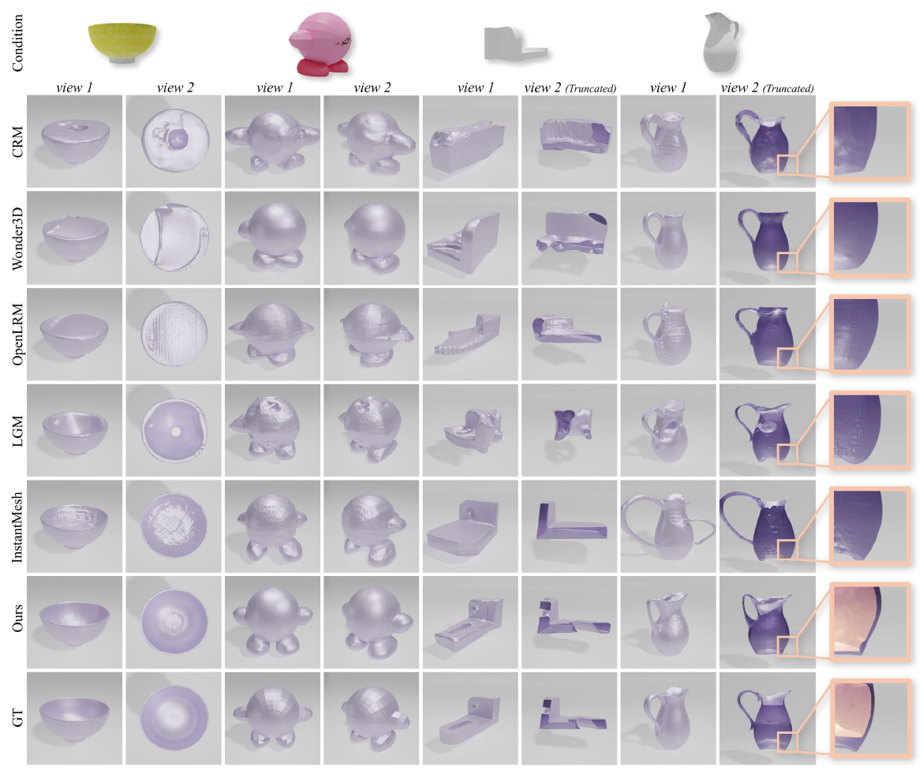
Results

Slide 20
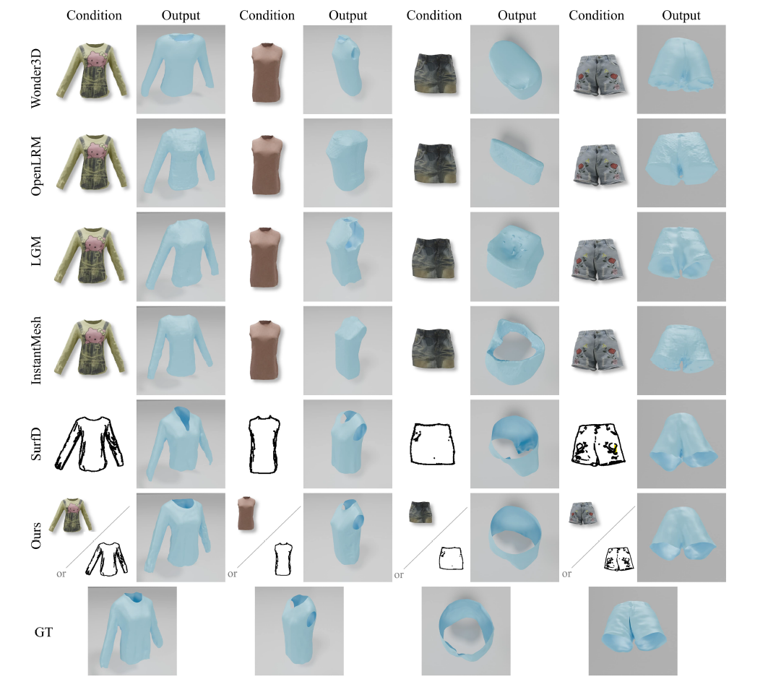
Results

