Slide 1
DeVOS: Flow-Guided Deformable Transformer for Video Object Segmentation
WACV 2024
黄慧光

Slide 2
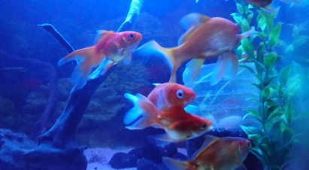
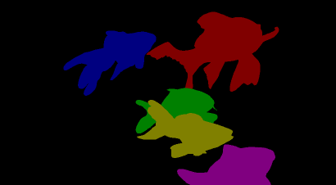


network
video
$$mask_{1\sim n}$$
$$mask_{1}$$
Very similar to coloring tasks

Slide 3
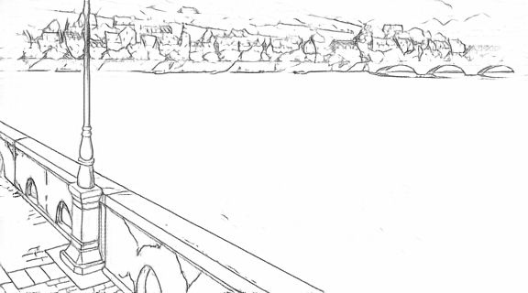



network
Sketch video
$${output}_{1\sim n}$$
$${reference}_{1}$$

Slide 4
LVCD & Tooncrafter: video generation model
strong
Frame 1
VDM
Frame 1~n
Sketch video
Sketch encoder
weak

Slide 5
Previous works
1. Feature memory storage
2. Dense memory matching

Slide 6
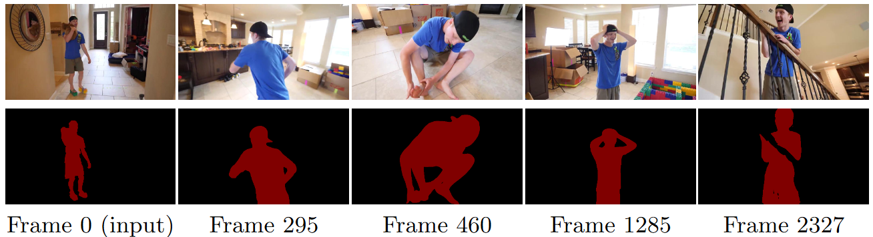
Xmem (2022 ECCV citation:754)
They break down "memory" into three storage methods at different time scales

Slide 7
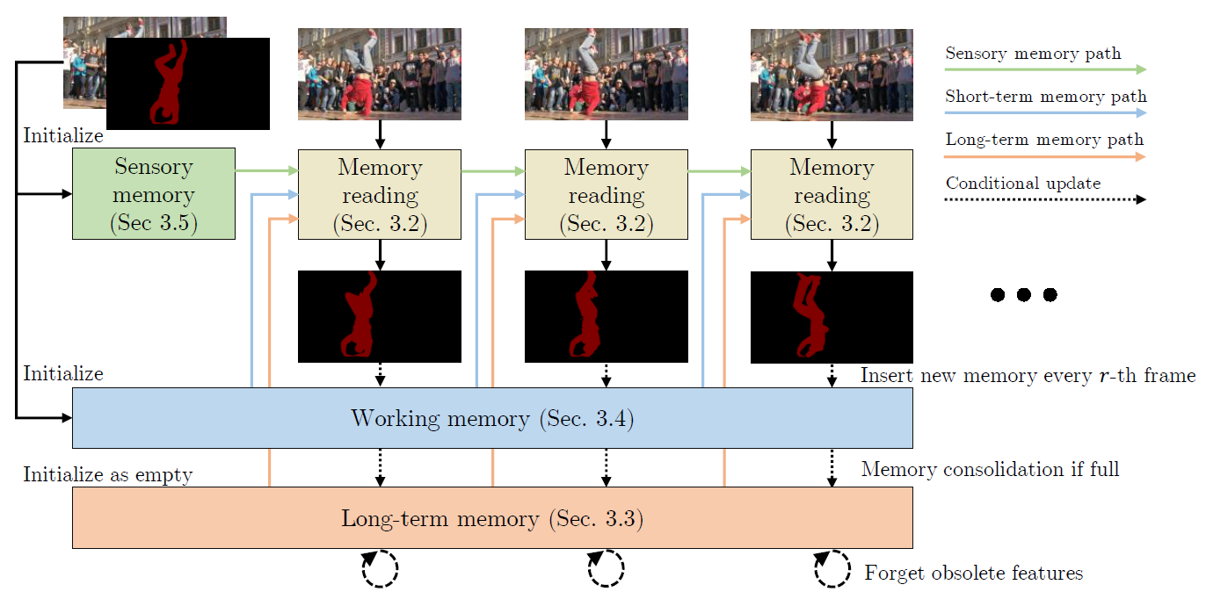

Slide 8
Limitations
The main research effort of the aforementioned approach lies in determining how to improve features for matching without focusing on how exactly to perform the matching.
memory
Inputs
How to use?
Notes:
上述方法的主要研究工作在于确定如何改进匹配特征，而不关注如何具体执行匹配。
Xmen等方法将所有信息都融入memory， 然后从memory中进行学习/处理。 而

Slide 9
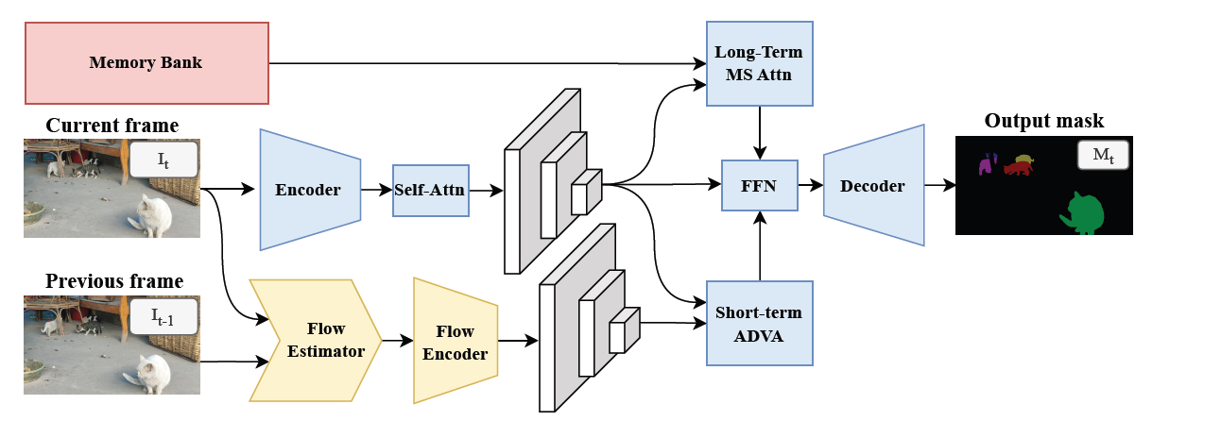
DeVOS
semantic
motion
Notes:
该论文将motion 和 semantics 在 matching 中解耦。

Slide 10
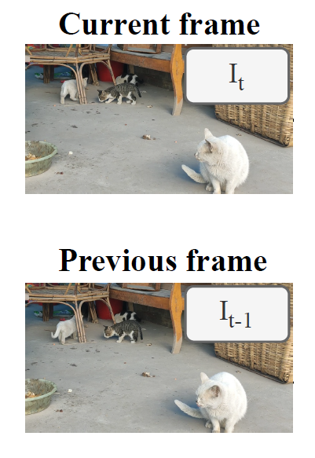
Flow estimator
Flow estimator
GMA (ICCV 2021)

Slide 11
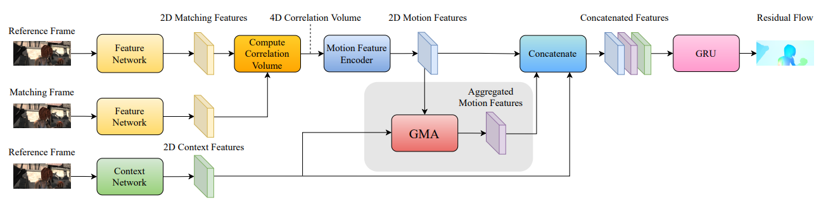
GMA (ICCV 2021)
Addressing the issue of insufficient local matching evidence when there is occlusion/out-of-frame.

Slide 12
GMA (ICCV 2021)
CNN encoder

Slide 13


GMA (ICCV 2021)
$$F_{1}∈R^{H×W×C},{ F}_{2}∈R^{H×W×C}$$
$$C(i,j,u,v)=\{F_{1}(i,j),{ F}_{2}(u,v)\}$$
Frame 1
Frame 2

Slide 14
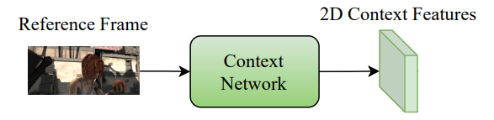
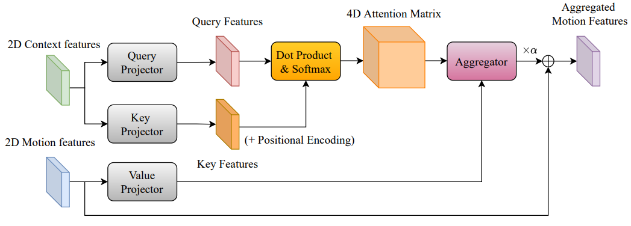
Query/Key : Who should I look at?
Value : What information do I get from it?
Which pixels appear to belong to the same object/region, and therefore their motion may be approximately the same.

Slide 15
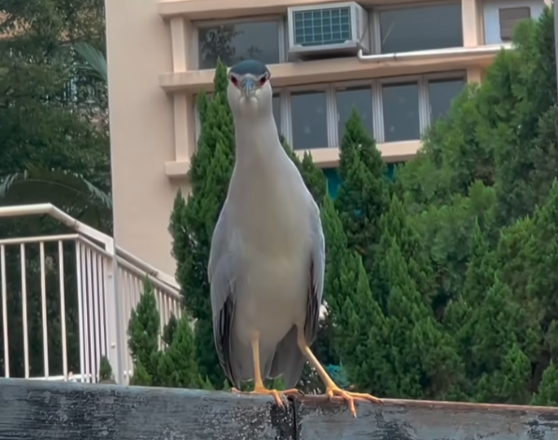
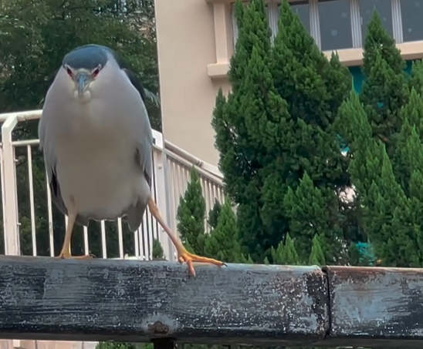
Reference image -> q & k
Motion flow -> v
Reference image
Motion flow
Notes:
聚合整只鸟的motion
鸟头q

Slide 16
GMA (ICCV 2021)
Gated Recurrent Unit
The GRU iteration number is set to 12

Slide 17
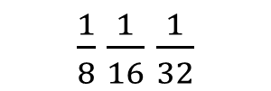
$\frac{1}{8}$ $\frac{1}{16}$ $\frac{1}{32}$
GMA

Slide 18
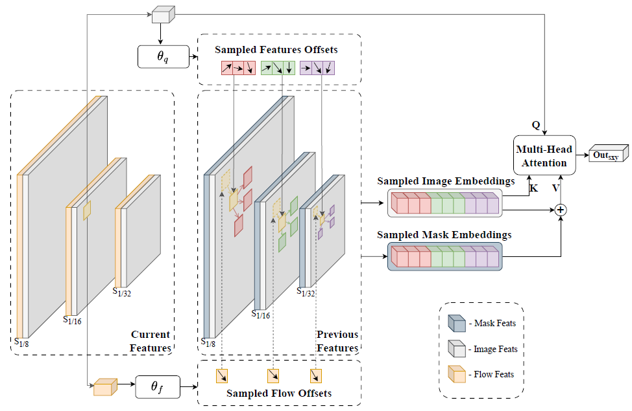
ADVA
将motion 和 semantics 在 matching 中解耦

Slide 19
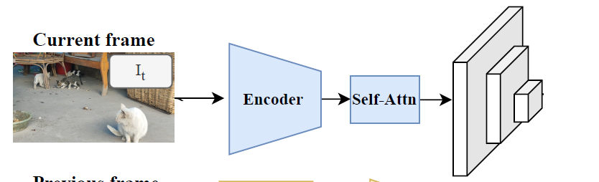


Memory bank
Frame 1
Frame 6
Frame n
……
$\frac{1}{16}$ $\frac{1}{32}$
$\frac{1}{16}$ $\frac{1}{32}$
$\frac{1}{16}$ $\frac{1}{32}$
attention-based global matching
Memory bank, FIFO
$$length ≤16$$

Slide 21
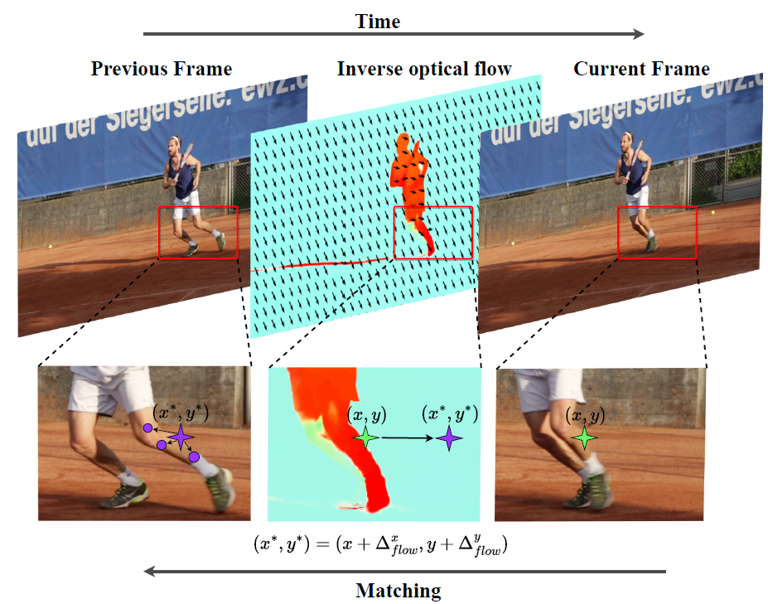

Slide 22
Experiments
2 stage training:
1. During the first stage, we adopt pretraining on synthetic sequences derived from static image datasets [35].
2. Consequently, we conduct main training on DAVIS 2017 [16], YouTubeVOS 2019 [17], and optionally MOSE 2023 [18].

Slide 23
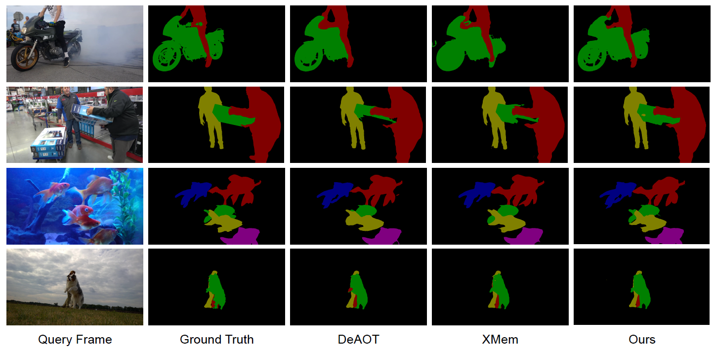
Experiments

Slide 24
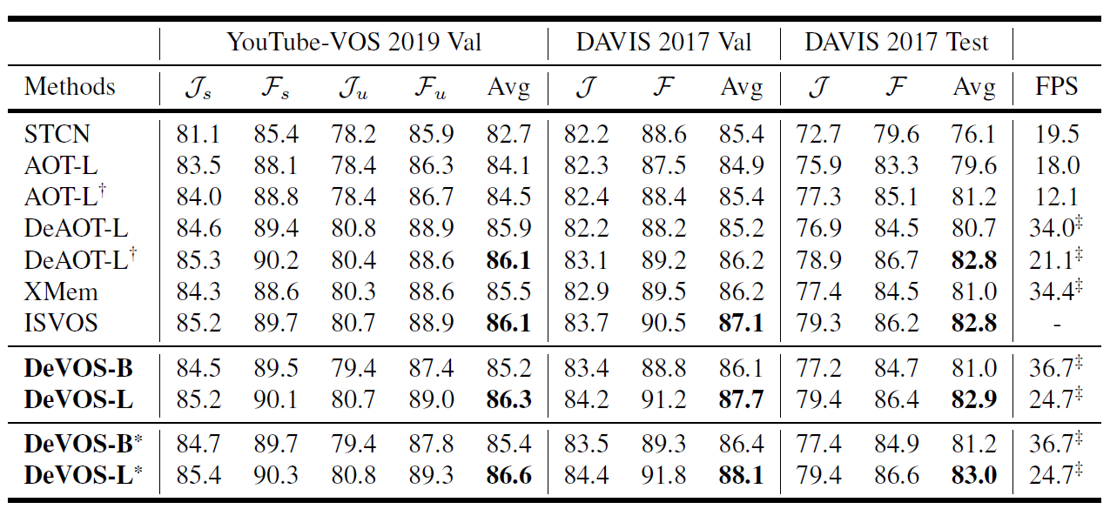
Experiments
J: Region Similarity(IoU) F: Contour Accuracy

