Slide 1
SCORE: Semantic Collage by Optimizing Rendered Elements
Zefan Shao, Jin Zhou, Hongliang Yang, Pengfei Xu*
The Fortieth AAAI Conference on Artificial Intelligence (AAAI-26)

Slide 2
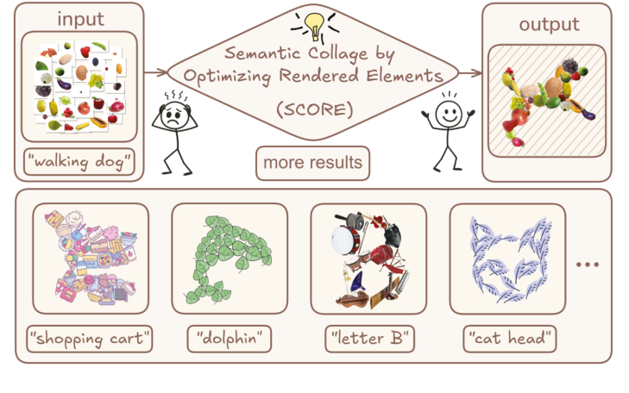
Abstract
Collage is a powerful medium for visual expression, traditionally demanding significant artistic expertise and manual effort. Existing methods often struggle with a trade-off between semantic expression and the visual fidelity of the constituent images. To address this, we introduce SCORE (Semantic Collage by Optimizing Rendered Elements)
• Semantic-driven Layout over Template Constraints. We introduce a paradigm that directly uses text to drive the layout optimization. By utilizing Variational Score Distillation (VSD) as a semantic loss, our method bypasses the need for intermediate representations such as contours or reference images, thereby significantly enhancing creative freedom and the precision of semantic alignment.
• Image element Fidelity via Minimal Editing. Our optimization process is strictly confined to adjusting the position, rotation, and scale of the image elements. No distortion, cropping, or content-level modifications are performed. This “minimal editing” strategy maximally preserves the integrity and visual clarity of the original images, resulting in highly interpretable final compositions that respect traditional collage practices.
• Joint Optimization of Semantics and Structure. We design a composite loss function that synergistically combines the semantic guidance from the pre-trained generative model with a suite of structural regularizers. These regularizers, which include penalties for overlap, size, and boundary constraints, ensure the resulting layout is not only semantically meaningful but also structurally sound and visually organized.

Slide 3
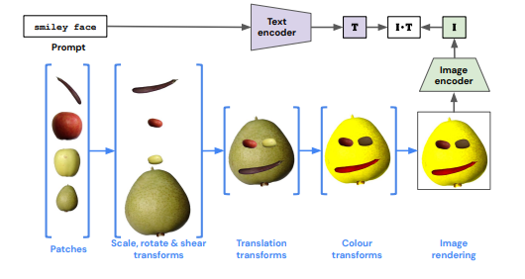
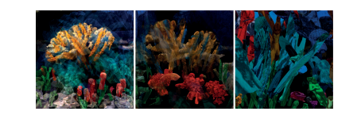
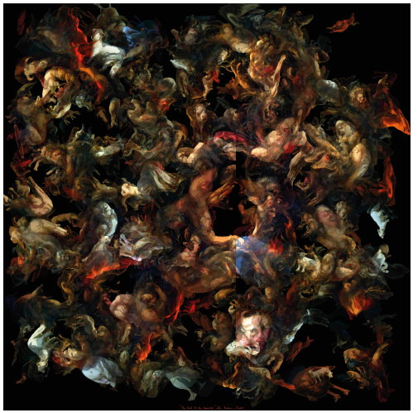
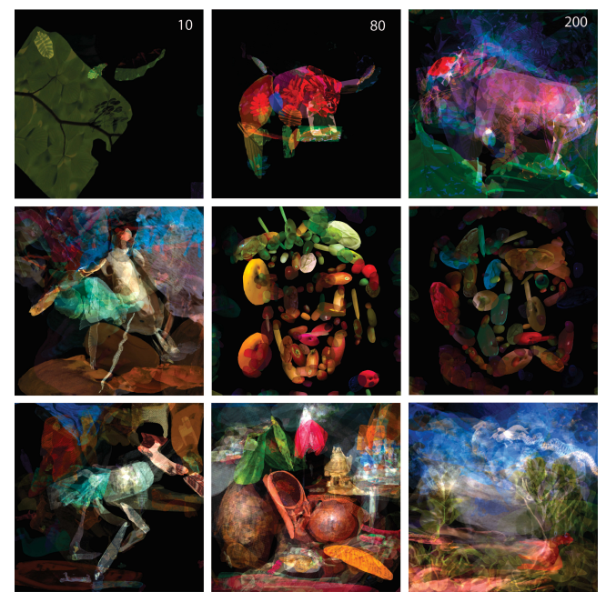
Related Work
CLIP-CLOP: CLIP-Guided Collage and Photomontage

Slide 4

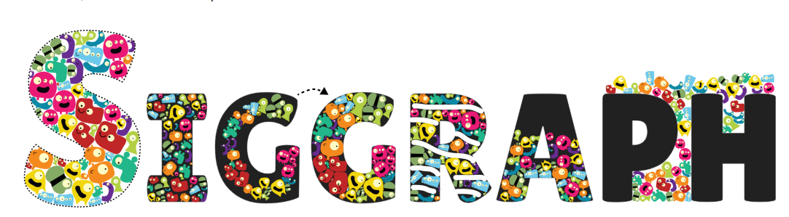
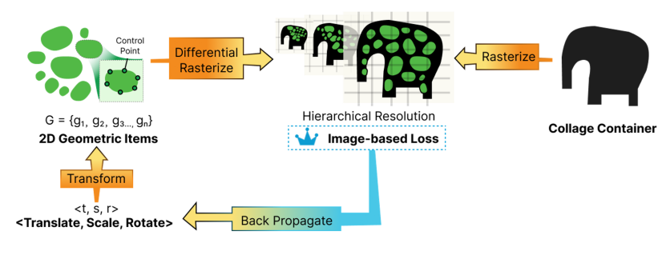
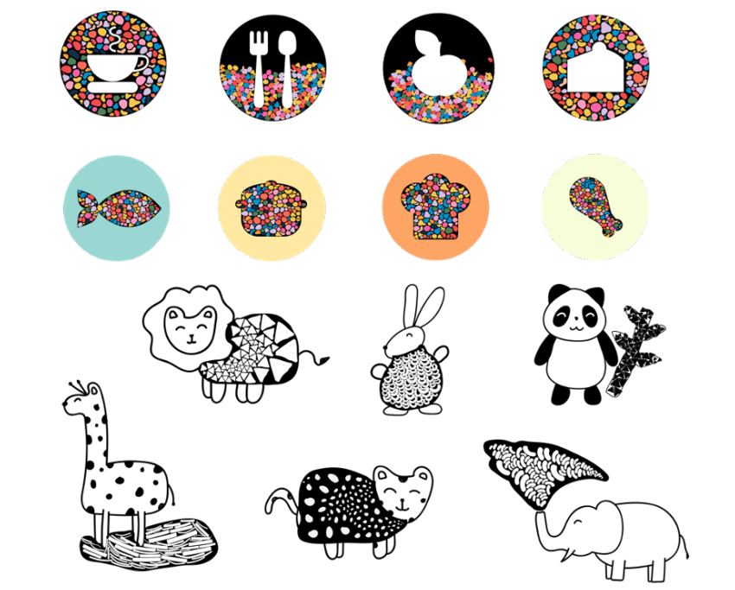

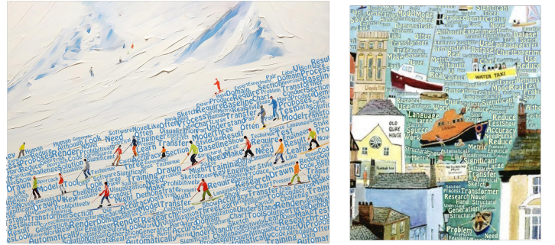
Related Work

Slide 5

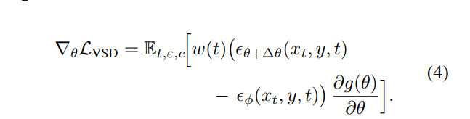
Preliminaries
Diffusion Models
Score Distillation Sampling (SDS)
Variational Score Distillation (VSD)

Slide 6
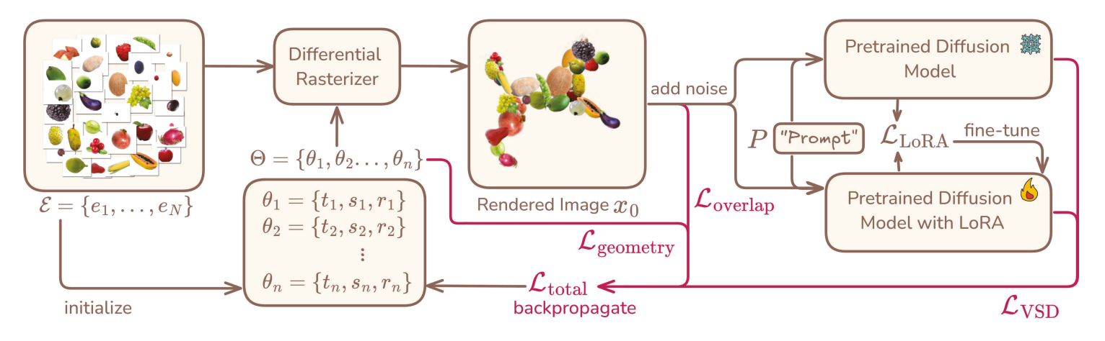

Methodology
Input. An image element set E = {e1, . . . , eN } and a text prompt P.
Output. A set of 2D affine transformation parameters Θ = {θ1, . . . , θn}, where each θi = {ti , si , ri} corresponds to the translation, scale, and rotation for image ei . A collage work that follows the text prompt P can be rendered with image elements and these parameters.
Layout Initialization A proper initialization is crucial for the stability and efficiency of the optimization process. To avoid trivial local minima and provide a reasonable starting point, we initialize the layout with the following strategy:
  Translation (t): The initial (x, y) positions of all elements are uniformly distributed across the canvas to provide a diverse and unbiased starting layout.
  Rotation (r): Each image element is given a small random rotation, sampled from a narrow range (e.g., ±0.1 radians), to introduce slight angular diversity.
  Scale (s): The initial scale of all elements is determined by the total number of image elements (N), providing a reasonable starting density:

Slide 7
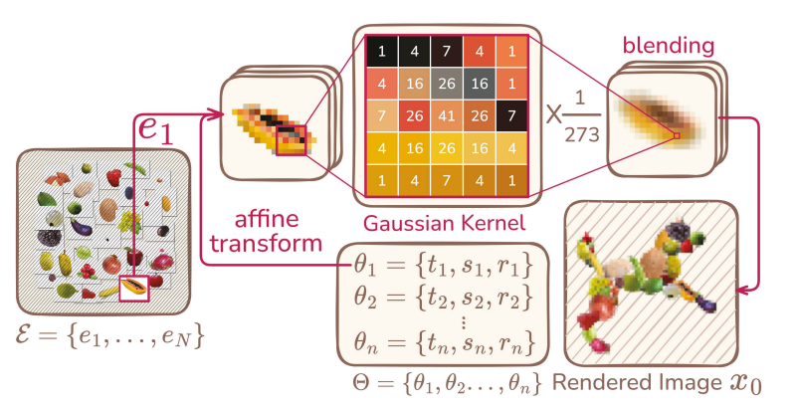


Methodology
Differentiable Renderer
  Gaussian Splatting
Joint Loss Function
  1
  1
  Variational Score Distillation Loss
  Render Loss

Slide 8
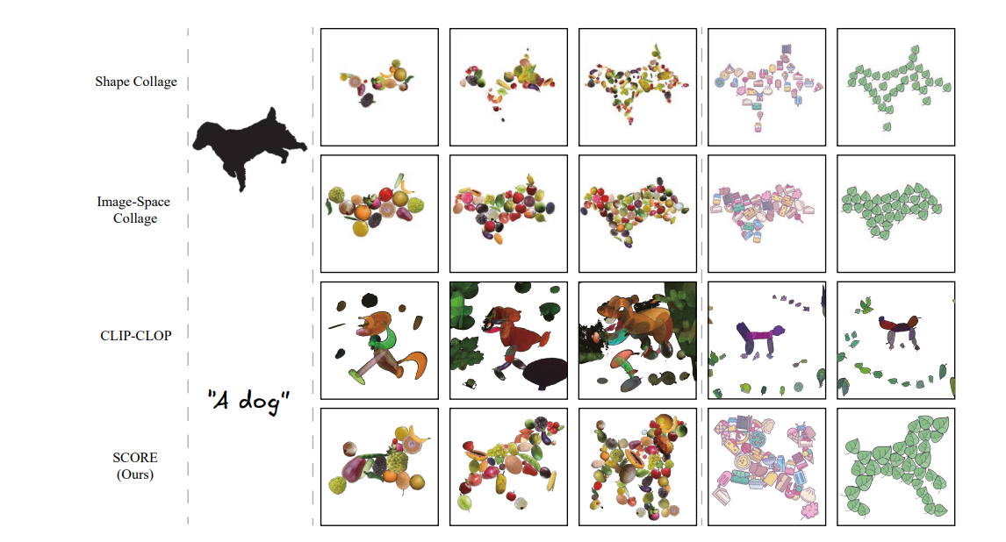
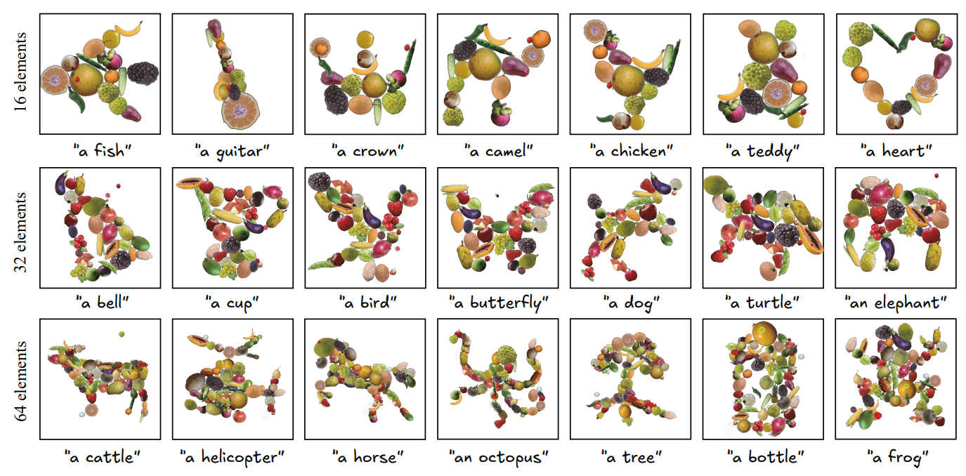
Results and Experiments

Slide 9
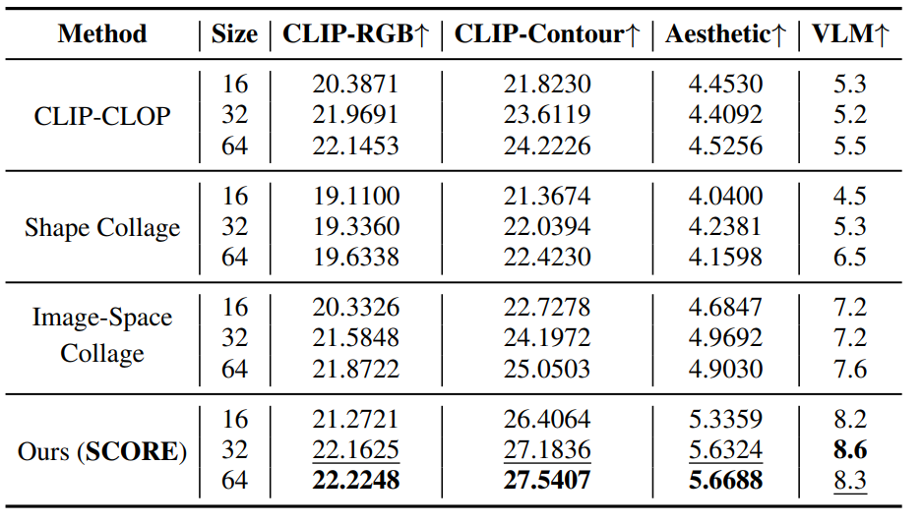
Results and Experiments
CLIPRGB (semantic alignment) computes the CLIP similarity between the rendered collage and the text prompt (Radford et al. 2021)
CLIP-Contour (shape) is our metric that converts the collage to a binary contour map and measures its CLIP similarity to the prompt, isolating shape from color
Aesthetic Score uses a LAION-trained aesthetic predictor (Schuhmann et al. 2022)
GPT-4o Score asks GPT-4o to rate 1-10 on Contour Expression, Layout Rationality, and Aesthetic Quality, consistent with evidence that LLM-based judgments (e.g., GPT-4V) correlate with human preferences for compositional T2I tasks (Huang et al. 2023)

Slide 10
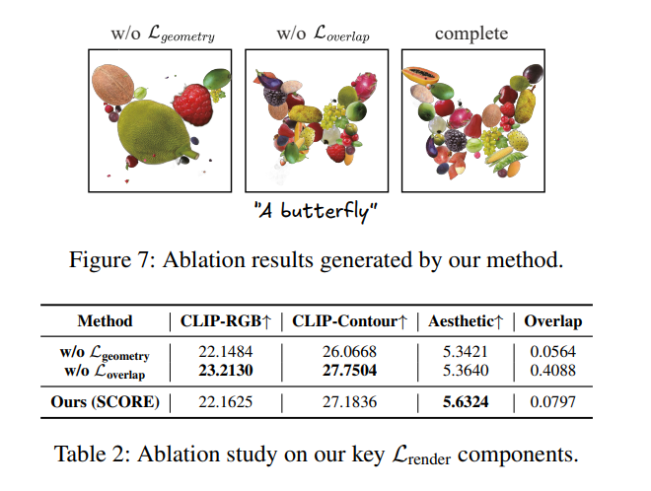
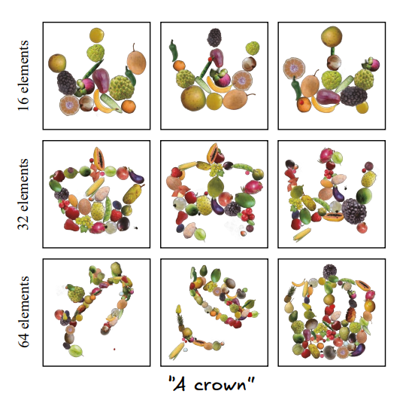
Results and Experiments
User study
  50 participants
  our method was selected in 59%
  20.8% for Image-Space Collage
  11.8% for Shape Collage
  8.4% for CLIP-CLOP

Slide 11
Conclusion & Discussion
We introduce SCORE, a text-driven collage framework that optimizes layouts directly in image space. By combining VSD with structural constraints, it generates collages that are semantically aligned, structurally coherent, and preserve the original image appearance. While effective and flexible, the method depends on accurate foreground segmentation and struggles with complex textures. Future work includes improving efficiency and extending the approach to 3D scenarios.

