Slide 1

LoRA-Edit
Controllable First-Frame-Guided Video Editing via Mask-Aware LoRA Fine-Tuning
Gao et al. · ICLR 2026 · arXiv:2506.10082
LoRA-Edit · Section 3 emphasis · 01/15
Sources: uploaded decks + arXiv/project page
Notes:
Open with the central message: LoRA-Edit is not a new video foundation model; it is a mask-aware per-video adaptation protocol that makes first-frame video editing more controllable.

Slide 2
Problem: first-frame control is not temporal control
What the user gives
One edited first frame and possibly a prompt / caption. The edit is flexible because any image editor can create it.
What the model must infer
New viewpoints, dis occluded regions, deformations, object states, and long-range temporal consistency.
Typical failure
The edited object drifts, hidden regions become inconsistent, or the background is rewritten despite being unedited.
Paper’s answer
Use a spatiotemporal mask during LoRA tuning so the adapter learns where to preserve source content and where to regenerate edited content.
first frame
later frames are underspecified
LoRA-Edit · Section 3 emphasis · 03/15
Sources: uploaded decks + arXiv/project page
Notes:
Define first-frame-guided video editing. Emphasize that frame 1 does not encode how the edit should behave under motion, occlusion, or new views.

Slide 3
Positioning: LoRA-Edit binds flexibility to region control
Reference-guided
video editing
(VACE, Kling)
First-frame
propagation
(AnyV2V, I2VEdit)
Motion / flow
propagation
(Go-with-the-Flow)
LoRA-Edit
mask-aware
per-video tuning
Gap targeted
Keep the freedom of editing a first frame, but add explicit spatiotemporal control so background preservation and foreground regeneration do not compete globally.
Three contributions
Mask as instruction; LoRA as per-video motion memory; optional edited later frames as appearance anchors for changing viewpoints or object states.
LoRA-Edit · Section 3 emphasis · 04/15
Sources: uploaded decks + arXiv/project page
Notes:
This slide combines related-work positioning from the general decks. LoRA-Edit is framed as a training protocol around an existing I2V model rather than a new editing backbone.

Slide 4
Method
3.1
Naive LoRA
learns source video motion
3.2
Mask study
reveals hidden preserve/generate interface
3.3
Mask-guided LoRA
learns motion + appearance selectively
Method logic
Naive LoRA gives motion transfer but no region-level control. Section 3.2 shows the I2V mask already acts like a preserve/generate control channel. Section 3.3 trains the LoRA to obey that channel while learning from different visual sources.
LoRA-Edit · Section 3 emphasis · 05/15
Sources: uploaded decks + arXiv/project page
Notes:
This is the pivot into the method section. Tell the audience that Section 3 is best understood as a sequence of deficiencies and repairs.

Slide 5
Cont.
V_cond
what the model sees
M_cond
what to preserve / generate
V_target
what LoRA learns to reconstruct
Mask convention
M_cond = 1 → preserve from V_cond
M_cond = 0 → generate / regenerate
Training behavior
Different V_cond, M_cond, V_target settings teach different skills: motion inheritance, background locking, or new appearance.
Inference behavior
Replace the first frame with the edited one, reuse the learned adapter, and apply the same mask semantics.
LoRA-Edit · Section 3 emphasis · 06/15
Sources: uploaded decks + arXiv/project page
Notes:
Make sure the mask convention is clear. In this paper, 1 means preserve from the conditioning input and 0 means generate. This is the most useful implementation-level mental model.

Slide 6
3.1 Naive LoRA: learn source motion, then swap the first frame
Source video
V_input
Train LoRA
to reconstruct
Edited first frame
Ĩ₁ at inference
Edited video
with source motion
Naive objective
L_naive = Eₜ,ε [ || εθ(xₜ, t; I₁, [p*]+c) − ε ||²₂ ]
I₁ = first frame
[p*] = special token
c = caption
What this solves
The adapter stores video-specific temporal behavior without full-model fine-tuning.
What it cannot solve
It still lacks explicit control over which regions should change and which should remain source-like.
LoRA-Edit · Section 3 emphasis · 07/15
Sources: uploaded decks + arXiv/project page
Notes:
The naive baseline is useful, not wrong. It captures motion via per-video LoRA, but it does not separate edited foreground from preserved background.

Slide 7
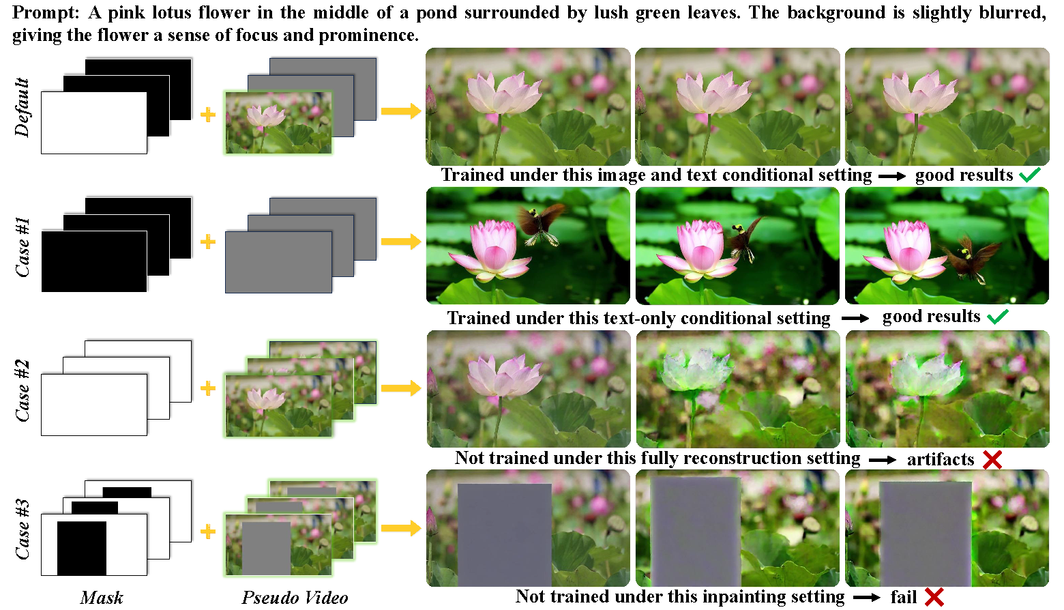
3.2 Mask study: the I2V mask is a hidden control interface
Default I2V
Pseudo-video contains the first frame; mask preserves frame 1 and generates later frames.
All-zero mask
The model behaves closer to unconstrained generation; it ignores video content.
All-one mask
Structure is heavily preserved, but discontinuous or mismatched motion can still create artifacts.
Selective mask
Exactly the desired edit setup, but raw I2V does not obey it robustly without adaptation.
LoRA-Edit · Section 3 emphasis · 08/15
Sources: uploaded decks + arXiv/project page
Notes:
This slide uses the official method figure. Explain the four cases. The raw mask interface exists, but selective preservation/generation is weak until LoRA is trained under that setting.

Slide 8
3.3 Core objective: mask-guided LoRA trains under explicit conditions
L = Eₜ,ε [ || εθ(xₜ, t; V_cond, M_cond, [p*]+c) − ε ||²₂ ]
xₜ = AddNoise(E(V_target), ε, t)
Difference from naive LoRA
Condition now includes a masked pseudo-video and binary mask, not only frame 1 + caption.
Configurable target
V_target can be the source video for motion/background learning or an edited frame for appearance learning.
Resulting control
The same objective supports multiple training branches by changing V_cond, M_cond, and V_target.
LoRA-Edit · Section 3 emphasis · 09/15
Sources: uploaded decks + arXiv/project page
Notes:
This is the most important equation. Emphasize that V_target is no longer fixed: it becomes the lever for learning either source motion or edited appearance.

Slide 9
3.3A Training branch: disentangle edited regions from background
V_input
source clip
Apply M_cond
1 = background
0 = edit region
V_cond
masked source video
V_target
= V_input
What LoRA learns
Generate content only where the mask says 0, while locking source-like content where the mask says 1. This converts a binary mask into training supervision for local regeneration.
LoRA-Edit · Section 3 emphasis · 10/15
Sources: uploaded decks + arXiv/project page
Notes:
Branch A is the background-locking branch. The target remains the original source video, but the condition hides the future edit area. This teaches mask obedience and source motion.

Slide 10
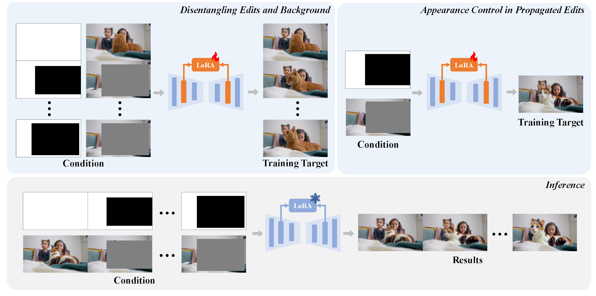
3.3B Training branch: use edited later frames as appearance anchors
Why extra frames help
A single first-frame edit cannot specify hidden surfaces, later poses, or future object states.
Training configuration
Use a pre-edited reference frame as condition, mask out the edited region, and set V_target to the user-edited frame Ĩₖ.
Important design choice
The edited later frame is supervision during LoRA tuning, not a hard inference keyframe. The adapter learns an appearance prior it can synthesize smoothly.
Appearance learning complements motion learning: source video gives context; edited references give desired generated-region appearance.
LoRA-Edit · Section 3 emphasis · 11/15
Sources: uploaded decks + arXiv/project page
Notes:
Use the official full method figure. Explain the top-right branch: appearance control is trained from additional edited frames as supervision rather than copied as fixed keyframes at inference.

Slide 11
Inference recipe: how the trained adapter is used
1
Edit first frame
Use any image editor or image model.
2
Build mask
1 = preserve; 0 = generate.
3
Tune LoRA
Source motion + mask obedience.
4
Optional anchors
Edited later frames shape appearance.
5
Generate
Trained LoRA + edited first frame.
Operational takeaway
The same base I2V model is reused. The per-video LoRA is the adaptation layer; the mask is both the command at inference and the curriculum during training.
LoRA-Edit · Section 3 emphasis · 12/15
Sources: uploaded decks + arXiv/project page
Notes:
This is the implementation-level recipe extracted from the three decks. It is useful to connect to the user’s own SAM/compositing/video-editing workflow.

Slide 12
Results: LoRA-Edit leads on the reported first-frame metrics
CLIP Score
DeQA Score
Input Similarity
AnyV2V
0.8995
AnyV2V
3.735
AnyV2V
0.7569
GwtF
0.9047
GwtF
3.562
GwtF
0.7504
I2VEdit
0.9128
I2VEdit
3.448
I2VEdit
0.7536
LoRA-Edit
0.9172
LoRA-Edit
3.801
LoRA-Edit
0.7608
LoRA-Edit · Section 3 emphasis · 13/15
Sources: uploaded decks + arXiv/project page
Notes:
Explain each metric before reading the bars. The bars are normalized visually by metric; labels provide the raw values from the source slides/table.

Slide 13
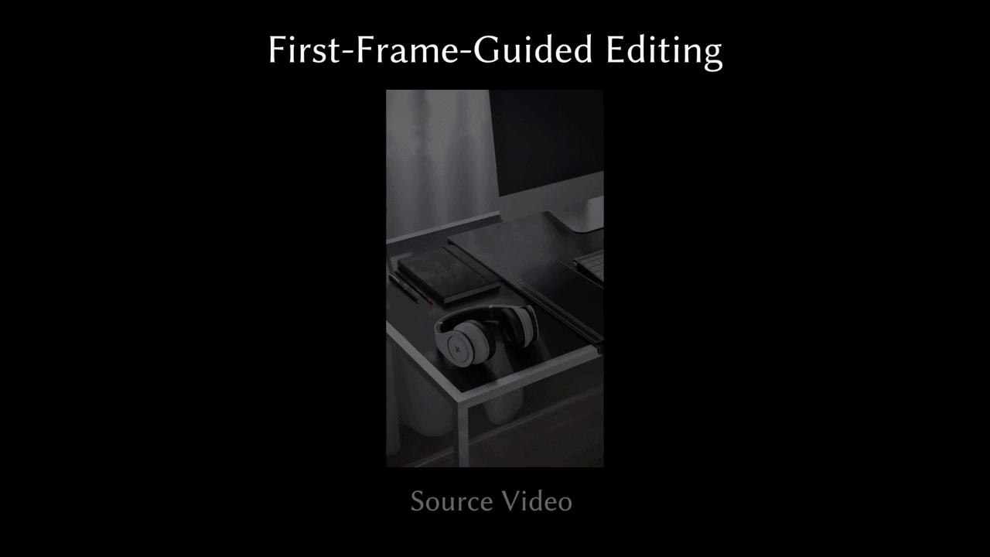
Result 3.3A

Slide 14
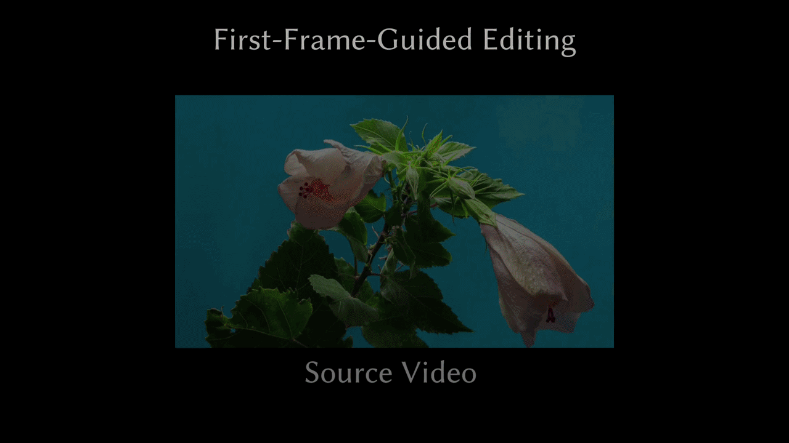
Result 3.3B

Slide 15
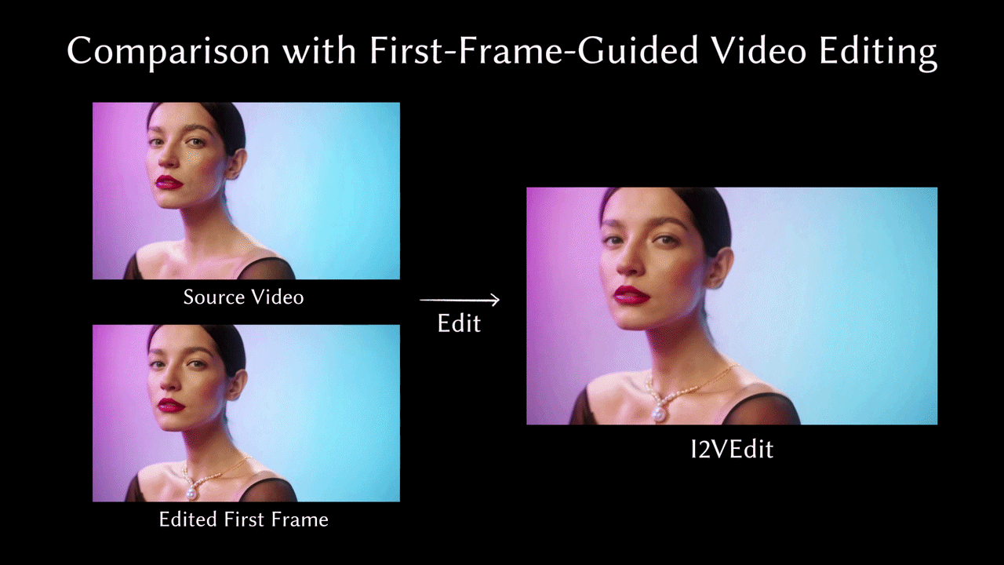
Comparison

Slide 16
Ablations, efficiency, and limits
Spatial conditioning
Localizes the edit and reduces background overwrite.
Additional edited frame
Improves later-state and viewpoint-specific appearance control.
Loose-mask robustness
The method is not only tuned for perfect masks, but mask quality still matters.
Efficiency
Main 49-frame setup is summarized as around 20 GB GPU memory.
With “Swap Blocks” optimization, peak usage 8 GB memory.
Limitations
Text can degrade through reconstruction; fast motion can break structure; base-model bias remain relevant; low-cost settings split clips and use offloading but may introduce stitching/stripe artifacts.
5 Frames: ~12.6 minutes (755 total seconds)
13 Frames: ~18.0 minutes (1,081 total seconds)
21 Frames: ~24.7 minutes (1,479 total seconds)
49 Frames: ~53.1 minutes (3,188 total seconds)
65 Frames: ~76.2 minutes (4,571 total seconds)
LoRA-Edit · Section 3 emphasis · 14/15
Sources: uploaded decks + arXiv/project page
Notes:
Compress the evidence section. Highlight that spatial conditioning and edited references are the important ablations, while efficiency is good enough for research workflows but not real time.

Slide 17
