Slide 1
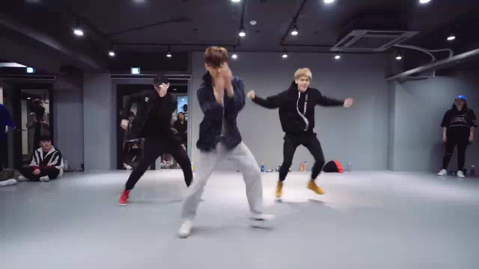
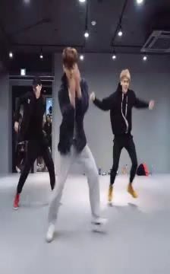
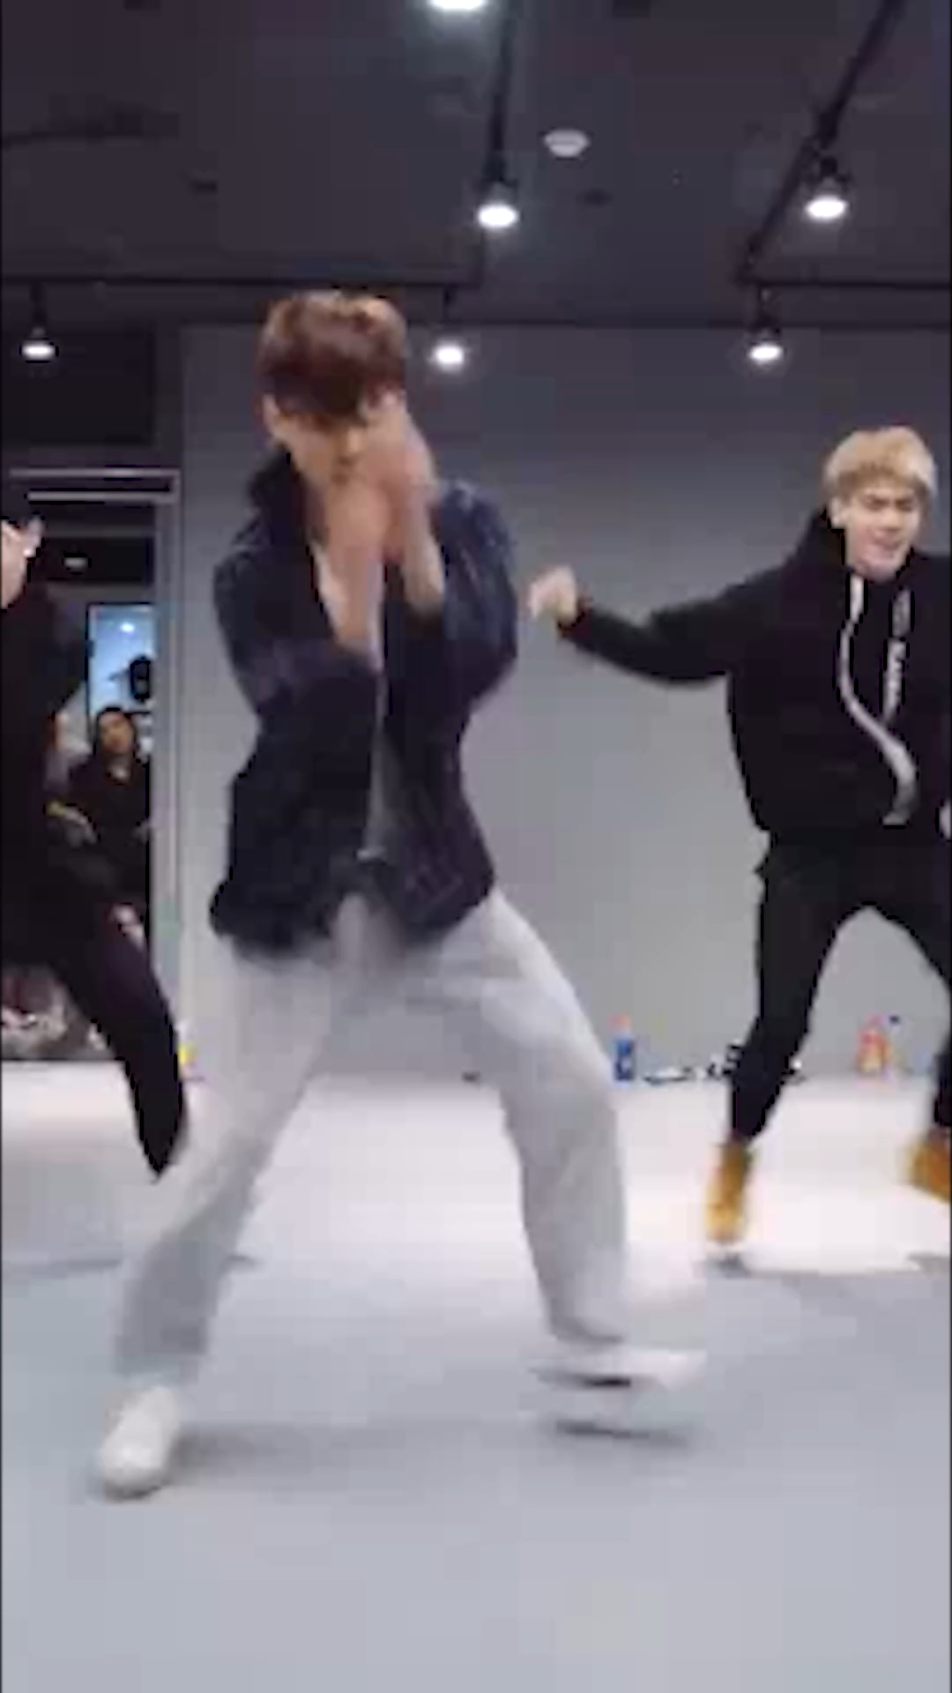
Retargeting Video with an end-to-end framework
Thi Ngoc Hanh Le, HuiGuang Huang, Yi-Ru Chen, Tong-Yee Lee*
IEEE Transactions on Visualization and Computer Graphics, Sept. 2024
Presenter: Thi Ngoc Hanh Le, Ph.D - ltnhanh@hcmiu.edu.vn
Input video
By our RETVI
By Adobe

Slide 2
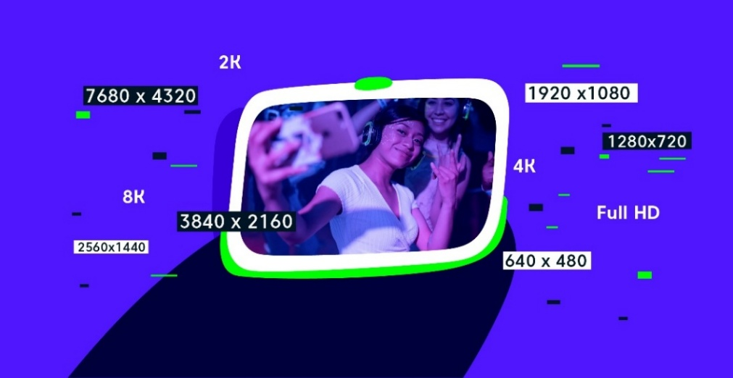
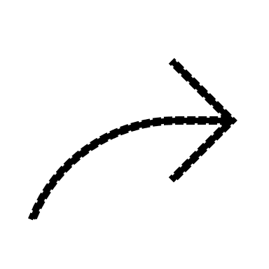

What is Retargeting?
Notes:
digital devices are with different display size, resolution, or aspect ratios

Slide 3

Why Retargeting?
Adapt video content in real-time based on use actions or analytical queries (AQ).
Seamlessly integrated with AR environment.
Dynamically adjusts the content of VR videos.
Notes:
For example, video retargeting can be employed to (1) adapt video content in real-time based on user actions or analytical queries [4]; (2) ensure that the video content is visually pleasing, legible, and seamlessly integrated with the augment reality environment [5]; or (3) dynamically adjusts the content of virtual reality (VR) videos to match the specific characteristics of different VR headsets

Slide 4

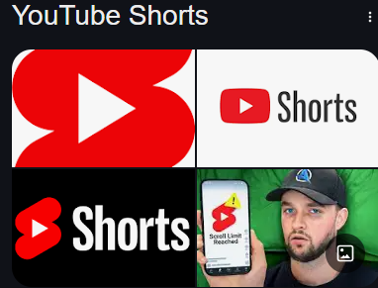

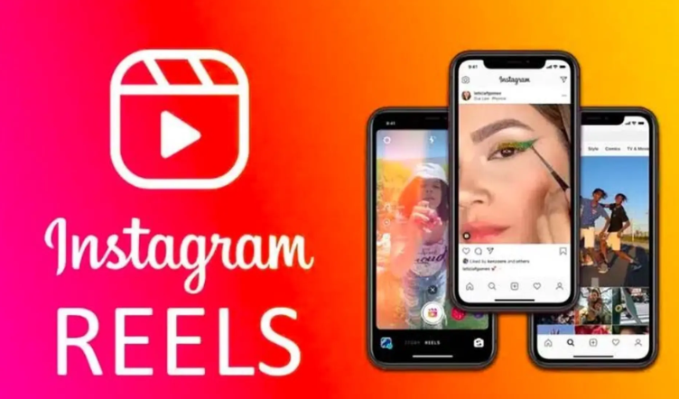
Why Retargeting?
Notes:
Additionally, resizing videos has become increasingly popular with the advent of smartphones equipped with video capabilities and the rise of social media platforms. Whether you choose a standard aspect ratio for content to be streamed on a laptop or a cell phone, it is crucial to ensure that the video presents clearly without unsightly cropping, providing the best experience for your audience. By leveraging video retargeting in these applications, it could ultimately enhance users overall viewing experience

Slide 5
Existing Approaches
Pre-processing
Resizing
Input frames
Resized frames
Saliency map
Segmentation
Optical flow

Slide 6

Existing Approaches - Drawbacks
Pre-processing
Resizing
Input frames
Resized frames
Saliency map
Segmentation
Optical flow

Slide 7

Existing Approaches - Drawbacks
Pre-processing
Resizing
Input frames
Resized frames
Objects are distorted /shrinking
Not adaptable to aspect ratios and video contents

Slide 8
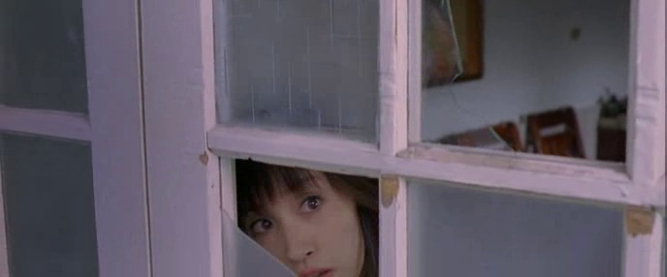
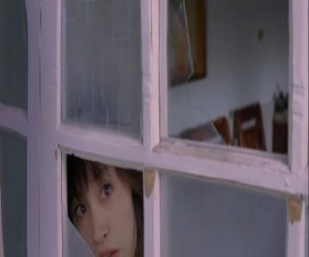
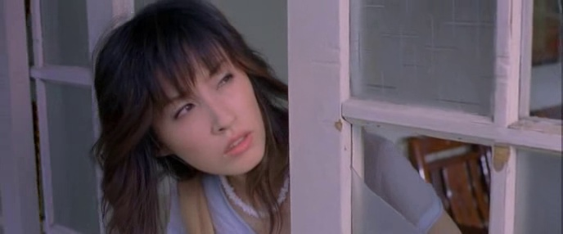

Existing Approaches - Drawbacks
Frame #87
Frame #199
Original frame
Linear scale
[Lin et al.]

Slide 9
Existing approaches - Drawbacks
Impractical to extend to video resizing!
70.23 seconds
51.59 seconds
28.81 seconds
4.37 seconds
WSSDCNN
Cycle-IR
DeepIR
SAMIR
Notes:
Extending a deep learning-based image retargeting technique to the video is tough to operate

Slide 10
Challenges in Video Retargeting
?
Without damaging important content
Temporal coherency
Adaptable to diverse video contents
Tolerate various aspect ratios
Fast

Slide 11

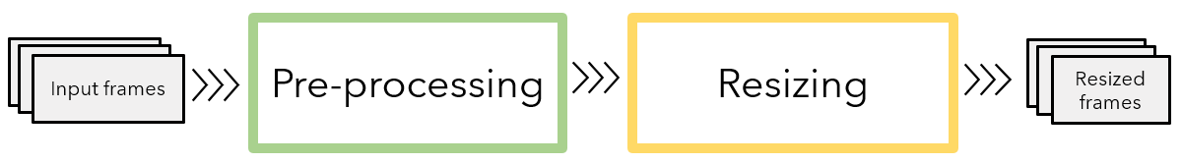
Our approach
Input frames
End-to-end
Video Resizing Model
Aspect ratio
Resized frames

Slide 12

Advantages
Conventional method vs Our RETVI
minutes/ frame
~0.2 second/ frame
End-to-end
Video Resizing Model
Input frames
Resized frames
Pre-processing

Slide 13
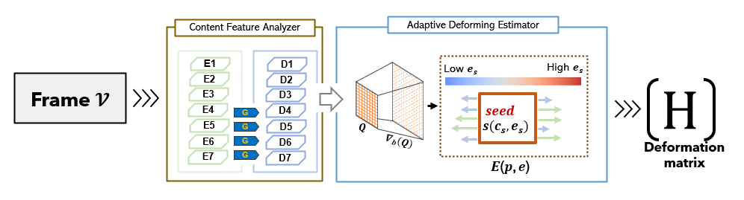
Our framework
Notes:
Our framework consists of two modules,
The first module is responsible for learning the content information of the input frames .
Then, with the knowledge learned from first module and a given resizing ratio, the adaptive deforming estimator tries to teach the network how to deform the input frame with minimum distortion.

Slide 14
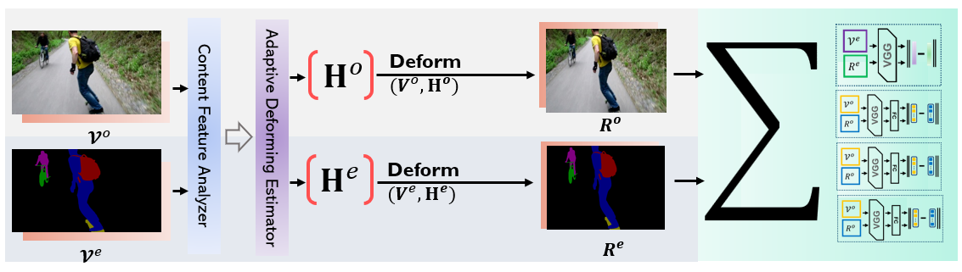
Our framework – Training phase
Notes:
In our training, a pair of video frames is required as input.
Their features are analyzed and deformed with an estimated deformation matrix, which is parameterized by four loss functions.
Detail of our framework, please see our paper.

Slide 15
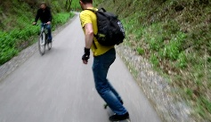


Our framework – Inference
+
$$r$$
RETVI
H
Deformation
Original Video
Target ratio
Resized video
Inference

Slide 16
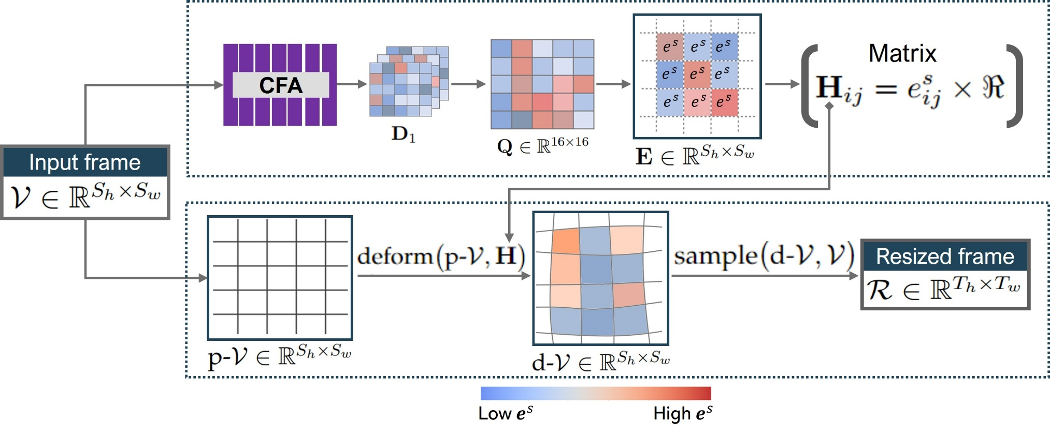

Our framework – Resizing strategy
$$seed s(c_{s}, e_{s})$$
Notes:
Now, we detail how we utilize feature maps D1 to deform frames. We transform D1 to 2D grid via activation function.

Slide 17
Loss function
Total loss function:
Critical region
Fidelity
Global integrity
Temporal consistency

Slide 18

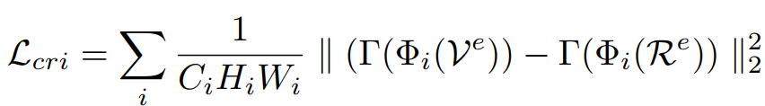
Loss function
Notes:
we formulate this loss to distinguish important objects in a frame and maintain their proportional shape between the ground truth foreground and the estimated foreground frame

Slide 19
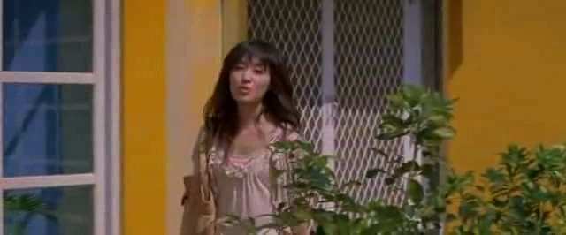
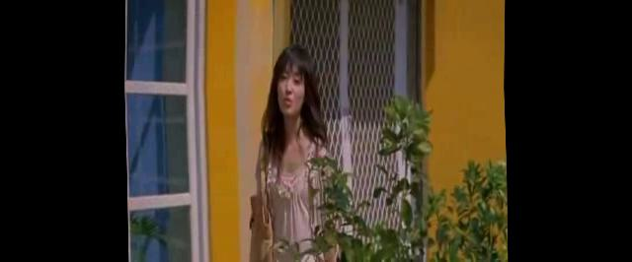

Input frame
Without $ℒ_{cri}$

Slide 20
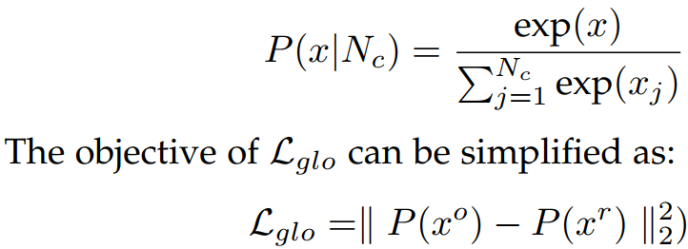
Loss function
Notes:
In addition to the critical regions, we also consider the overall presentation of the output image. This objective function is particularly effective when the content is dense and distributed entire frame, To preserve the frame information as much as possible, making resized frames more harmonious and natural, we rely on the advantage of an image classification network

Slide 21
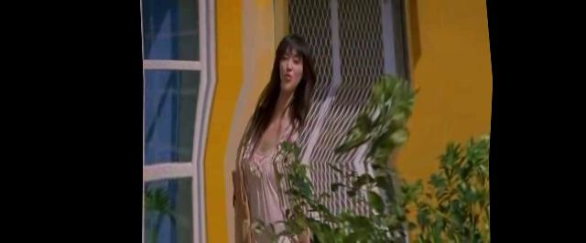

Input frame
Without $ℒ_{glo}$

Slide 22
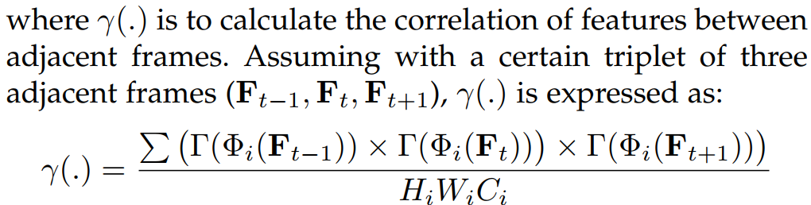
Loss function
http://graphics.csie.ncku.edu.tw/RETVI/TemporalLoss.mp4
Notes:
The temporal consistency loss is used for evaluating the coherence between adjacent resized frames, we base on the knowledge of the correlations between the features of the adjacent frames to infer the temporal consistency degree in the retargeted videos. For any triplet of the adjacent frames with the respective supper script t - 1, t, and t + 1, the temporal consistency loss is formulated as

Slide 23

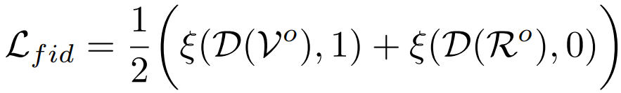
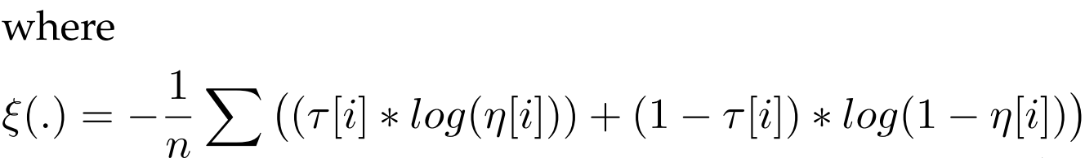
Loss function
Notes:
Apart from minimizing geometry distortions, the quality of the resized frames is also a vital aspect we take into account in our current application
The training goal of D is to distinguish the input frame from its resized frame by the ADE module. Our network tries to generate a high score (i.e., close to 1) from D, so that the output of ADE module can be closer to the quality of the input frame.

Slide 24


Input frame
Without $ℒ_{fid}$

Slide 25
Results
Project website: http://graphics.csie.ncku.edu.tw/RETVI

Slide 26

Thanks for your listening
More results could be explored at our project website:
http://graphics.csie.ncku.edu.tw/RETVI

