Slide 1

CreativeSynth
Cross-Art-Attention for Artistic Image Synthesis With Multimodal Diffusion
Nisha Huang, Weiming Dong, Yuxin Zhang, Fan Tang, Ronghui Li, Chongyang Ma, Xiu Li, Tong-Yee Lee, Changsheng Xu — IEEE TVCG 2025
DIFFUSION MODELS
MULTIMODAL GUIDANCE
VISUAL ART
Presenter: Dong-Yi Wu, NCKU

Slide 2
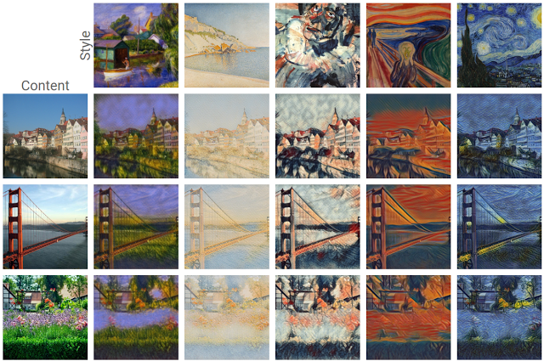

Slide 3
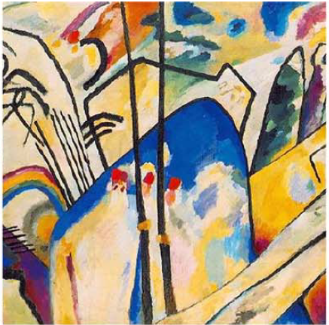

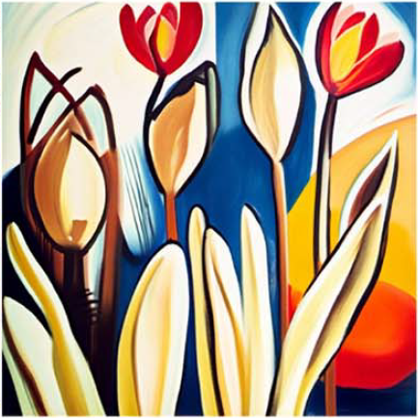
+
Target
Semantic
Artistic Image Synthesis

Slide 4
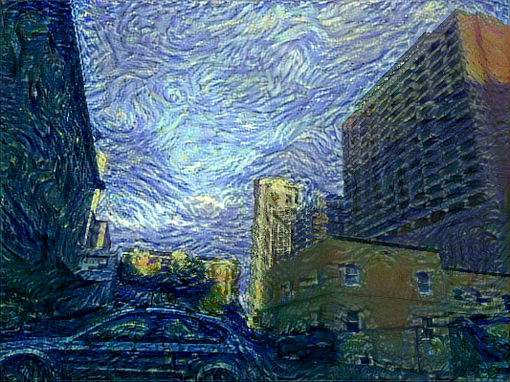

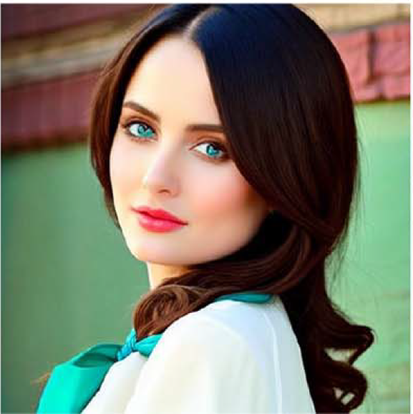
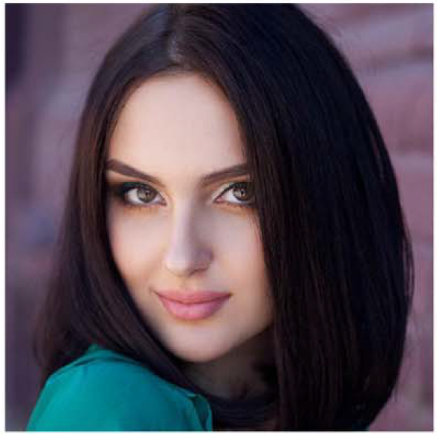
The Problem: Beyond Simple Style Transfer
Style Transfer Falls Short
Directly transferring extracted style features to natural images creates obvious synthetic traces. Key painting attributes — layout, perspective, shape, semantics — cannot be conveyed through style transfer alone.
Image Fusion Models Have Limits
They can combine content from two images, but the output often either becomes too realistic, loses the target artwork’s specific style, or disrupts the original composition.

Slide 5
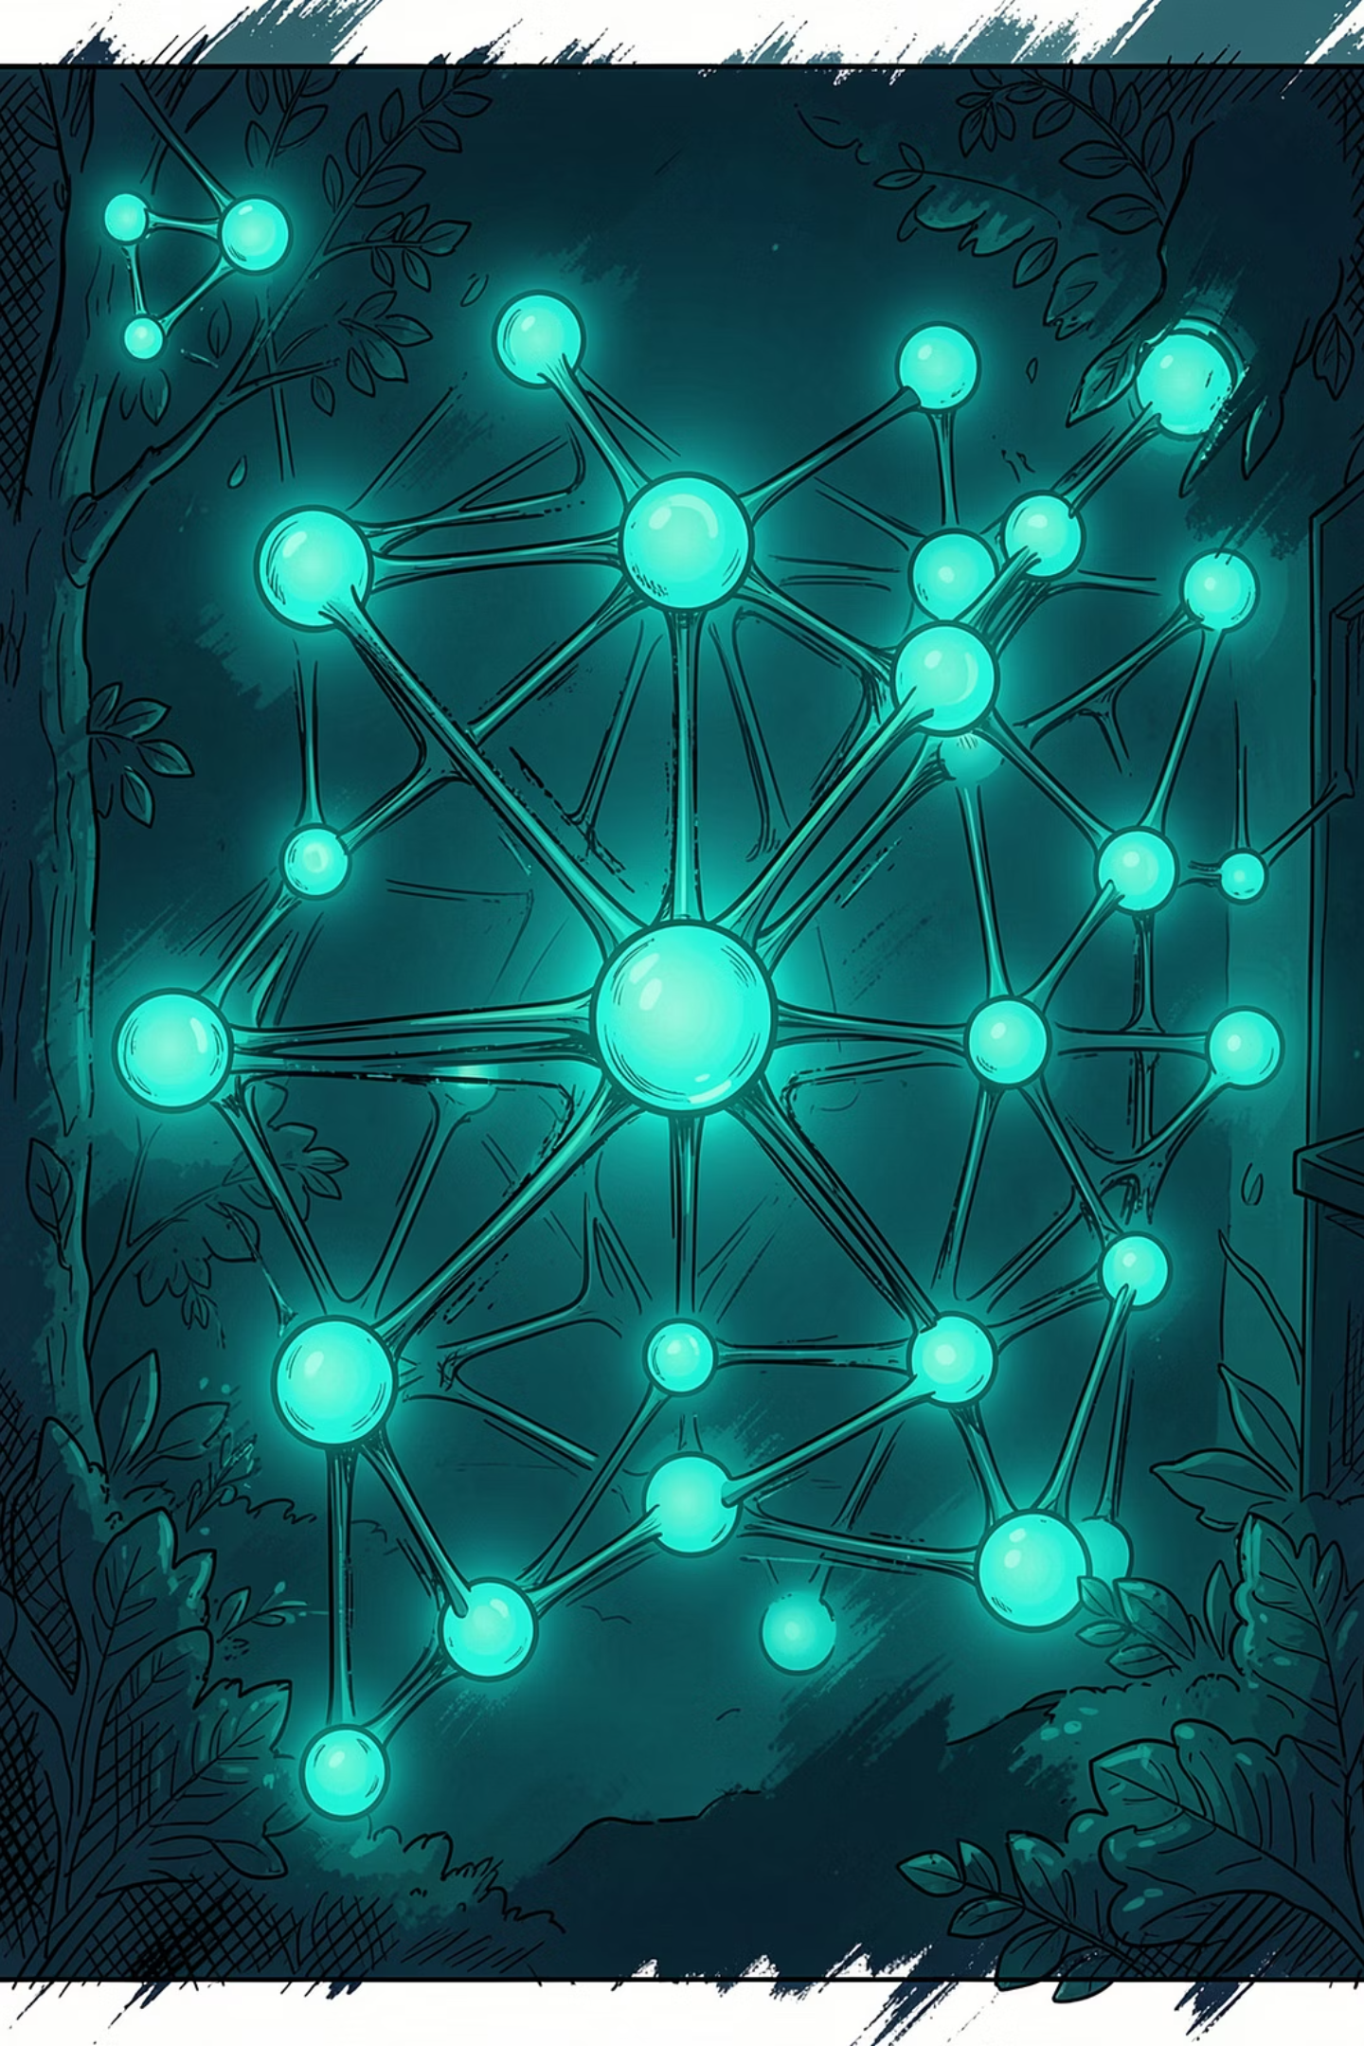
CreativeSynth: Unified Framework Overview
🎨 No Extra Training
Works with pre-trained SDXL without fine-tuning model parameters
🔀 Multimodal Inputs
Accepts target images, semantic images, and text prompts simultaneously
⚡ 5 Unified Tasks
Image variation, editing, style transfer, image fusion, and multimodal blending
🎯 Cross-Art-Attention
Novel mechanism aligning semantic content with artistic style at feature level

Slide 6

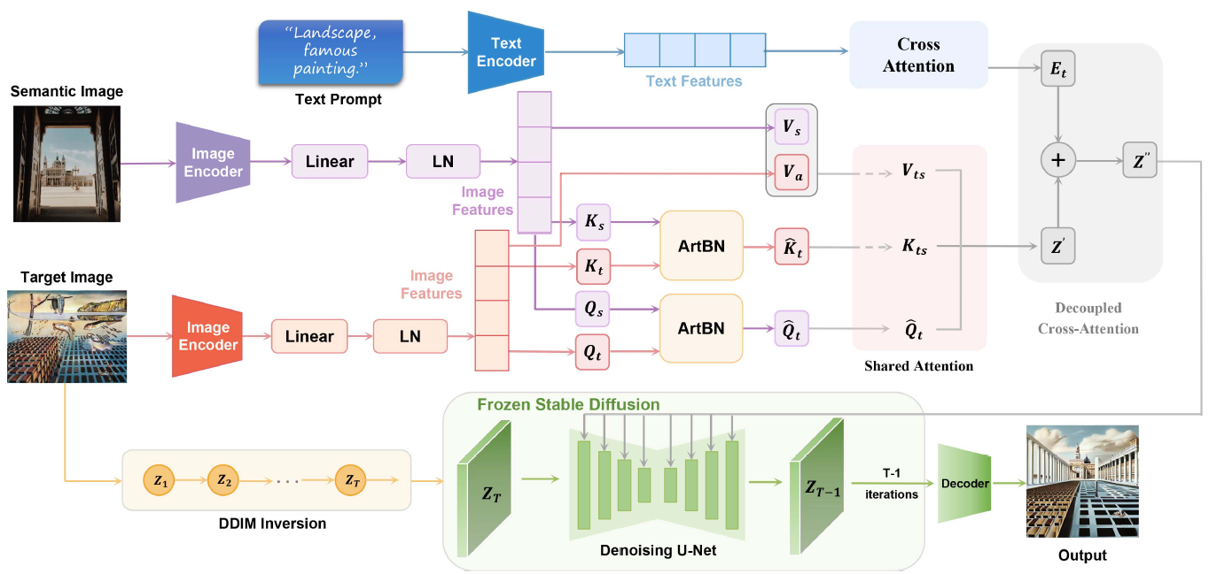

Slide 8
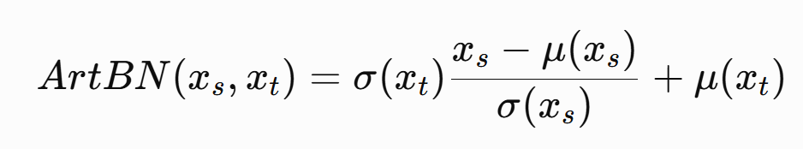


Target
$$x_{t}$$
ArtBN (Art Batch Normalization)
Channel-wise feature.
Semantic
$$x_{s}$$

Slide 10
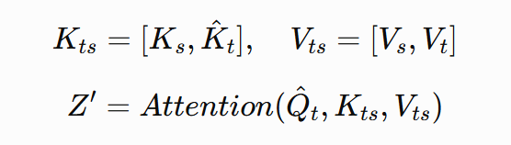
Target
$$x_{t}$$
Shared Attention
Aggregates keys and values from both target and semantic images
Semantic
$$x_{s}$$

Slide 12
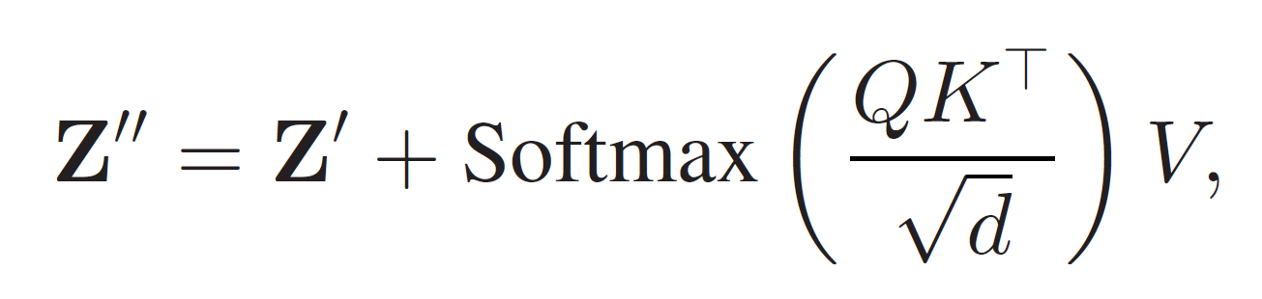
Decoupled Cross-Attention
Aggregates keys and values from both target and semantic images

Slide 13
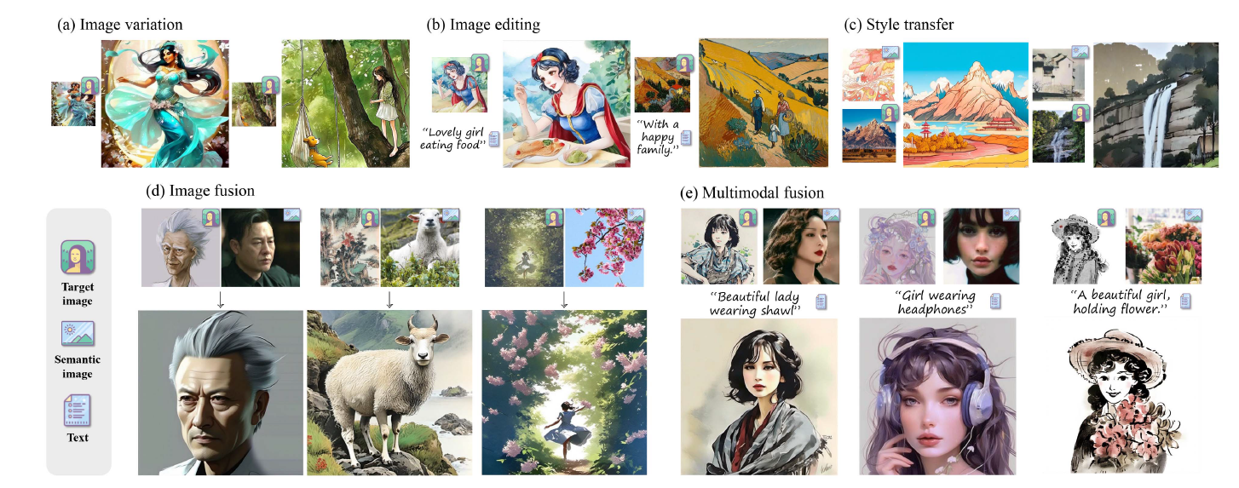
Five Application Tasks

Slide 14
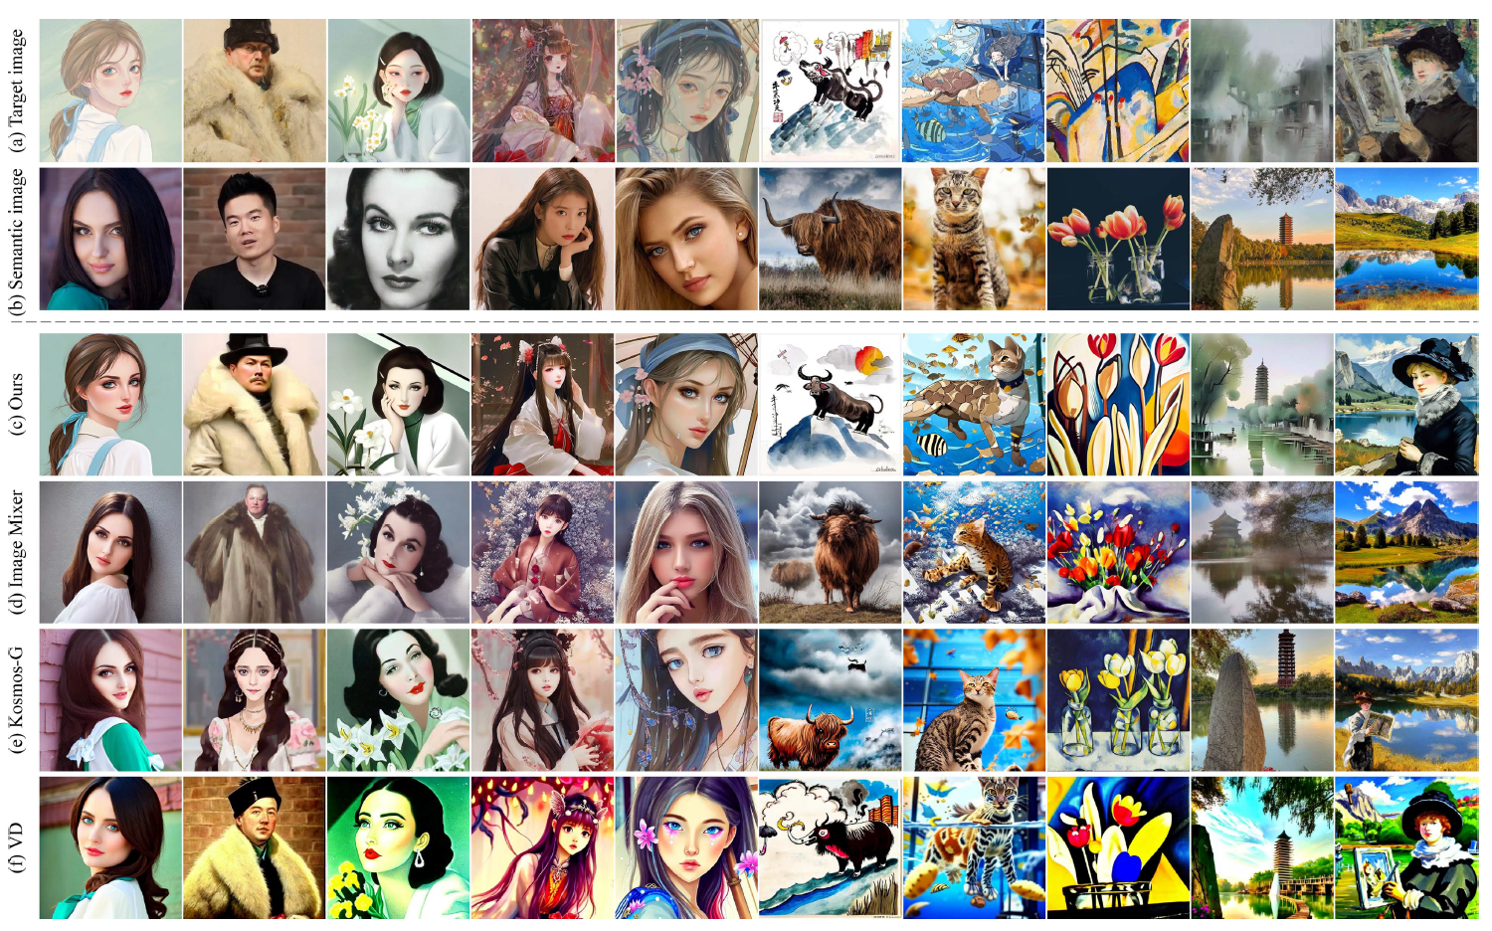
Image Fusion

Slide 15
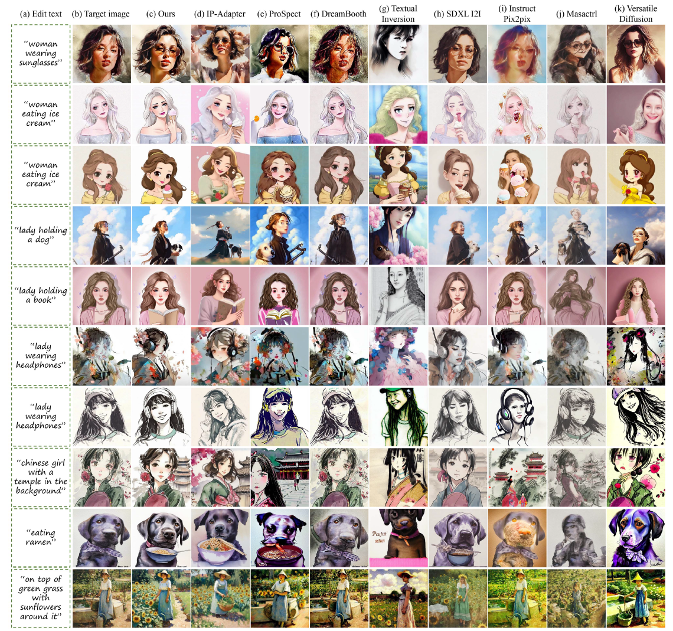
Text-guided Editing

Slide 16

Quantitative Results: State-of-the-Art Performance
Text-Guided Image Editing
Image Fusion
Metric
CreativeSynth
Best Baseline
Metric
CreativeSynth
Aesthetic Score ↑
7.563
7.249 (IP-Adapter)
Aesthetic Score ↑
7.563
NIMA ↑
6.365
NIMA ↑
6.438
5.971 (IP-Adapter)
CLIP-I ↑
52.067
CLIP-T ↑
59.123
58.004 (ProSpect)
CreativeSynth outperforms VD, Image Mixer, and Kosmos-G across all fusion metrics.
CLIP-I ↑
69.84
84.36 (DreamBooth)
Generation time: ~5s on NVIDIA L40, ~2s on RTX 4090 (1024×1024, 30 steps)
DreamBooth leads in CLIP-I but fails to execute text commands. CreativeSynth leads all other metrics.

Slide 17
User Study & Ablation Analysis
User Study Results
Ablation Study Findings
79 participants, 11,850 votes across 50 result sets. CreativeSynth was compared against 10 leading methods.
Particularly popular in ink drawing, oil painting, and digital art categories.
Aesthetic Maintenance
Without it: oversaturated colors, loss of stylistic consistency
Image Inversion
Without it: reduced detail retention and visual coherence
Semantic Preservation
Without it: confused semantic structure, incomplete information
Guidance Scale
Higher scale → richer details, closer alignment to target style
94.9%
96.2%
91.1%
Supported necessity and practical potential
Found outputs innovative and appealing
Believed realistic art creation is achievable

Slide 18
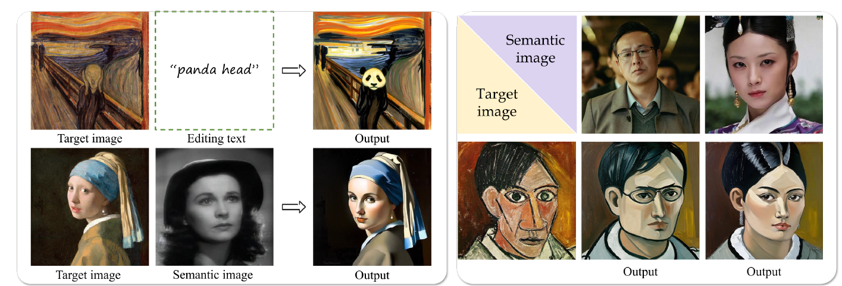
Failure Case

Slide 19
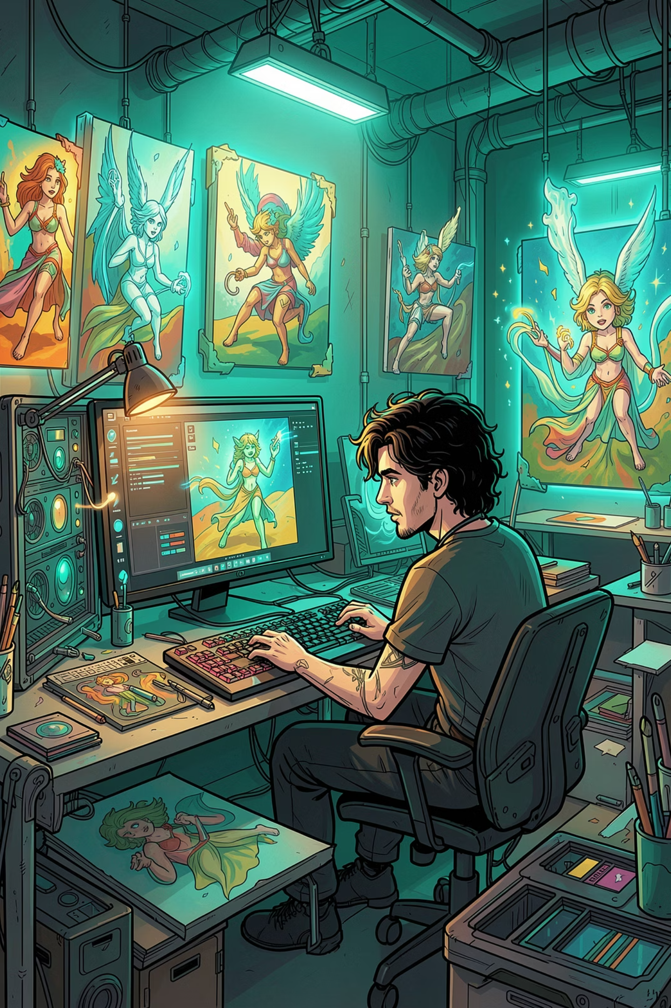

Conclusions & Future Directions
What CreativeSynth Achieves
A unified, training-free framework that bridges generative models and artistic expression via Cross-Art-Attention — integrating multimodal semantic information into artworks while preserving aesthetic integrity, theme, and narrative.
Known Limitations
May produce overly smooth results for styles with complex brushstrokes (e.g., Impressionism). Realism in face generation from artistic inputs remains challenging. Semantic conflicts between text and image require careful parameter balancing.
Future Work
Extend to different diffusion architectures, broaden to video and other media forms, and develop refined techniques for capturing detailed brushstroke textures and complex style characteristics.
Code and results available at: github.com/haha-lisa/CreativeSynth

