Slide 1
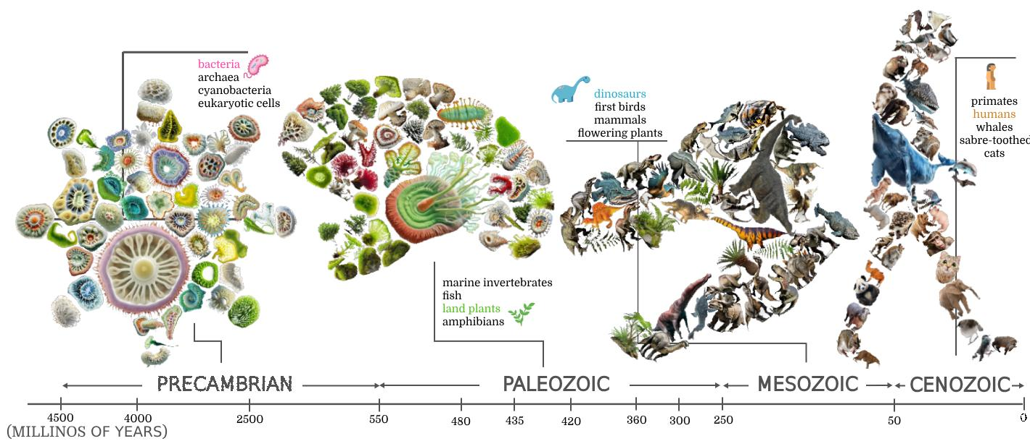
Shape Cloud Collage on Irregular Canvas
A novel 2D shape visualization framework that arranges irregular shapes on arbitrary canvases — emphasizing important objects with larger sizes, inspired by word clouds.
Sheng-Yi Yao , Dong-Yi Wu , Thi-Ngoc-Hanh Le, and Tong-Yee Lee*
IEEE TVCG VOL. 31, NO. 10, OCTOBER, 2025, pp.8297-8309

Slide 2

Introdution
This paper proposes Shape Cloud, a visualization method that arranges irregular 2D shapes inside an irregular canvas. Similar to word clouds, important objects are shown in larger sizes to represent quantitative values. The main challenge is to reduce empty spaces and overlaps while keeping the layout compact and visually meaningful. To solve this, the authors formulate the packing process as a differentiable optimization problem, allowing the system to optimize object placement, rotation, scaling, and deformation. Experiments show that the proposed method can generate high-quality shape cloud layouts more effectively than existing methods.
We propose a novel visualization framework called shape cloud for 2D shapes that mimics the concept of the word cloud.
We provide an analysis of the task of the associated task of mix discrete-continuous optimization.
Our packing optimization framework is designed to tackle the challenging scalable irregular packing problem at an interactive rate without the need for extensive training.
Experiments show that our method outperforms qualitatively and quantitatively existing tools and methods on our curated irregular packing dataset.

Slide 3
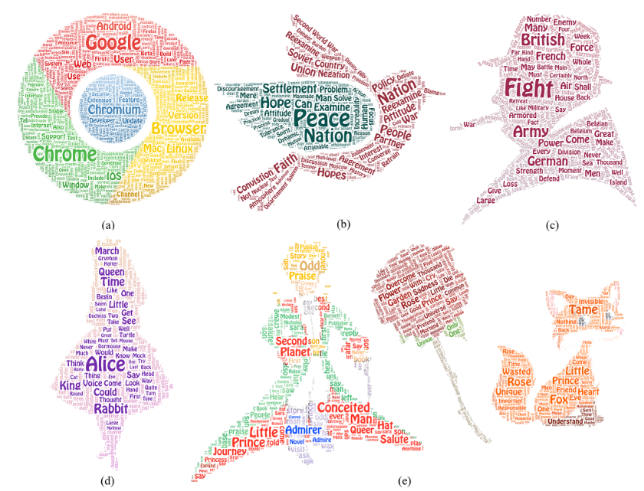
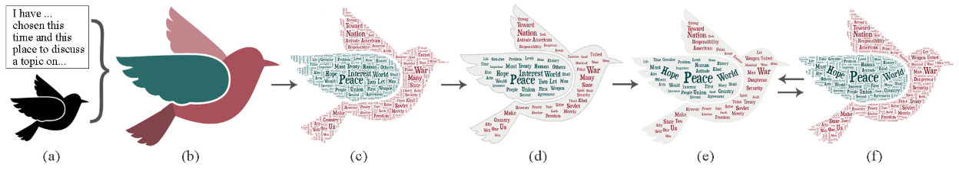
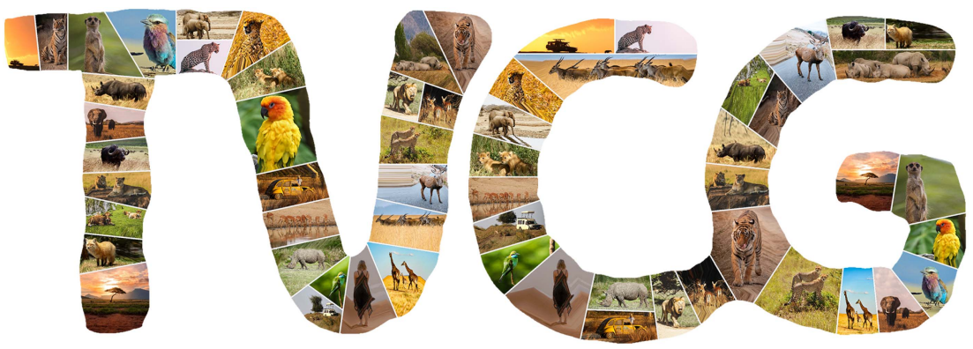
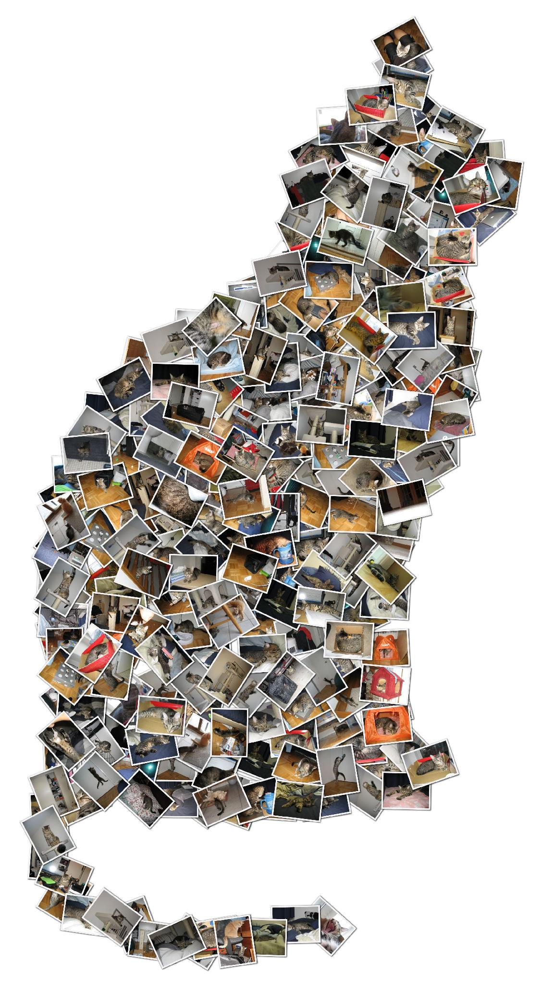
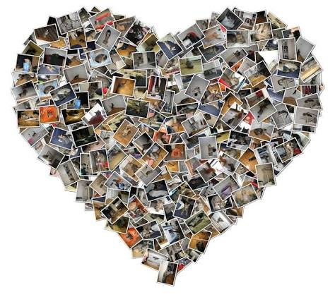
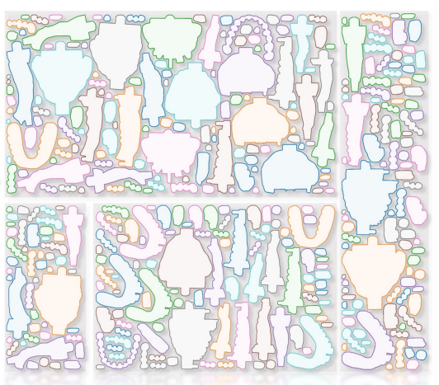
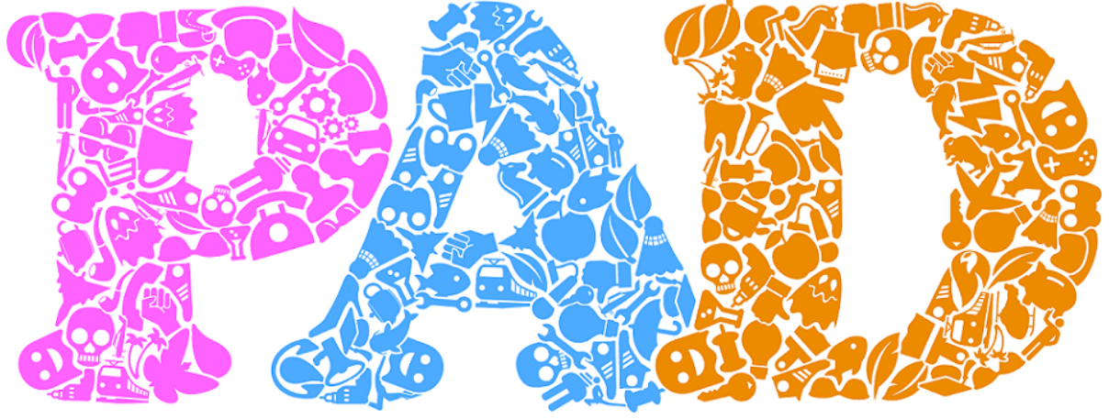
Related Work
Word Cloud
Image Collage
Object Packing
ShapeWordle (Proc. InfoVis 2019)
Image Collage(TVCG 2024)
Shape Collage
PAD(SIGGRAPH Asia 2016 issue)
GFPack(SIGGRAPH Asia 2023)

Slide 4
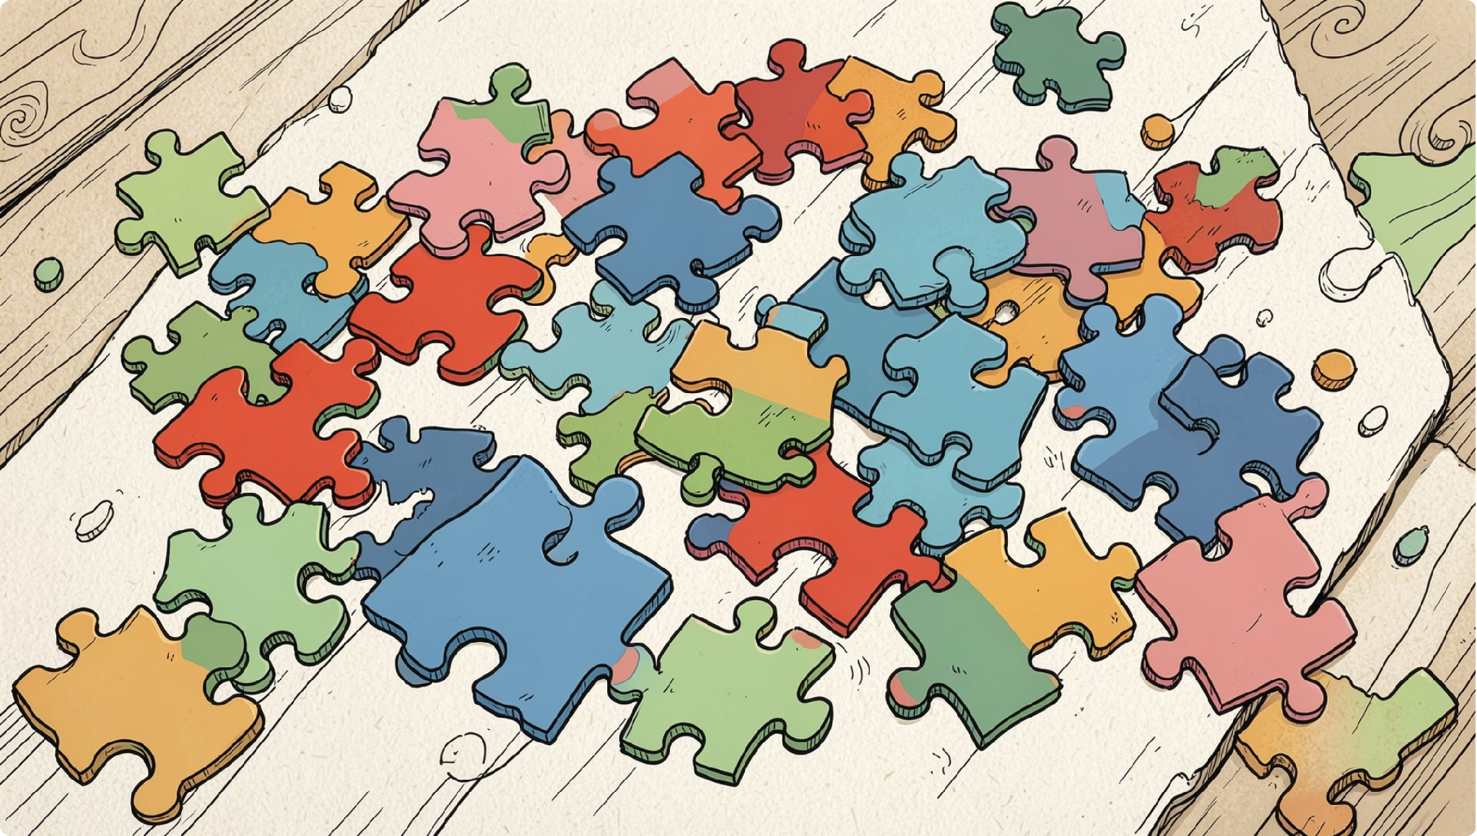

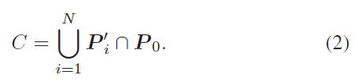

Problem Analysis
The paper analyzes the shape cloud layout as a scalable irregular packing problem. Each object needs to be placed on the canvas by deciding its position, rotation, and scale. The goal is to cover the canvas as much as possible while minimizing overlaps between objects and keeping them inside the canvas boundary. However, this problem is difficult because both the objects and the canvas are irregular, and the best placement depends strongly on location. Therefore, the authors treat it as a mixed discrete-continuous optimization problem and reformulate collision and coverage as differentiable losses for gradient-based optimization.

Slide 5
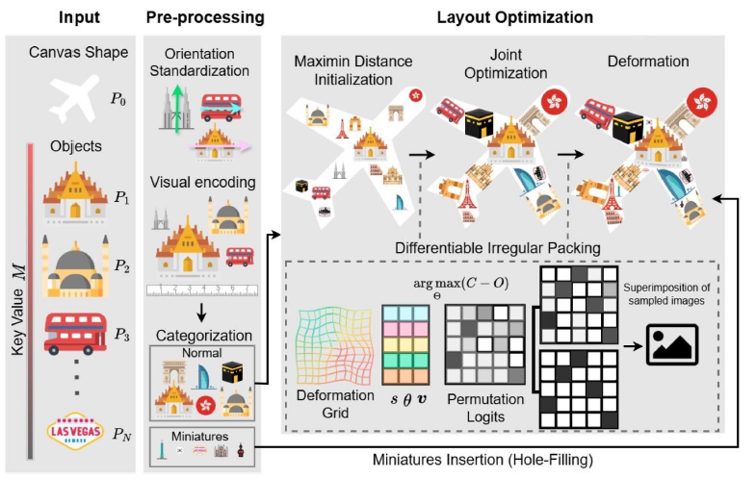
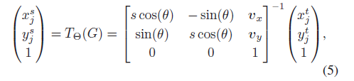
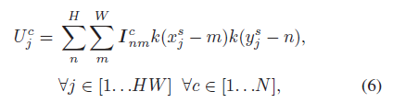
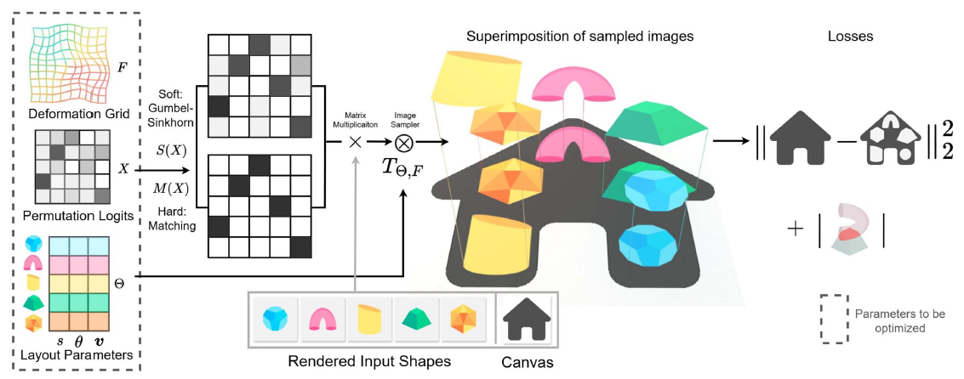
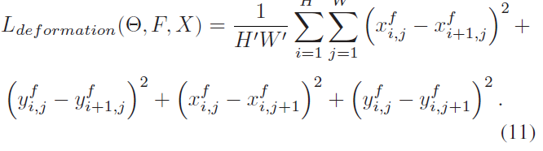
Our Method
Differentiable image sampling
Differentiable image sampling

Slide 6
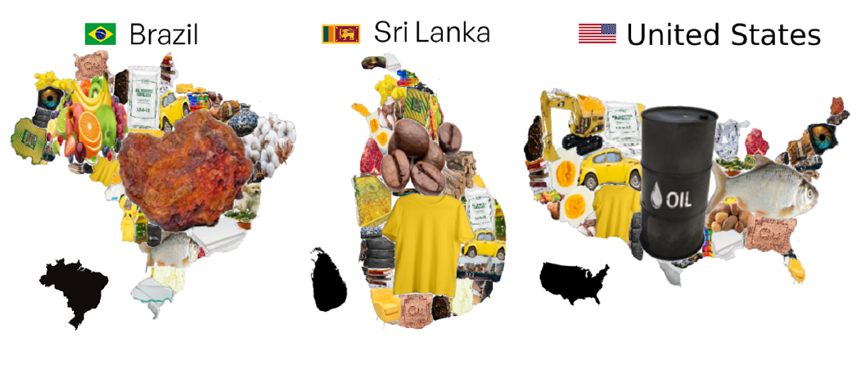
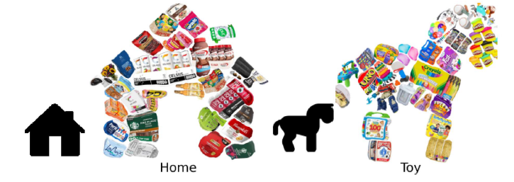
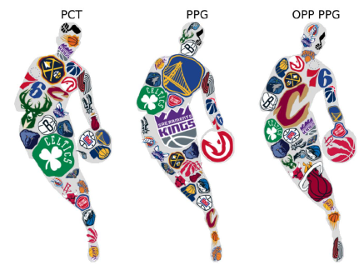

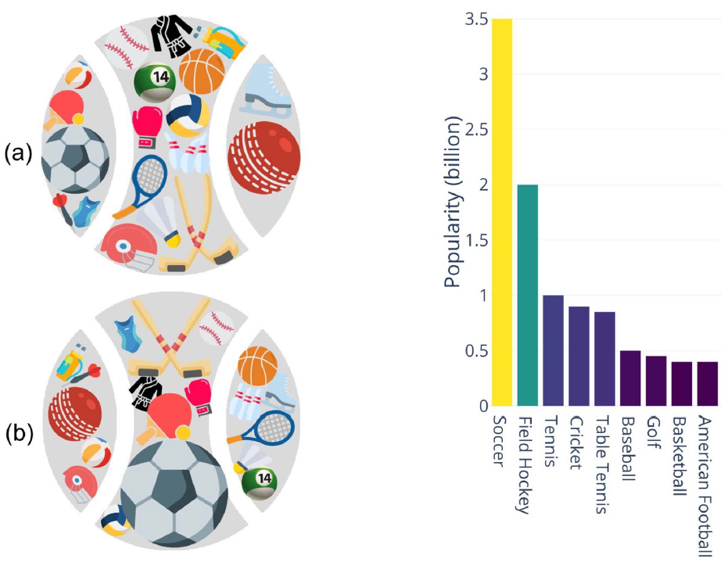
Implementation Details
Intel Core i9-9900K CPU
NVIDIA GeForce RTX 2080
The results shown in this paper are 512 × 512 pixels
The parameters are optimized under the resolution H ×W =300 × 300
Experimental Results

Slide 7
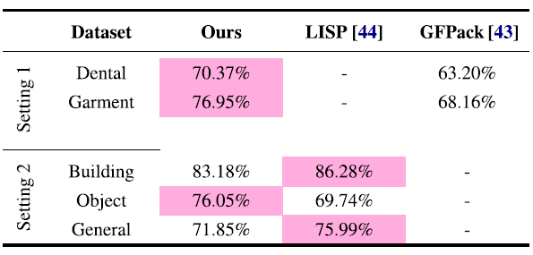

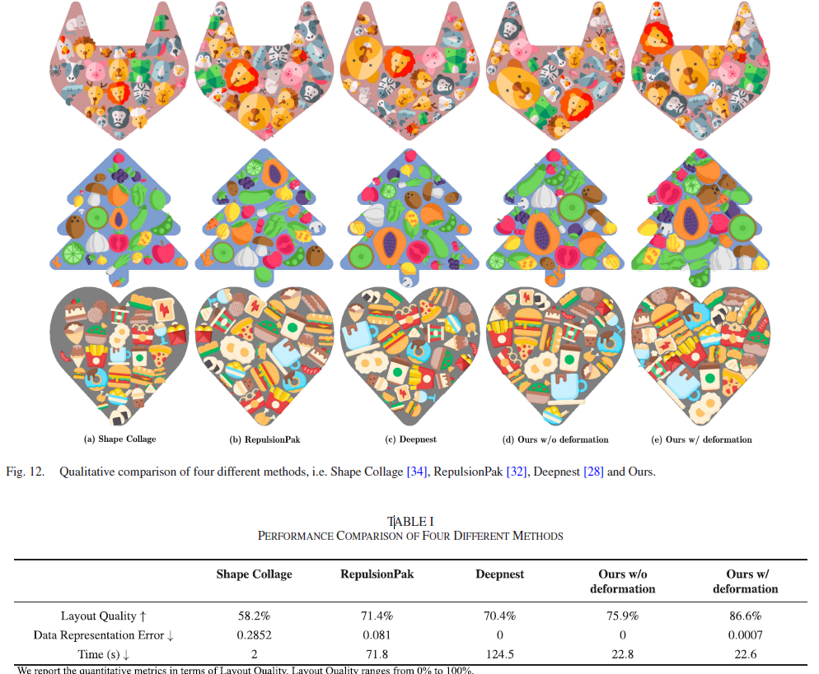
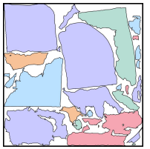
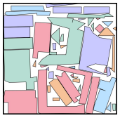
Evaluation

Slide 8
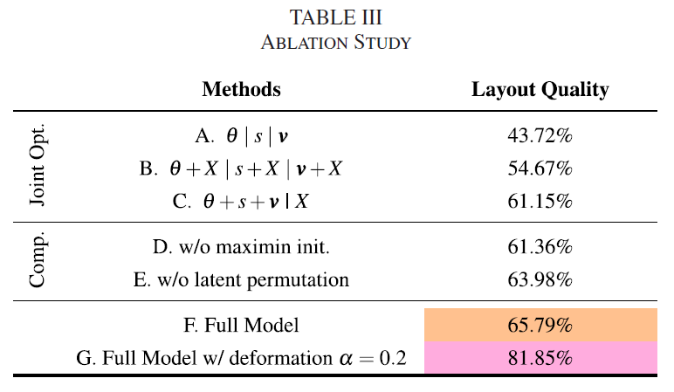
Ablation Study

Slide 9
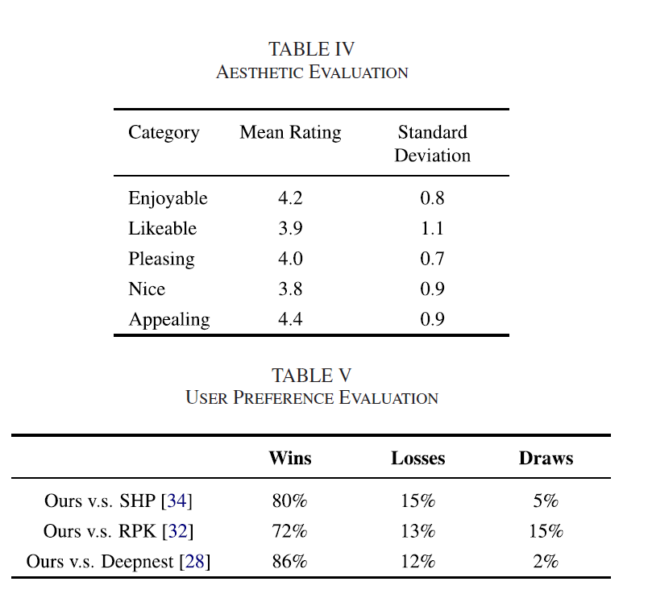
User Study

Slide 10
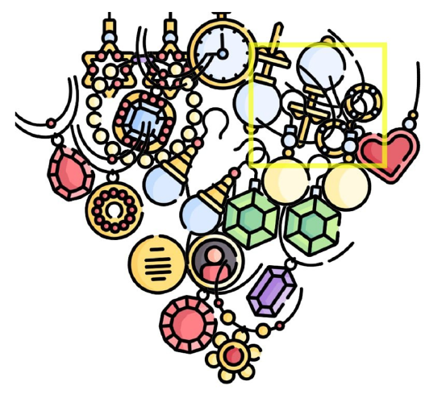
Limitations
Conclusion
This paper introduces Shape Cloud, a new visualization method for arranging 2D shapes. The main idea is to reformulate the packing problem as an end-to-end differentiable image sampling process, allowing the layout to be optimized efficiently with gradients. Compared with existing methods and commercial tools, the proposed method achieves a better balance between visual quality and data accuracy. Future work includes improving data representation in narrow canvases and exploring dynamic shape cloud visualization.

